Slide 1
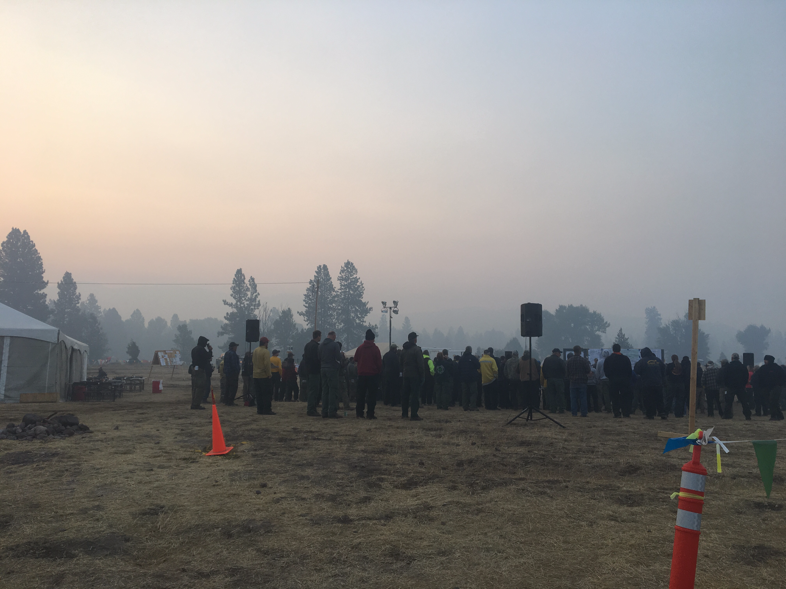
Photo Kat Navarro
Notes:
Kat Navarro – Air Resource Advisor
Seeley Lake, Montana
Morning Briefing 8/18/2017

Slide 2
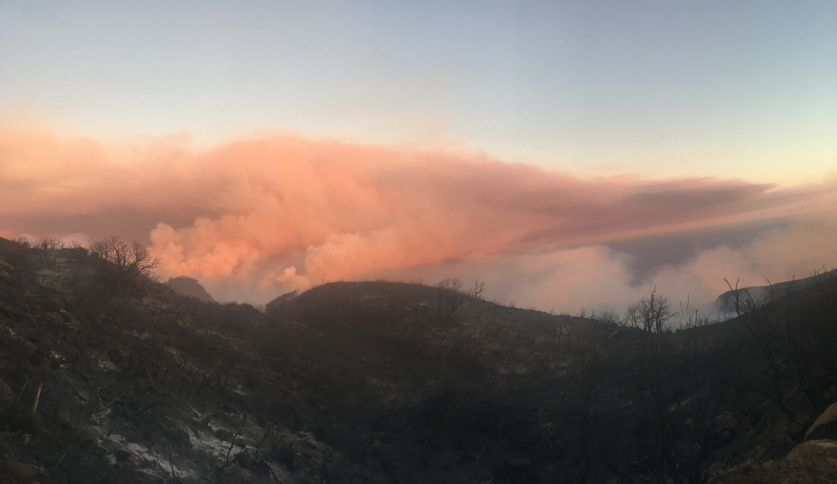
Photo Kat Navarro
Notes:
Kat Navarro – ARA
7/14/2017
Whittier fire during the sundowner winds from up top.
California

Slide 3
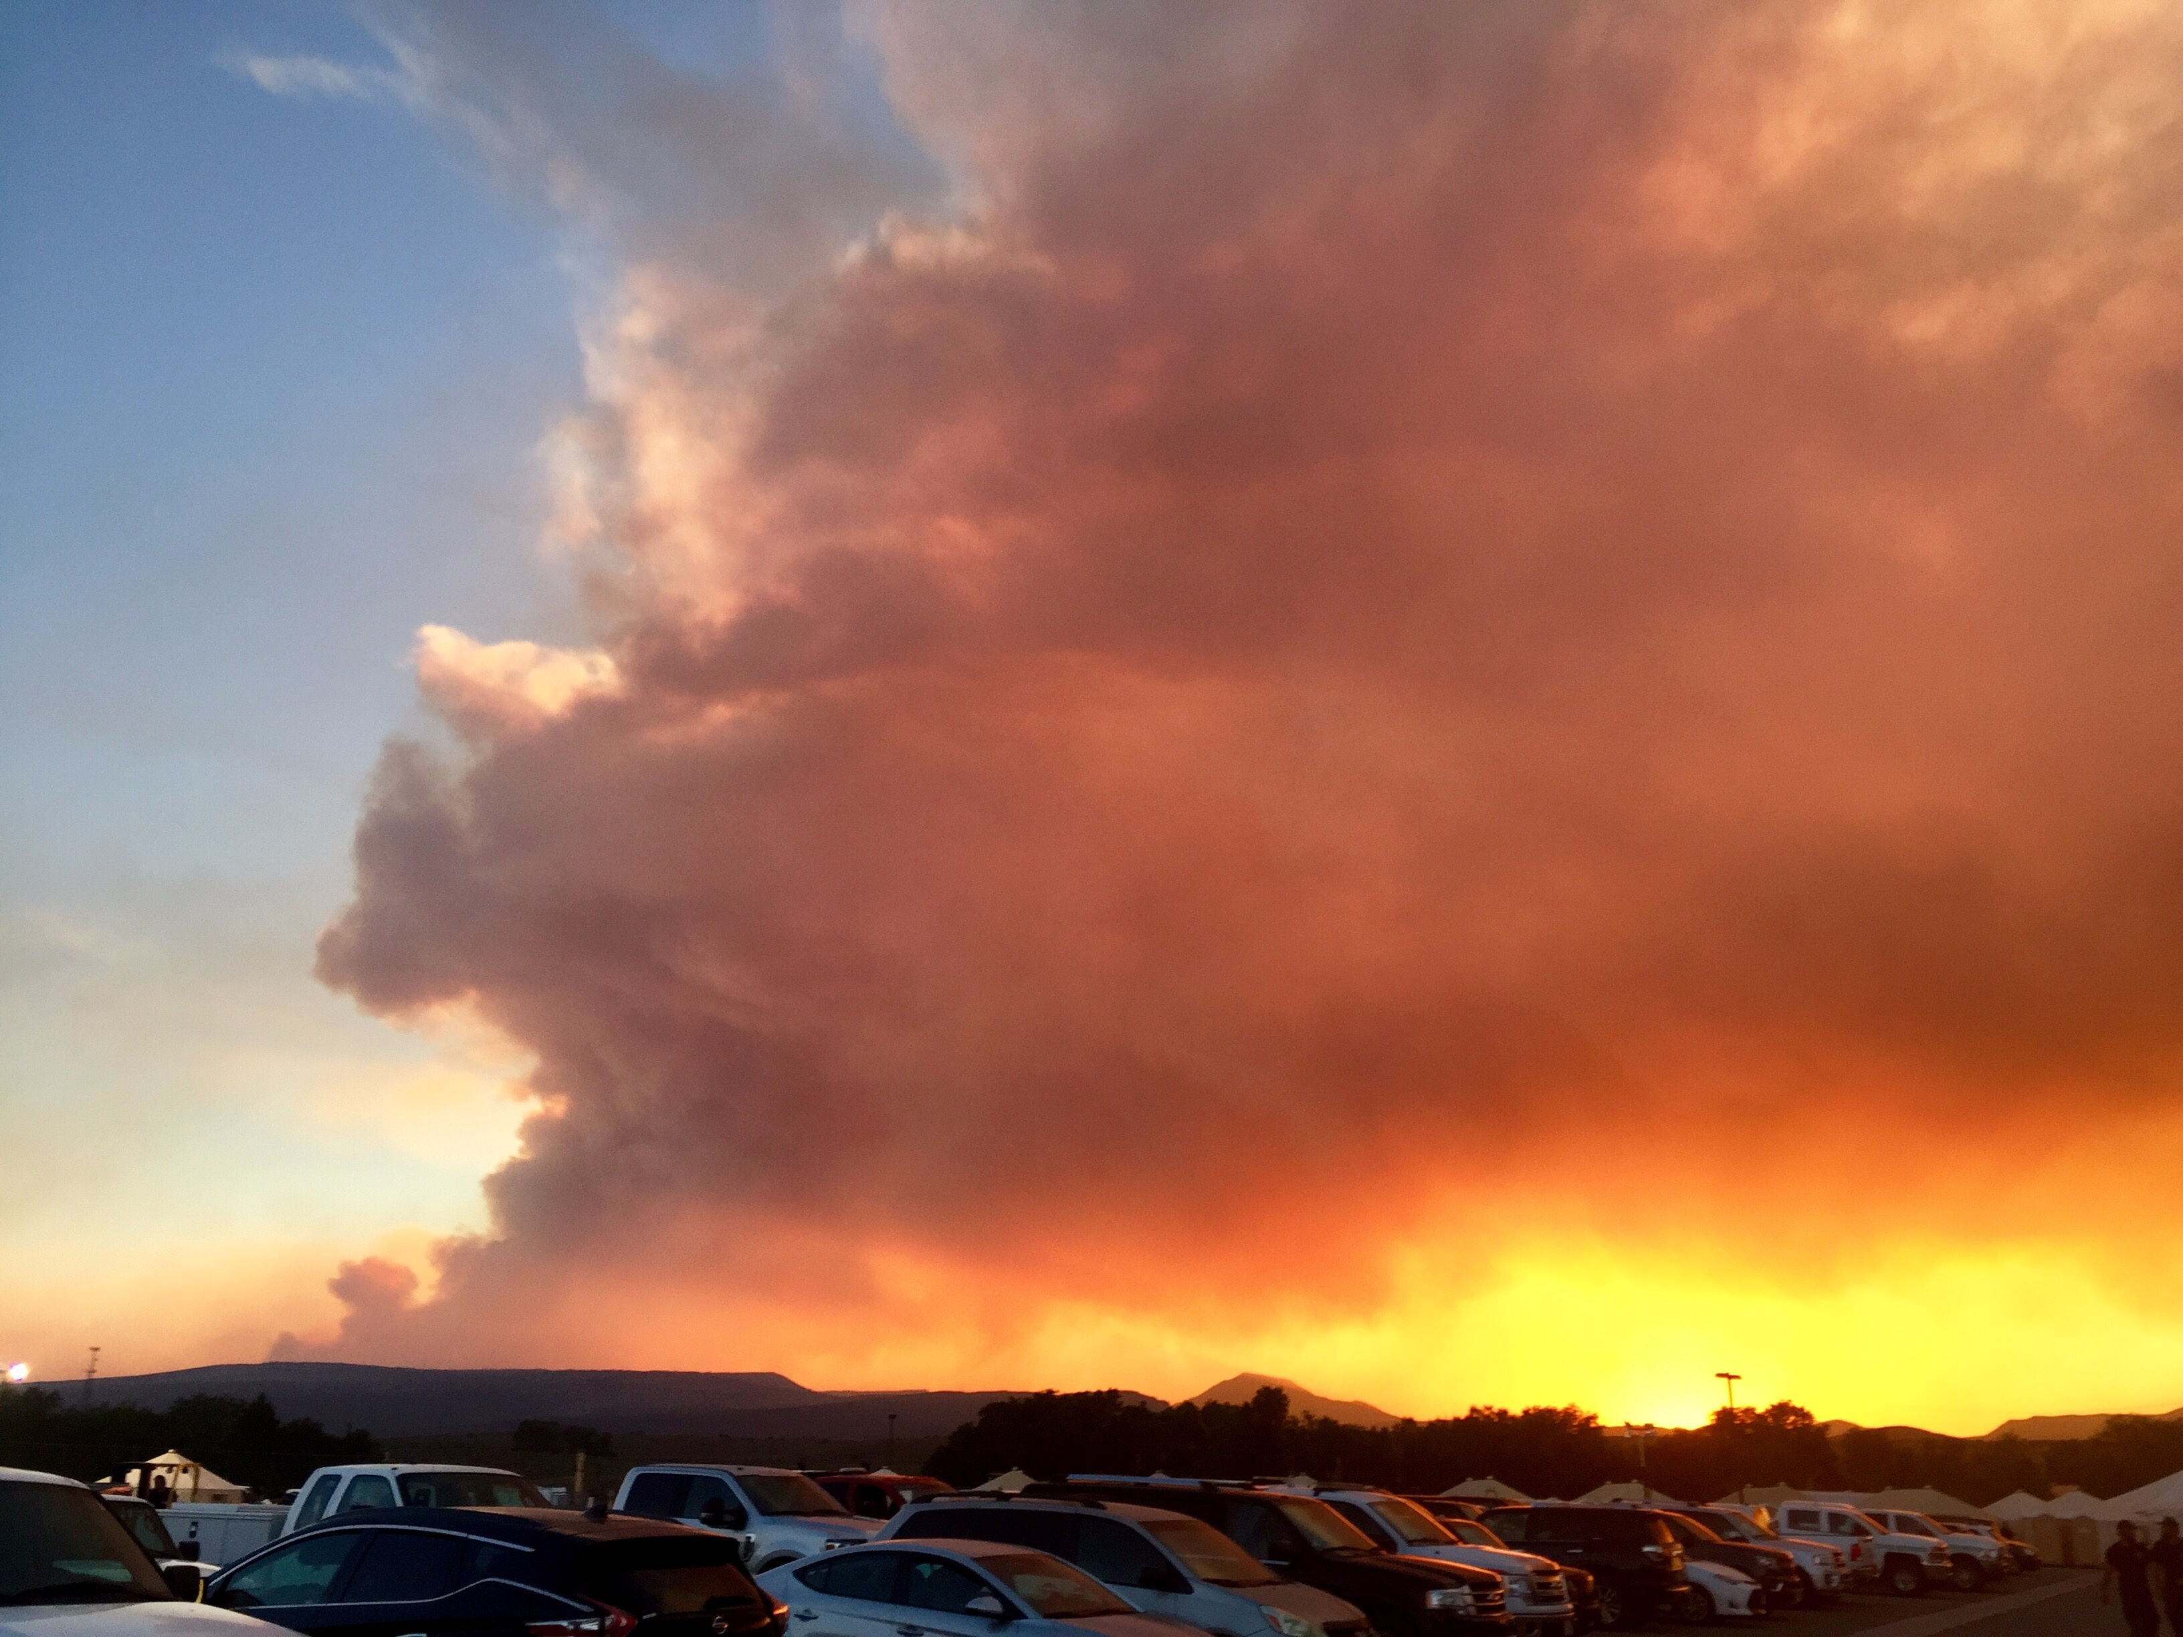
Photo Andrea Nick
Notes:
Andrea Nick - ARA
Brianhead wildfire

Slide 4
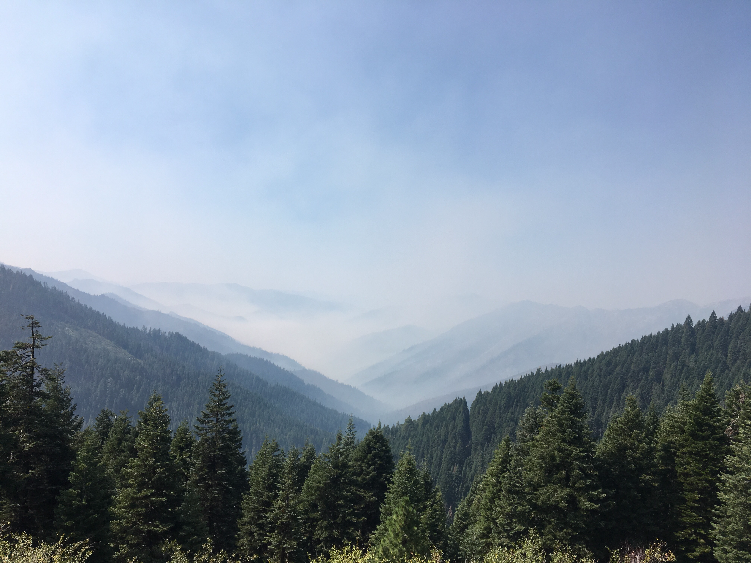
Photo Andrea Nick
Notes:
Andrea Nick – ARA
8/23/2017
Smoke pooling into the Sawyers Bar area earlier this morning. Photo taken from Etna Summit.

Slide 5
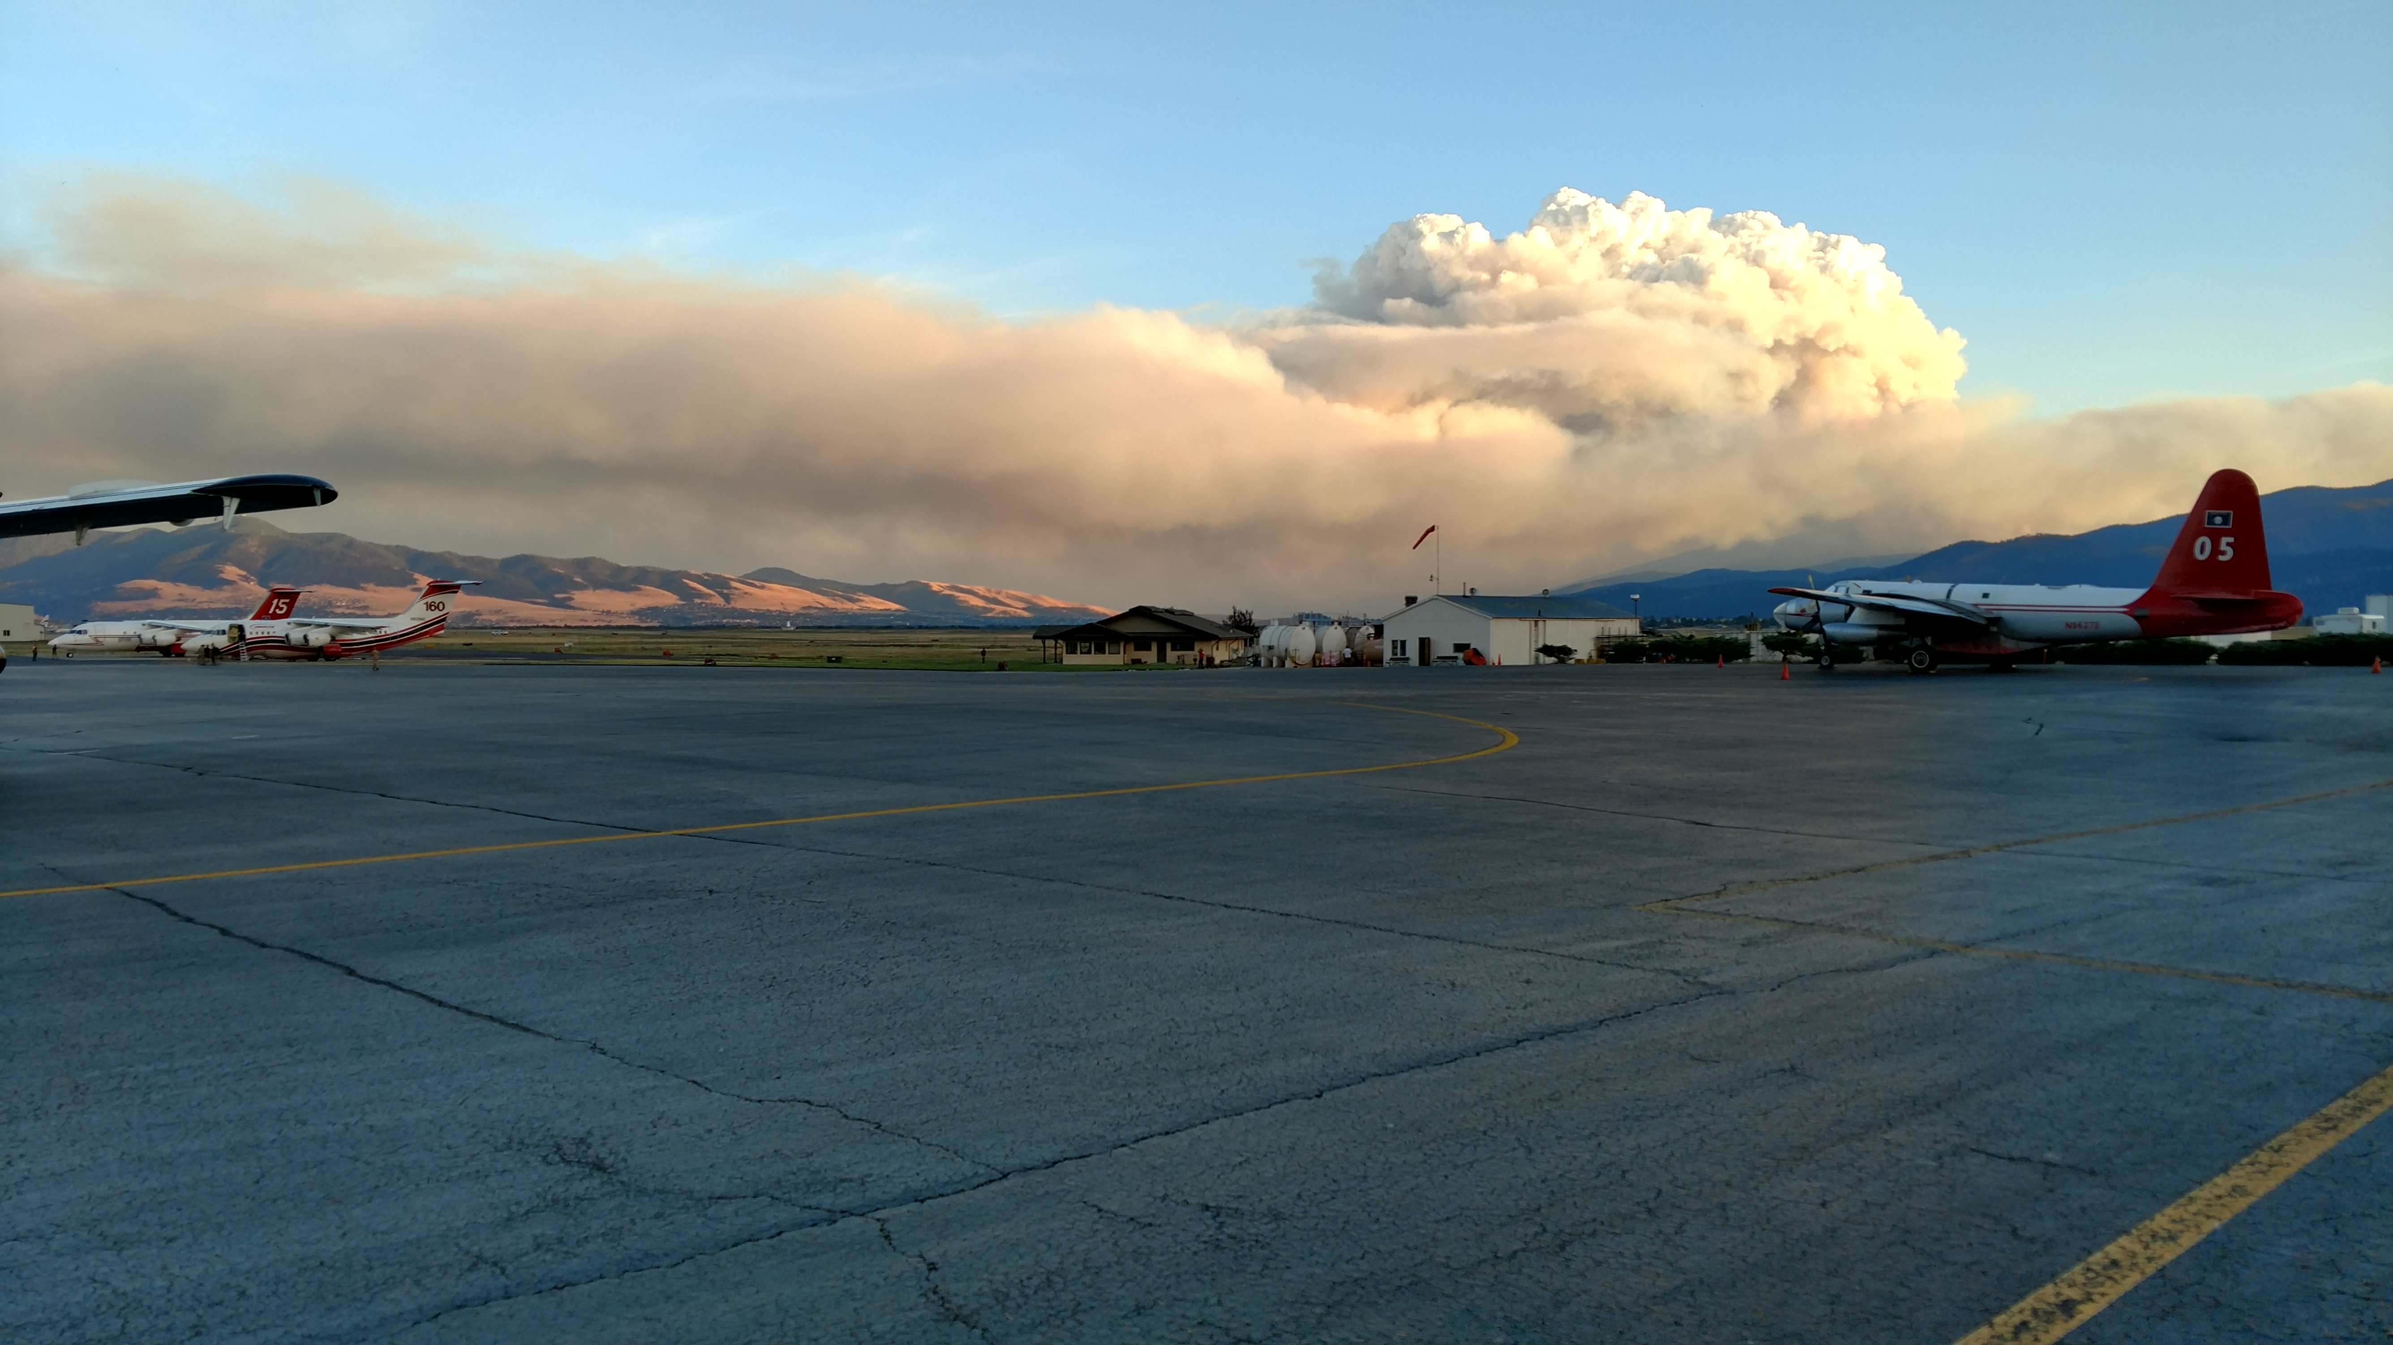
Photo Pete Lahm
Notes:
Pete Lahm – WFAQRP Lead
Lolo Peak wildfire, view from Missoula
8/16/2017

Slide 6
Notes:
Mike Broughton – Air Resource Advisor
8/13/2017 Mammoth Mountain, California

Slide 7
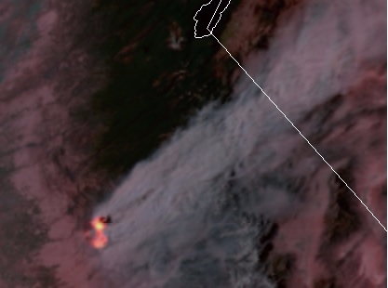
Notes:
GOES-16
Detwiler wildfire, California
Detwiler 07/18 GOES 16 derived imagery.

Slide 8
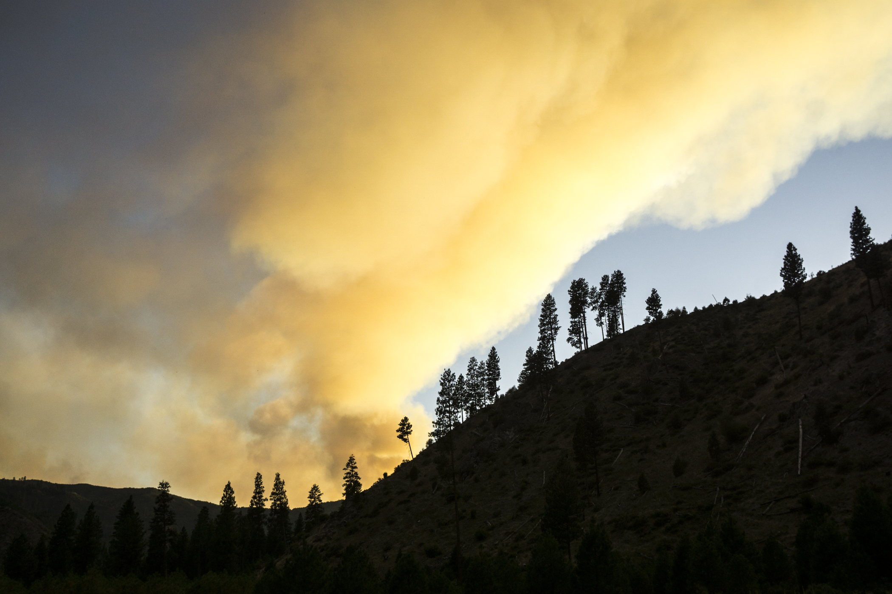
Photo Andrea Holland
Notes:
Pioneer Wildfire 2016

Slide 9
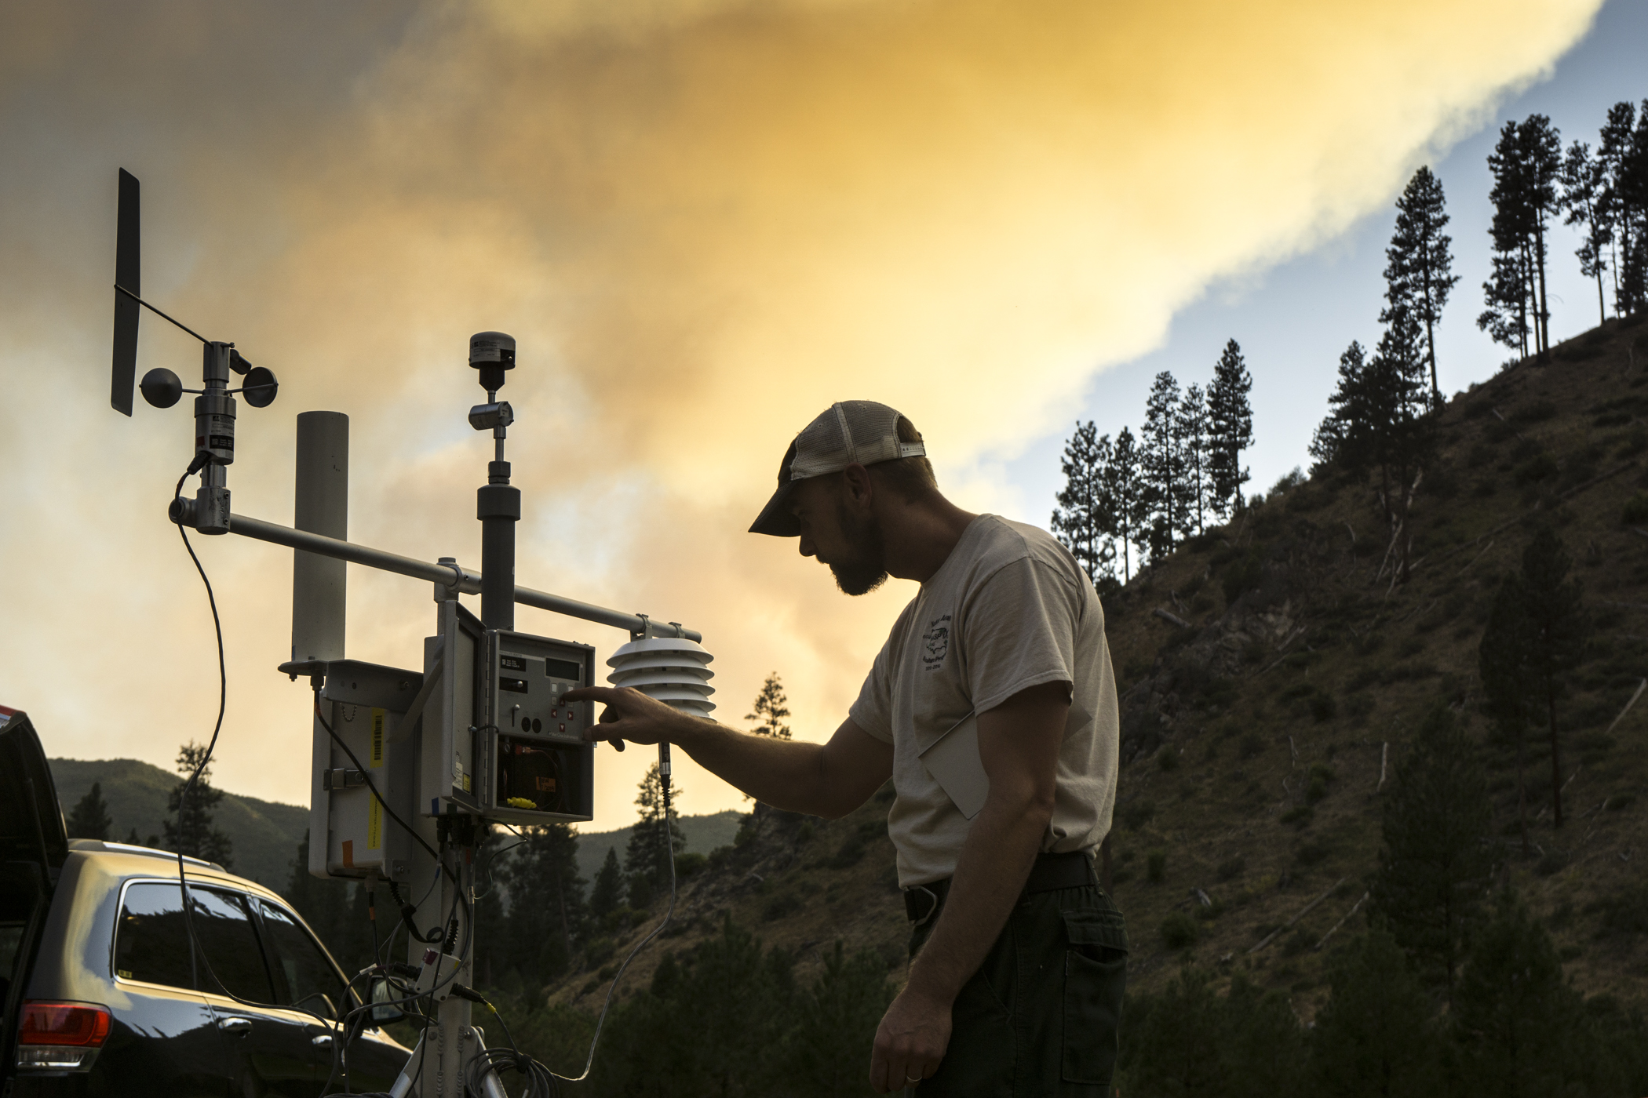
Photo Andrea Holland
Notes:
Pioneer Wildfire 2016

Slide 10
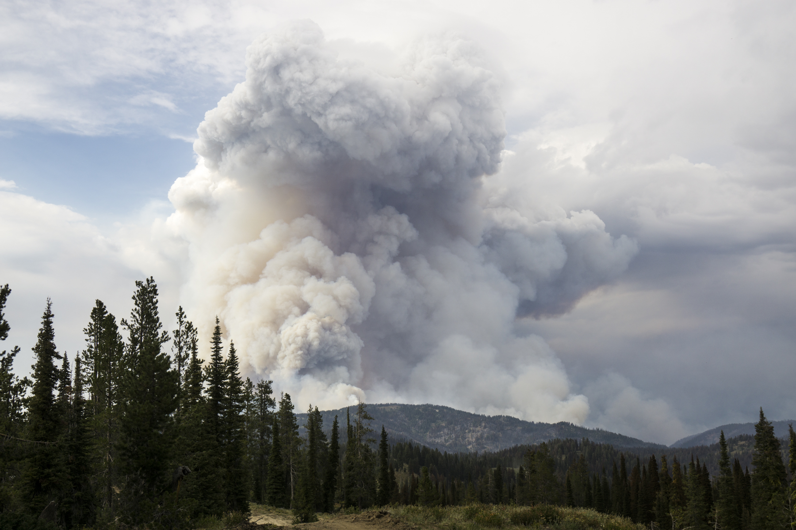
Photo Andrea Holland

