Slide 1


NOAA CLASS Demo
Jorel Torres
JPSS Satellite Liaison, CIRA/CSU
6 January 2018 AMS - JPSS Short Course, Austin, TX

Slide 2
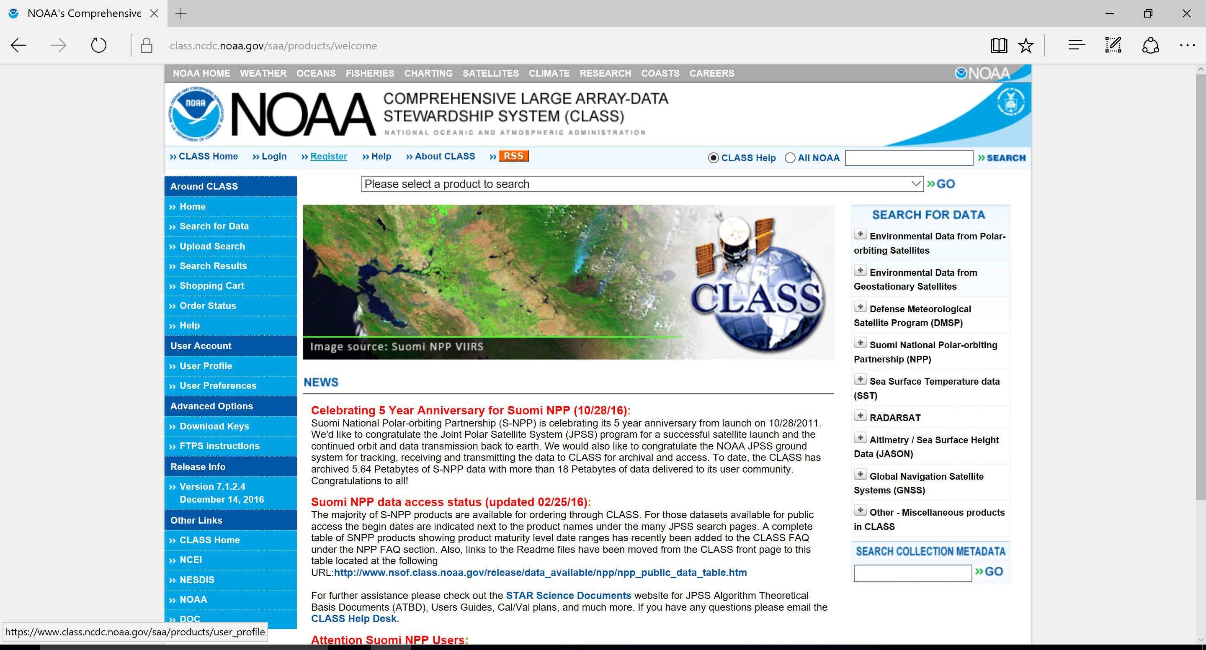
www.class.noaa.gov
Step 1: Go to www.class.noaa.gov and click the ‘Register’ button.

Slide 3
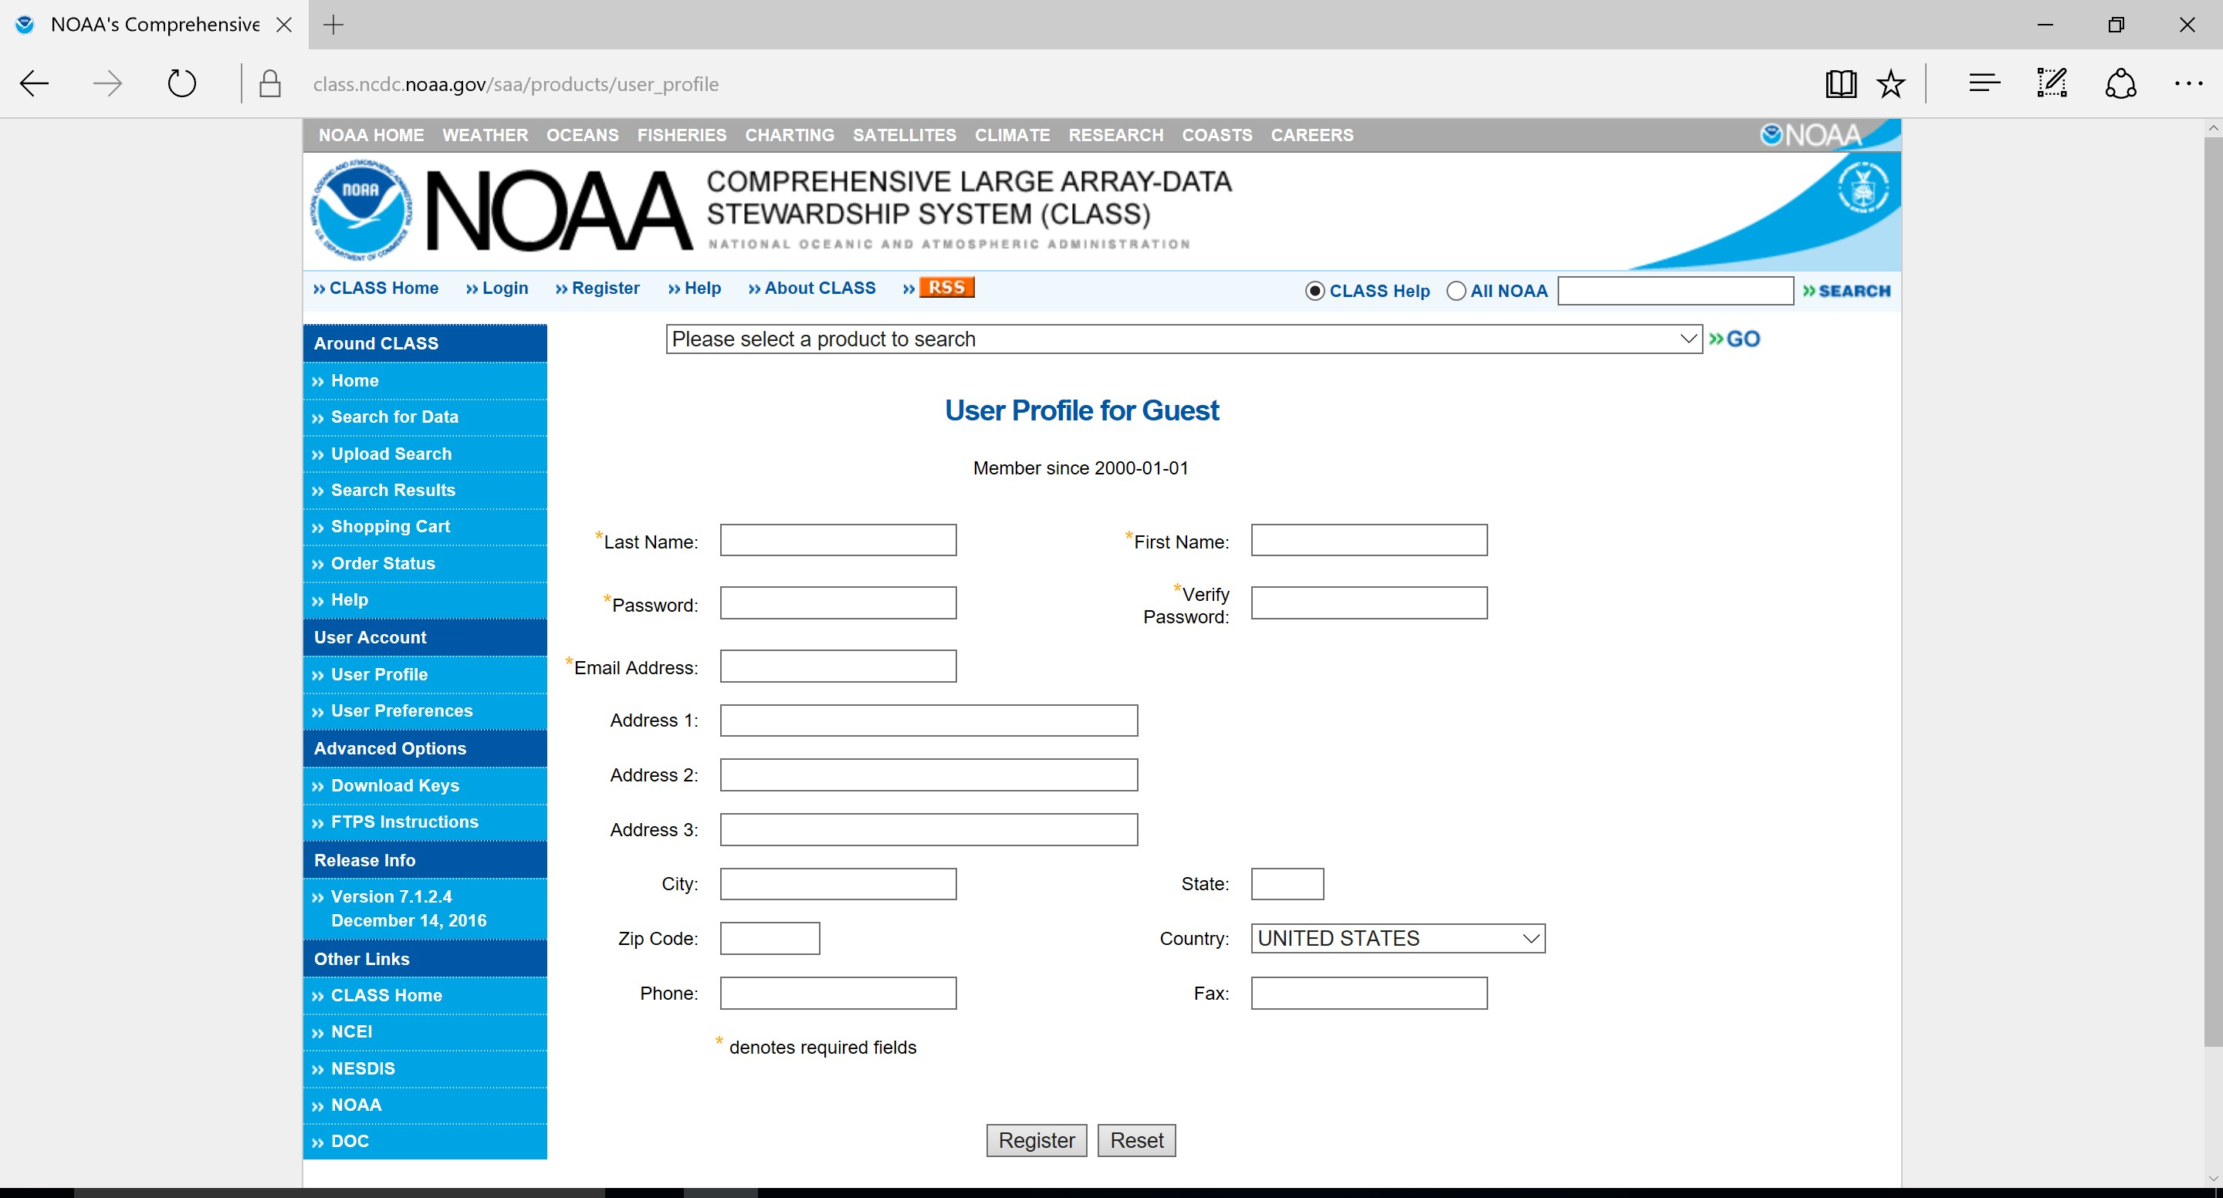
Step 2A: Fill in user profile information, then click ‘Register’.

Slide 4
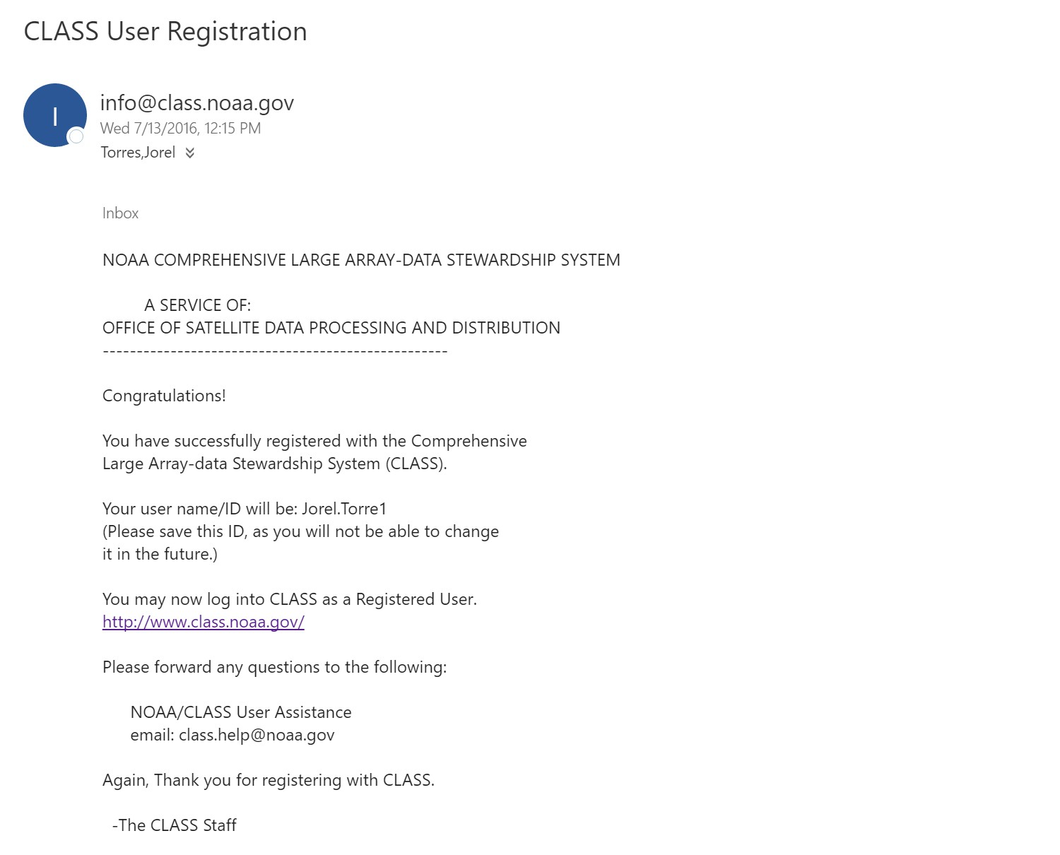
Step 2B: Once you ‘Register’ you will receive an e-mail titled ‘Class User Registration’ that will have your username/ID, (highlighted by the red-box), which you will use when you log-in for future data inquiries.

Slide 5

Step 3: If you are already registered with NOAA CLASS then click ‘Login’.

Slide 6
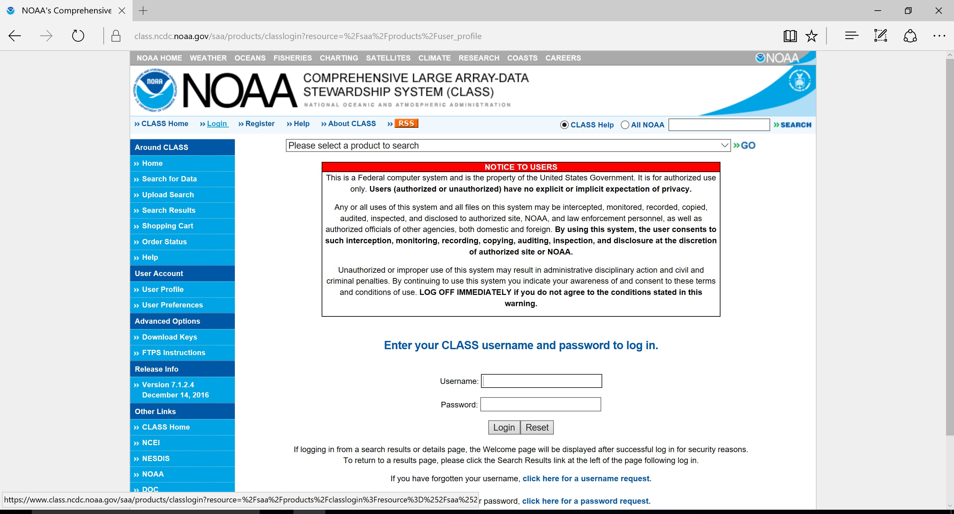
Step 4: Type in your username and password and click ‘Login’.

Slide 7
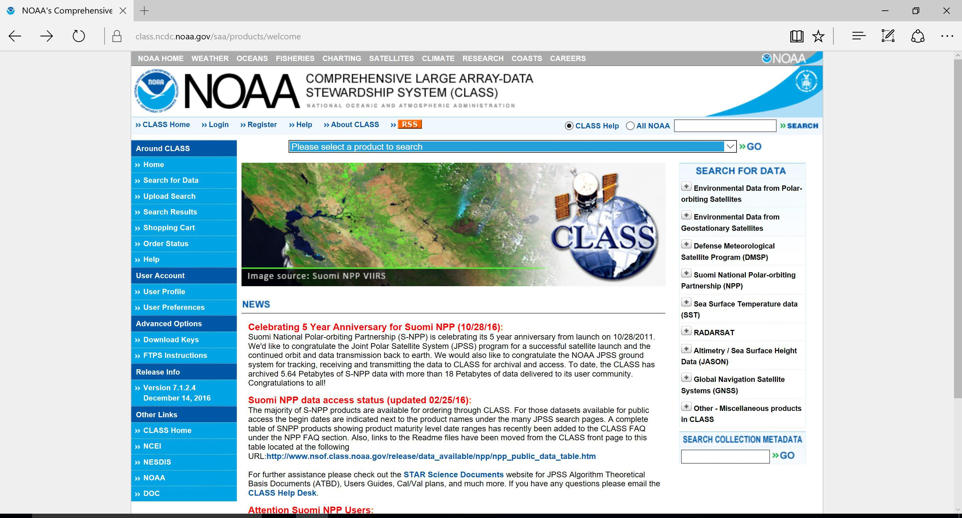
Step 5: Once logged into NOAA CLASS, notice the product search engine, located near the top of web page, denoted as ‘Please select a Product to search’.

Slide 8
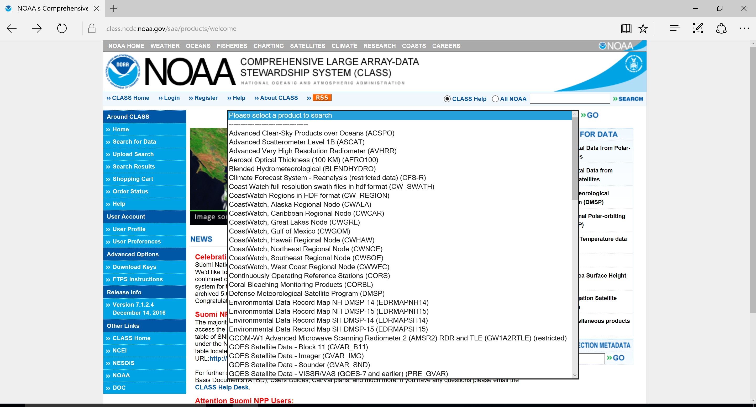
Step 6: Click on the drop-down menu (via the red arrow) and you will see an array of products listed.

Slide 9
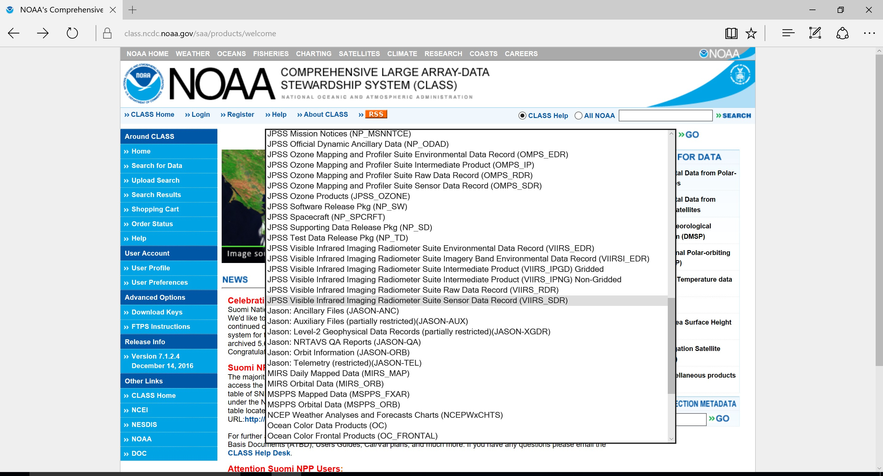
Step 7: Utilizing the drop down menu, scroll down and click on the ‘JPSS Visible Infrared Imaging Radiometer Suite Sensor Data Record (VIIRS_SDR)’ product.

Slide 10
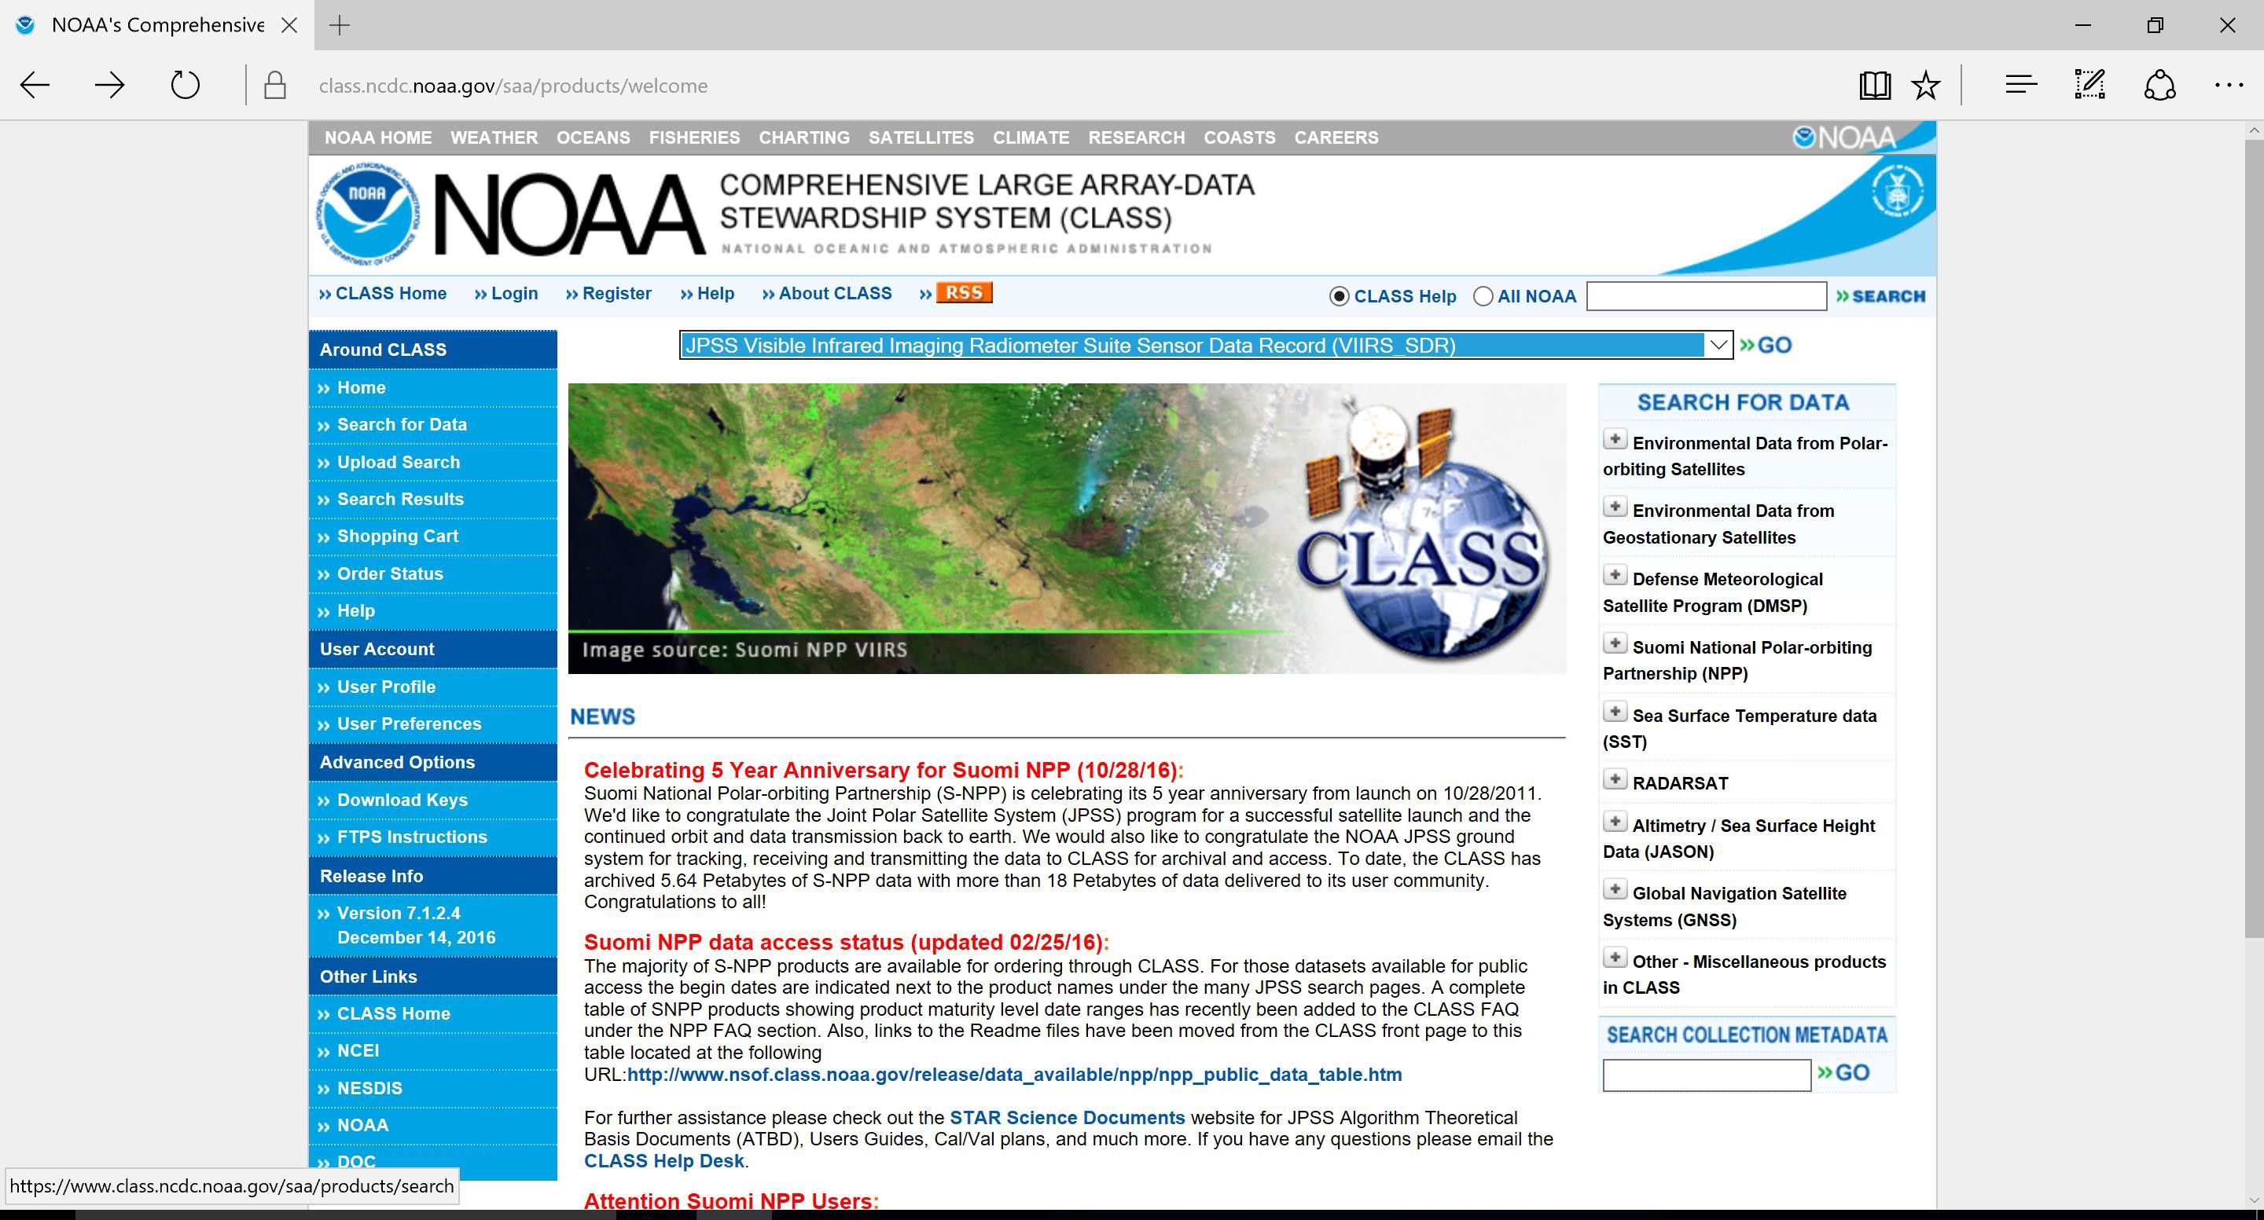
Step 8: Once the ‘JPSS Visible Infrared Imaging Radiometer Suite Sensor Data Record (VIIRS_SDR)’ product is selected, then select ‘GO’.

Slide 11
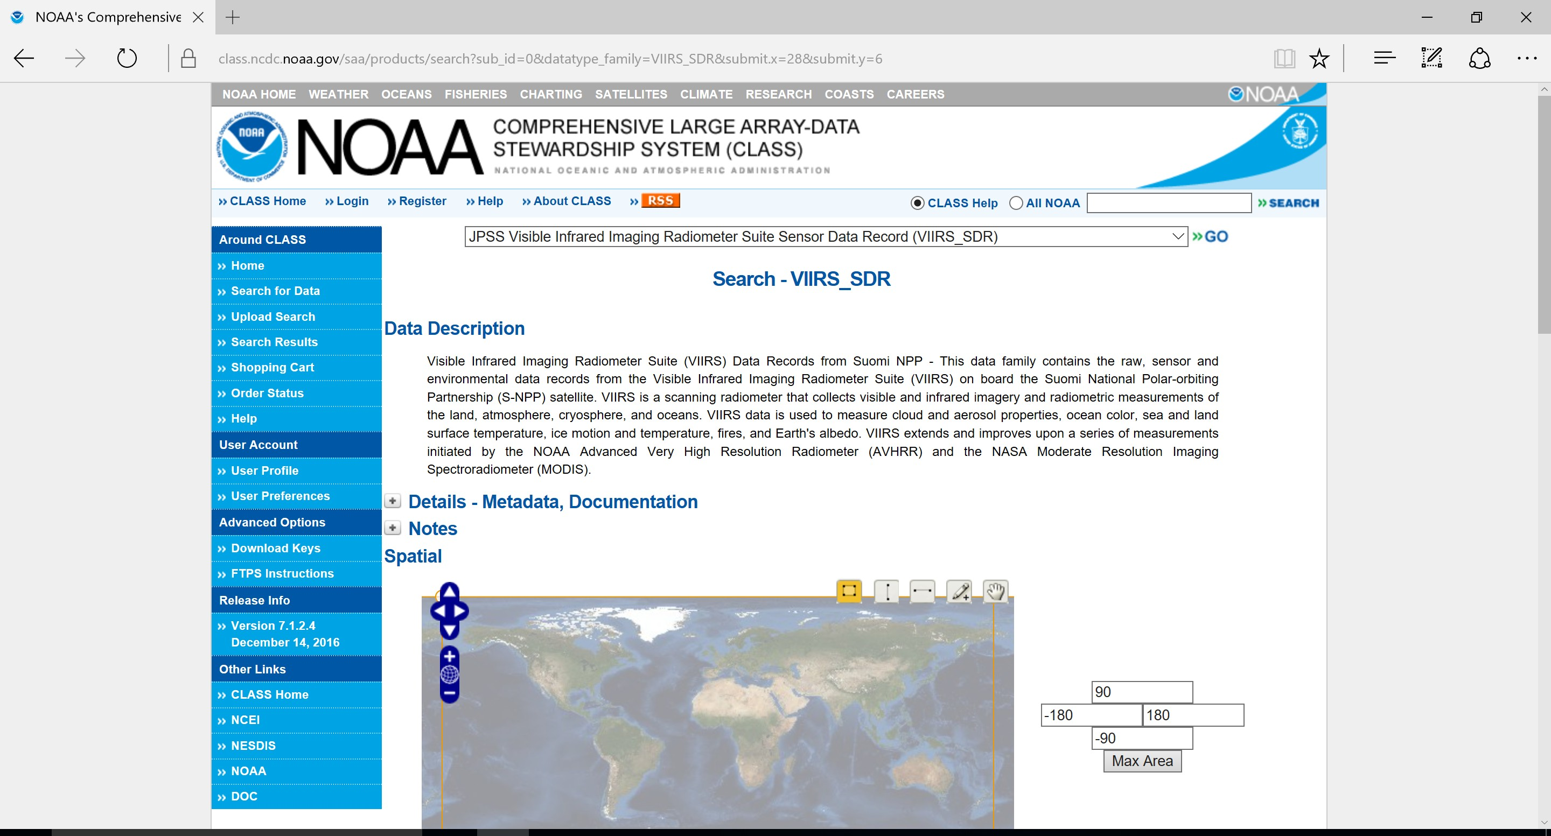
Step 9: The ‘JPSS Visible Infrared Imaging Radiometer Suite Sensor Data Record (VIIRS_SDR)’ product data description will be shown.

Slide 12
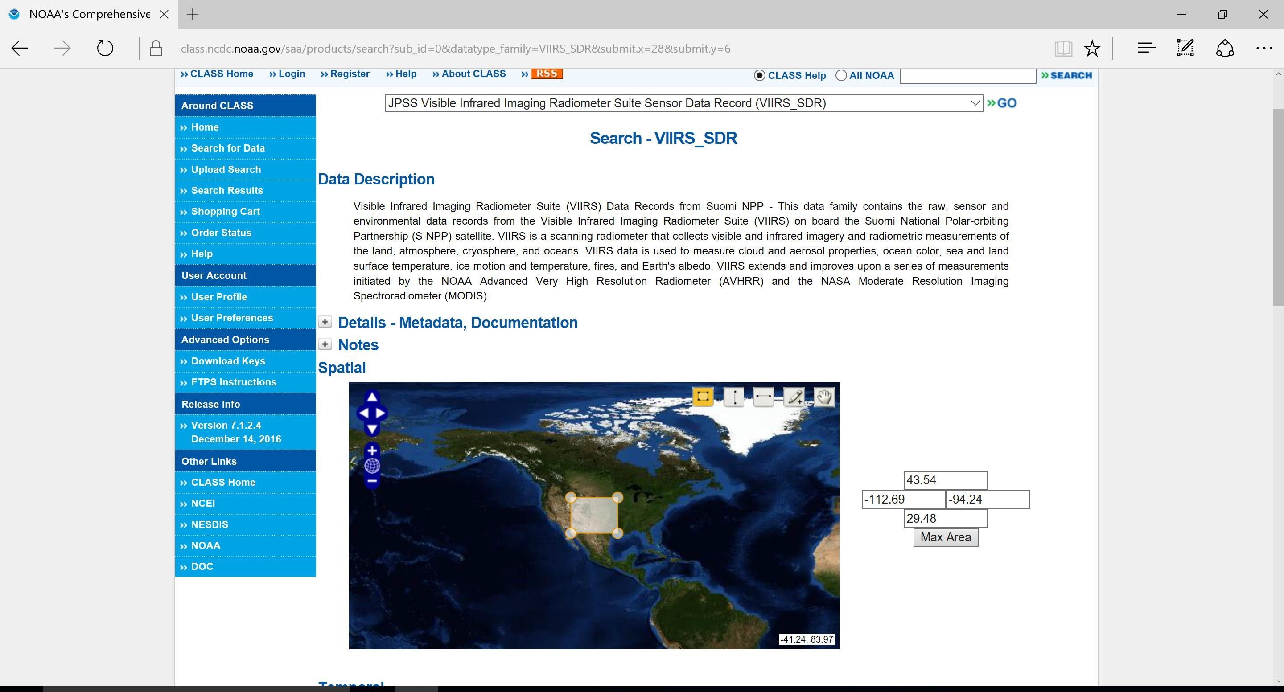
Step 10: In the ‘Spatial’ Section, utilize the zoom in/zoom out and ‘pan’ function (red circle) to find your domain of interest. If you left-click and drag your mouse, you can create your domain of interest.

Slide 13
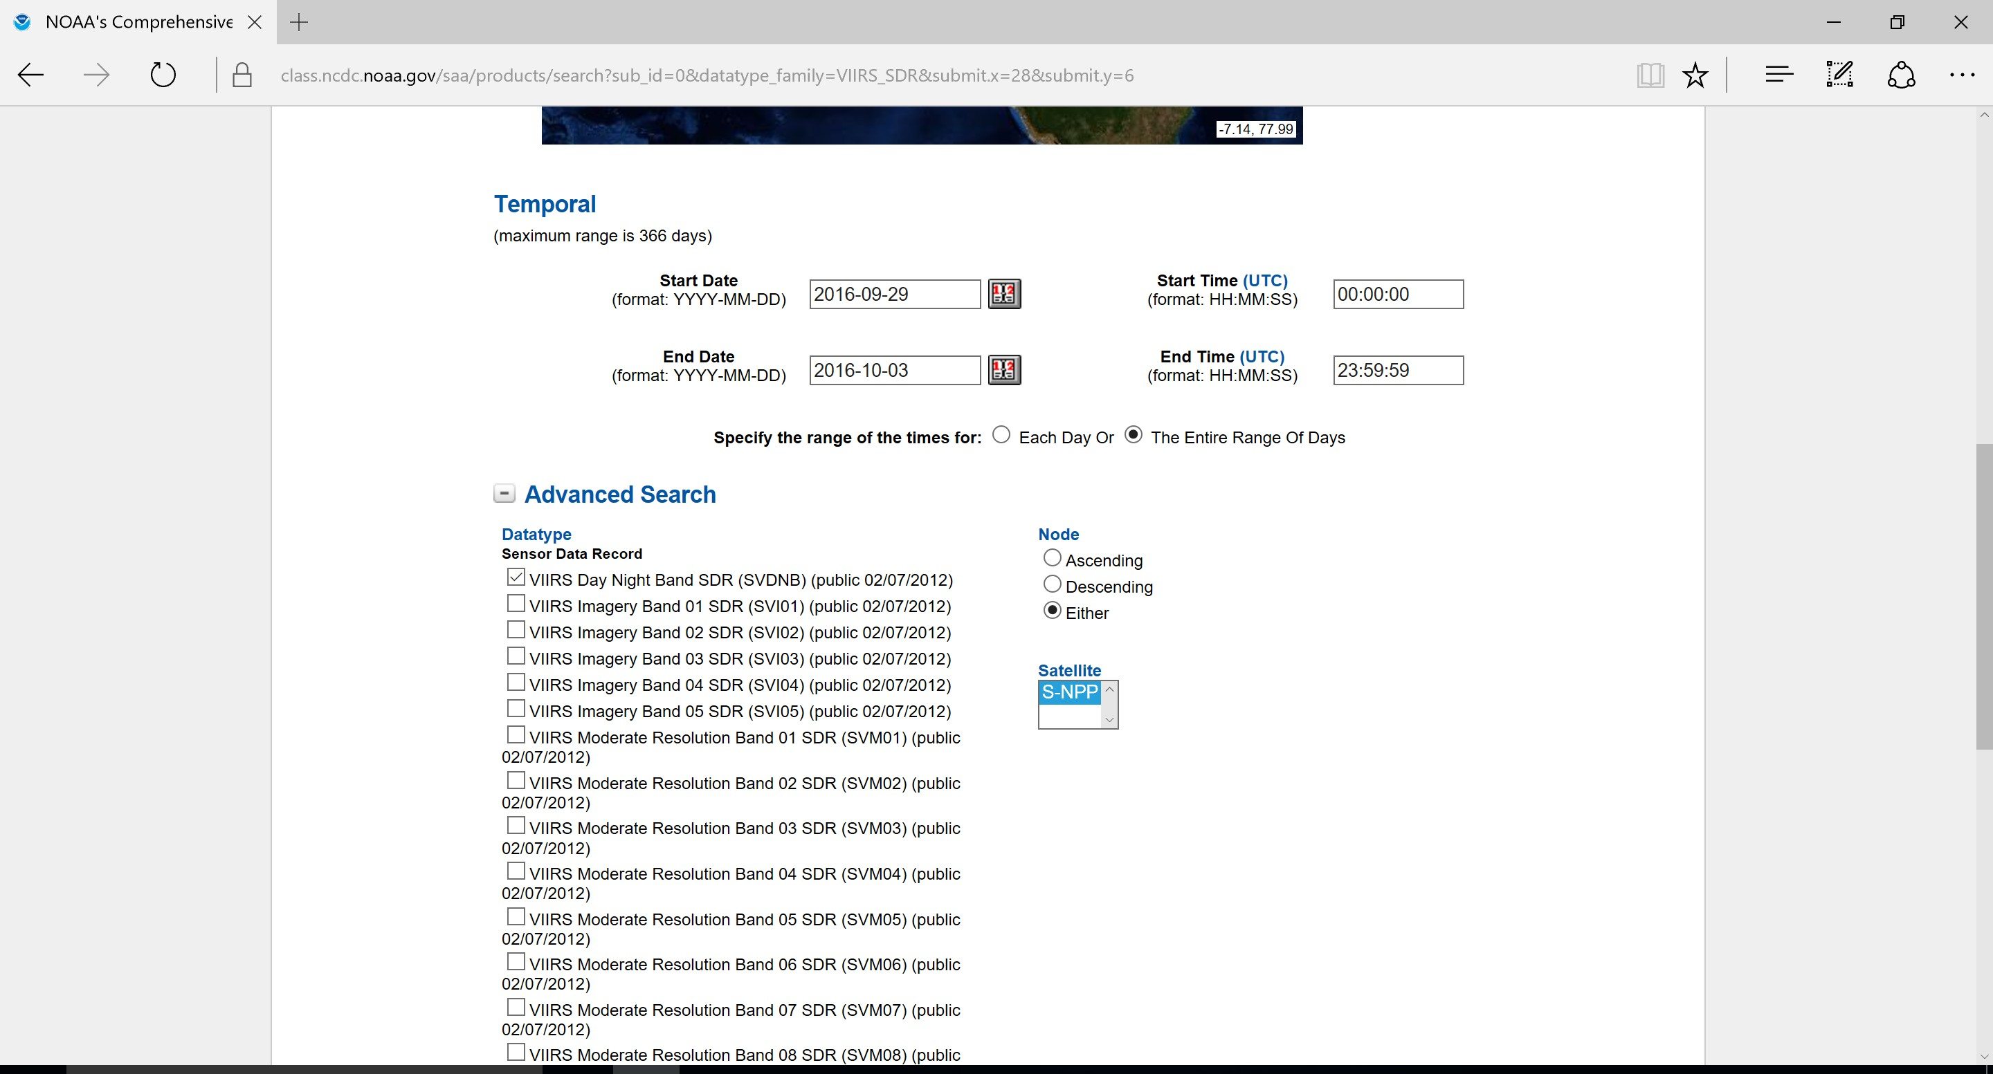
Step 11: Once you completed the ‘Spatial’ Section you can scroll down and see the ‘Temporal’ Section where you can manually put in the time/date of the data that you are interested in. For Node, click ‘Either’, and under Satellite click ‘S-NPP’.

Slide 14
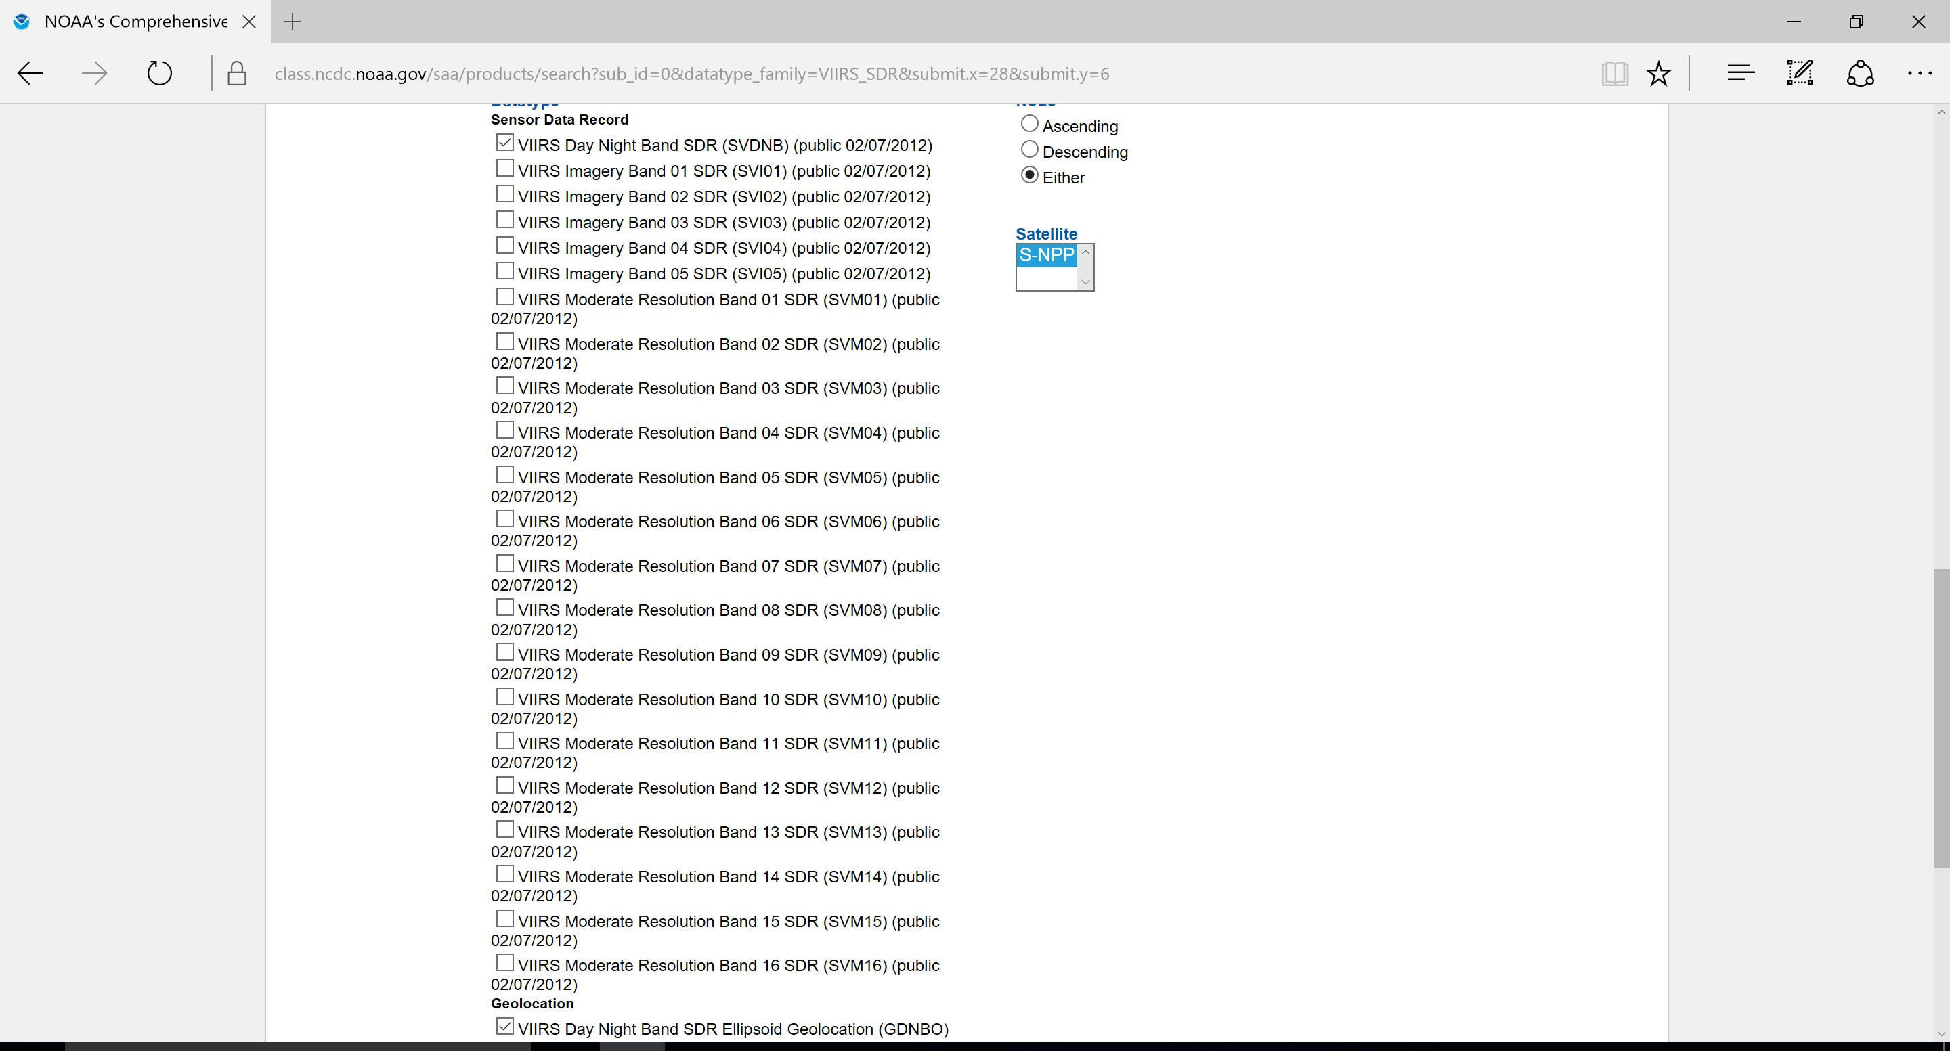
Step 12: Continue to scroll down and click ‘VIIRS Day Night Band SDR (SVDNB)’ under ‘Datatype’ and under ‘Geolocation’ click ‘VIIRS Day Night Band Ellipsoid Geolocation (GDNBO)’.

Slide 15
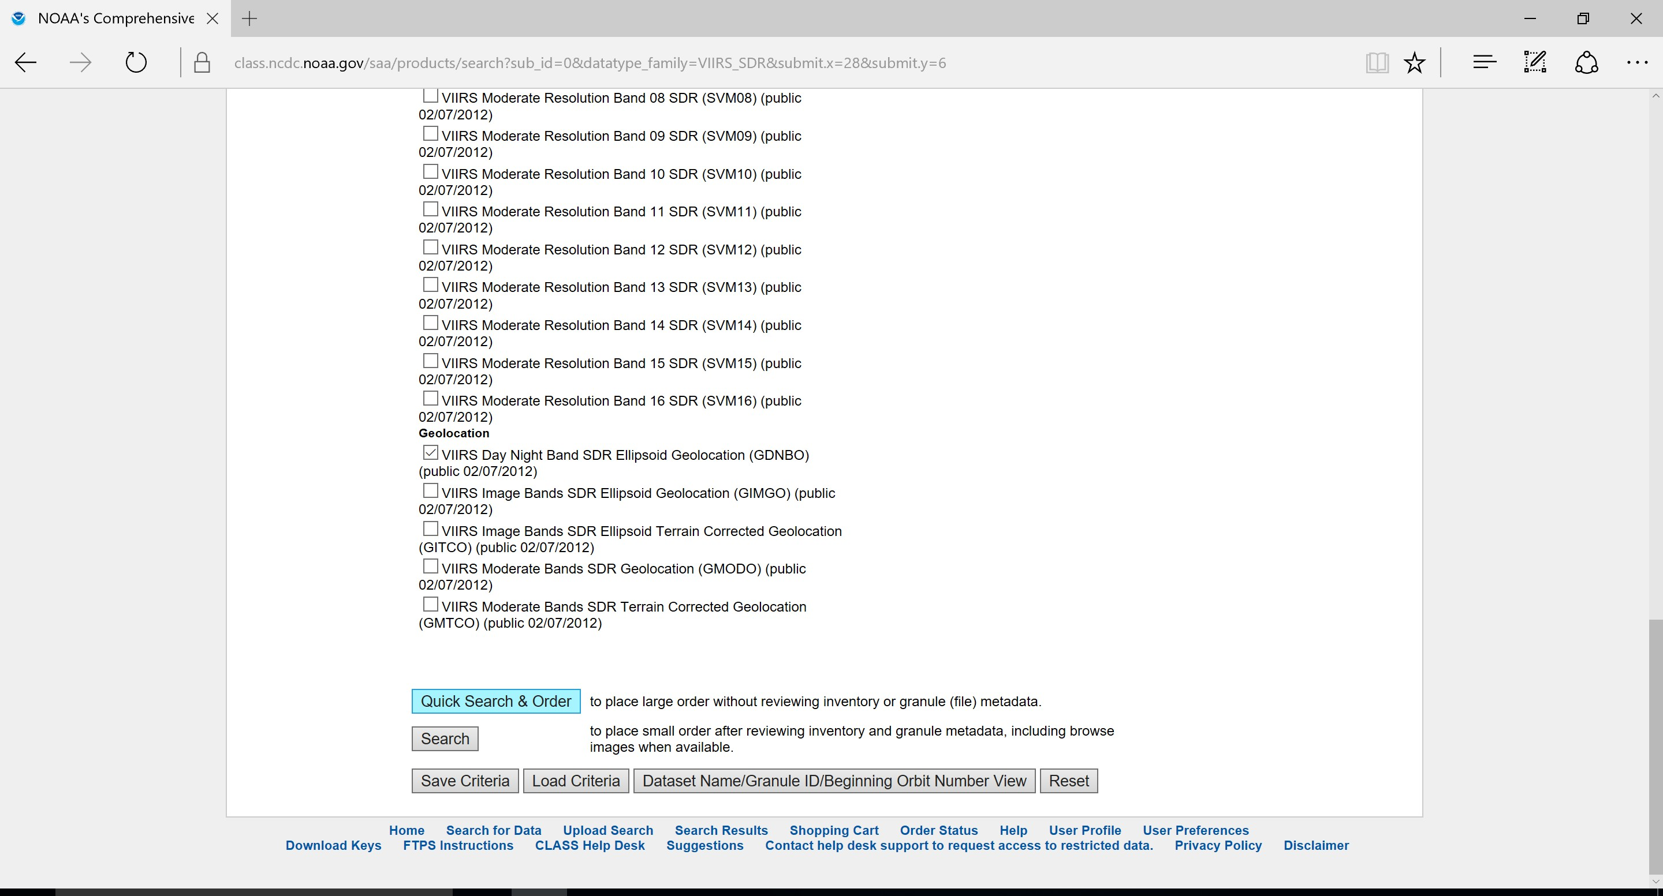
Step 13: To quickly request the data that you have just chosen, click ‘Quick Search & Order’.

Slide 16
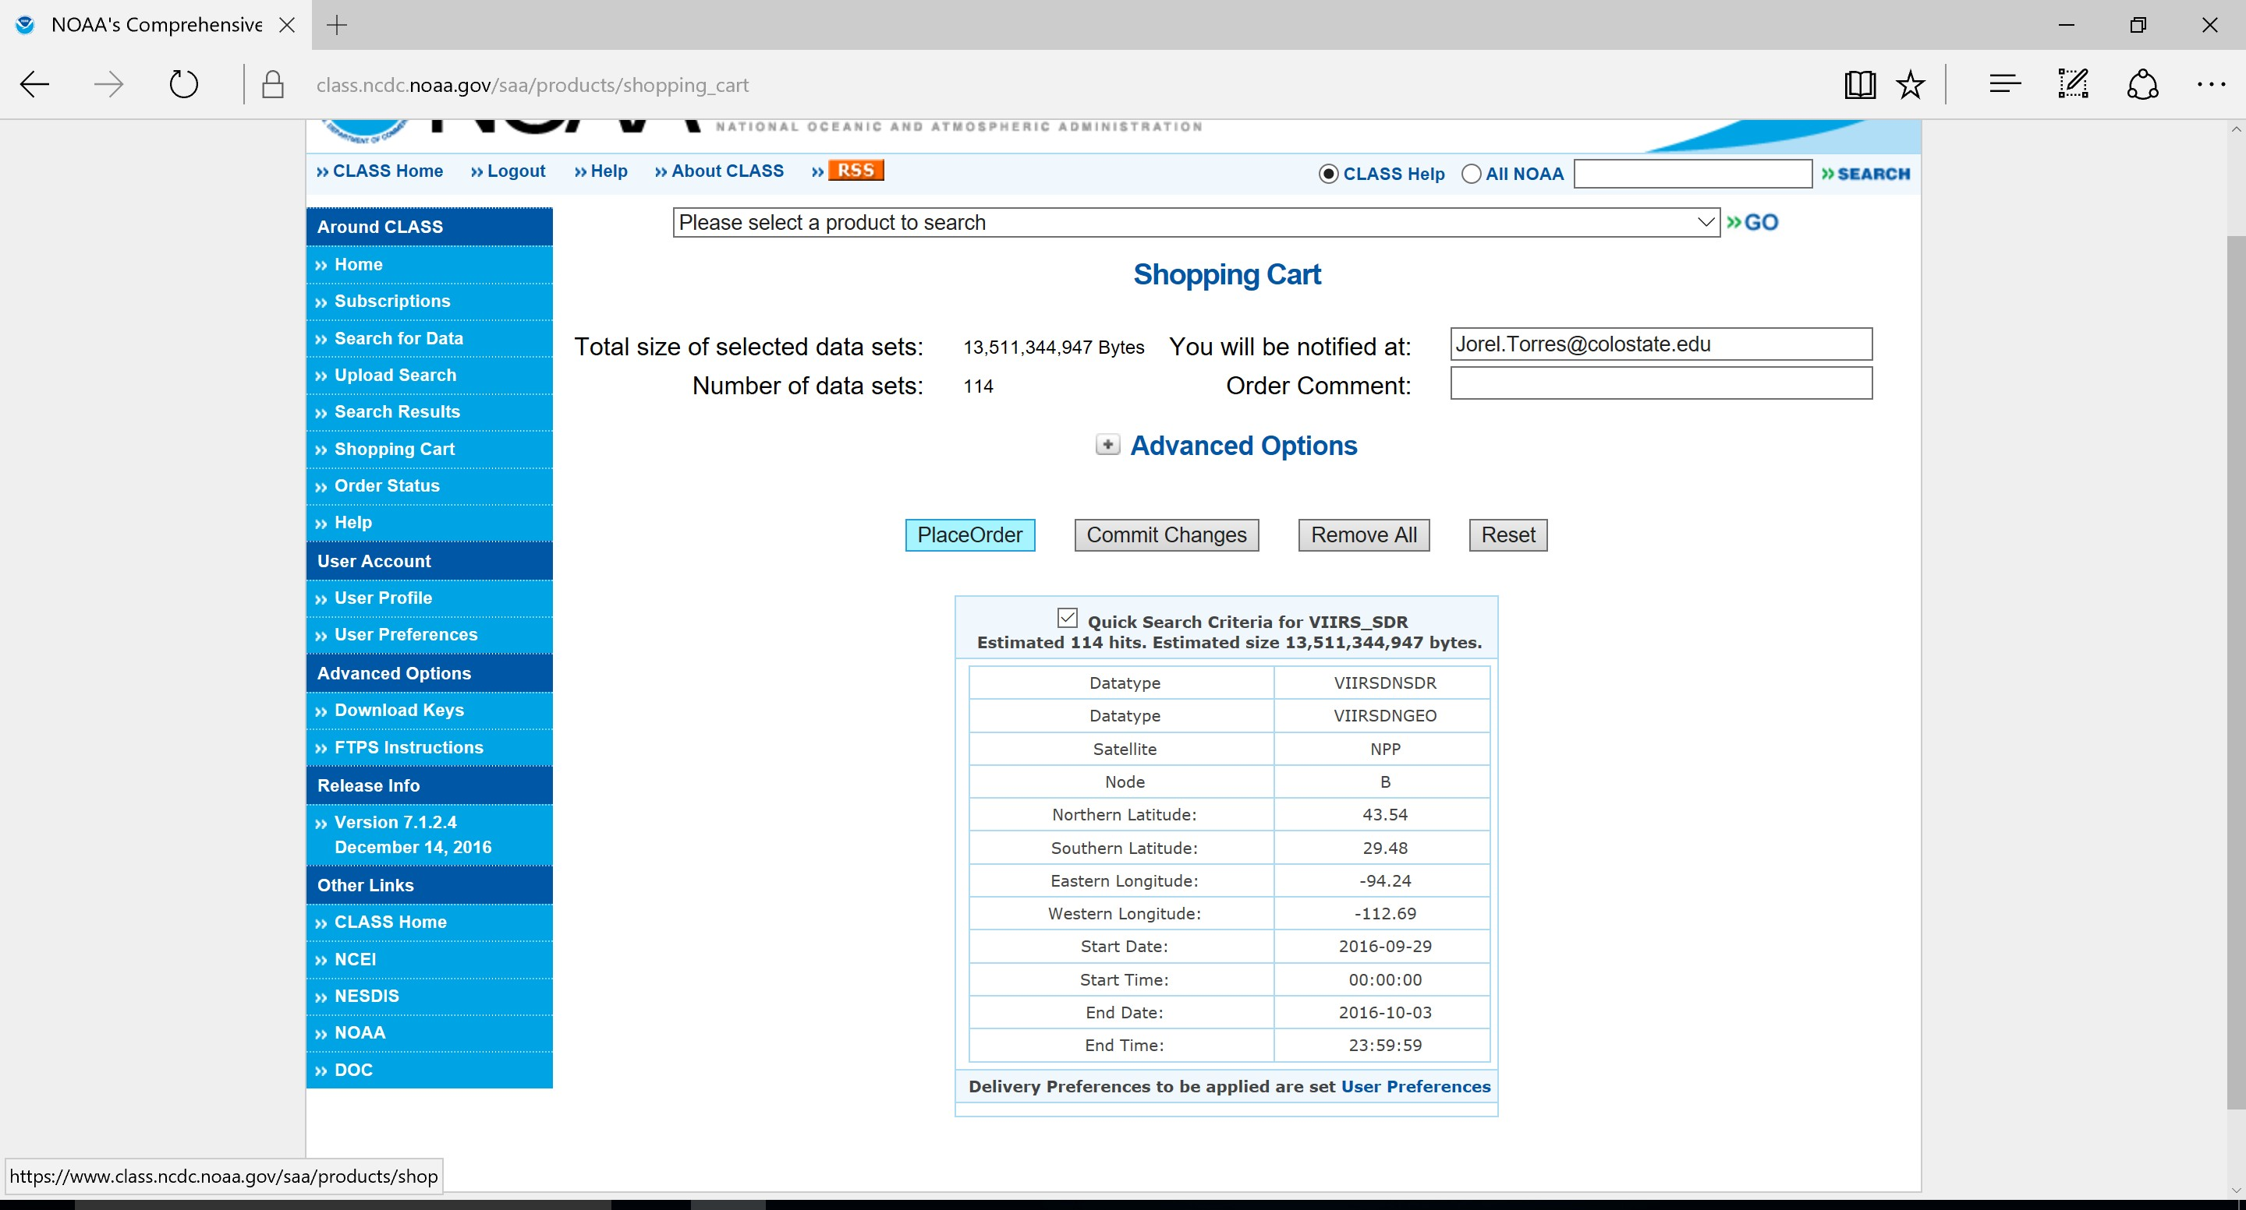
Step 14: Then click ‘Place Order’. You will then be notified by e-mail from NOAA CLASS about your ‘CLASS order summary’ and then approximately 24-48 hours later you will be notified by second e-mail that the order process has been complete.

Slide 17
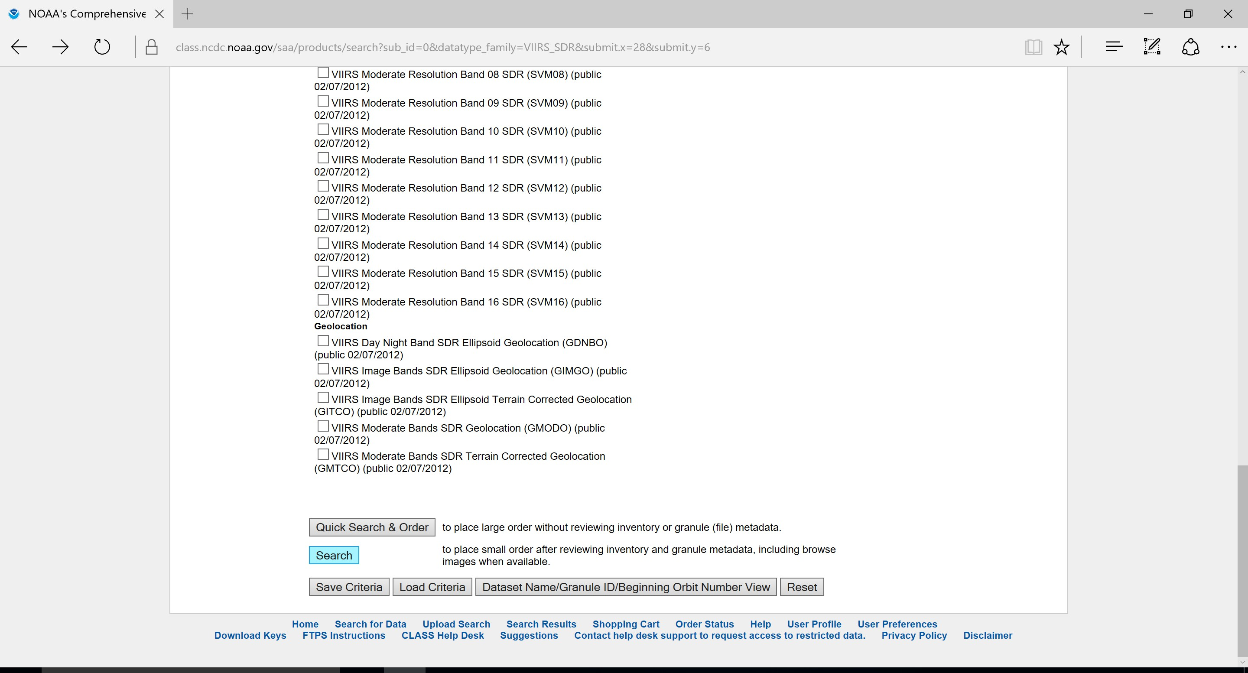
Step 15: An alternative to the ‘Quick Search & Order’ method, you can click on ‘Search’ which will give you additional information on the data that you will be requesting.

Slide 18
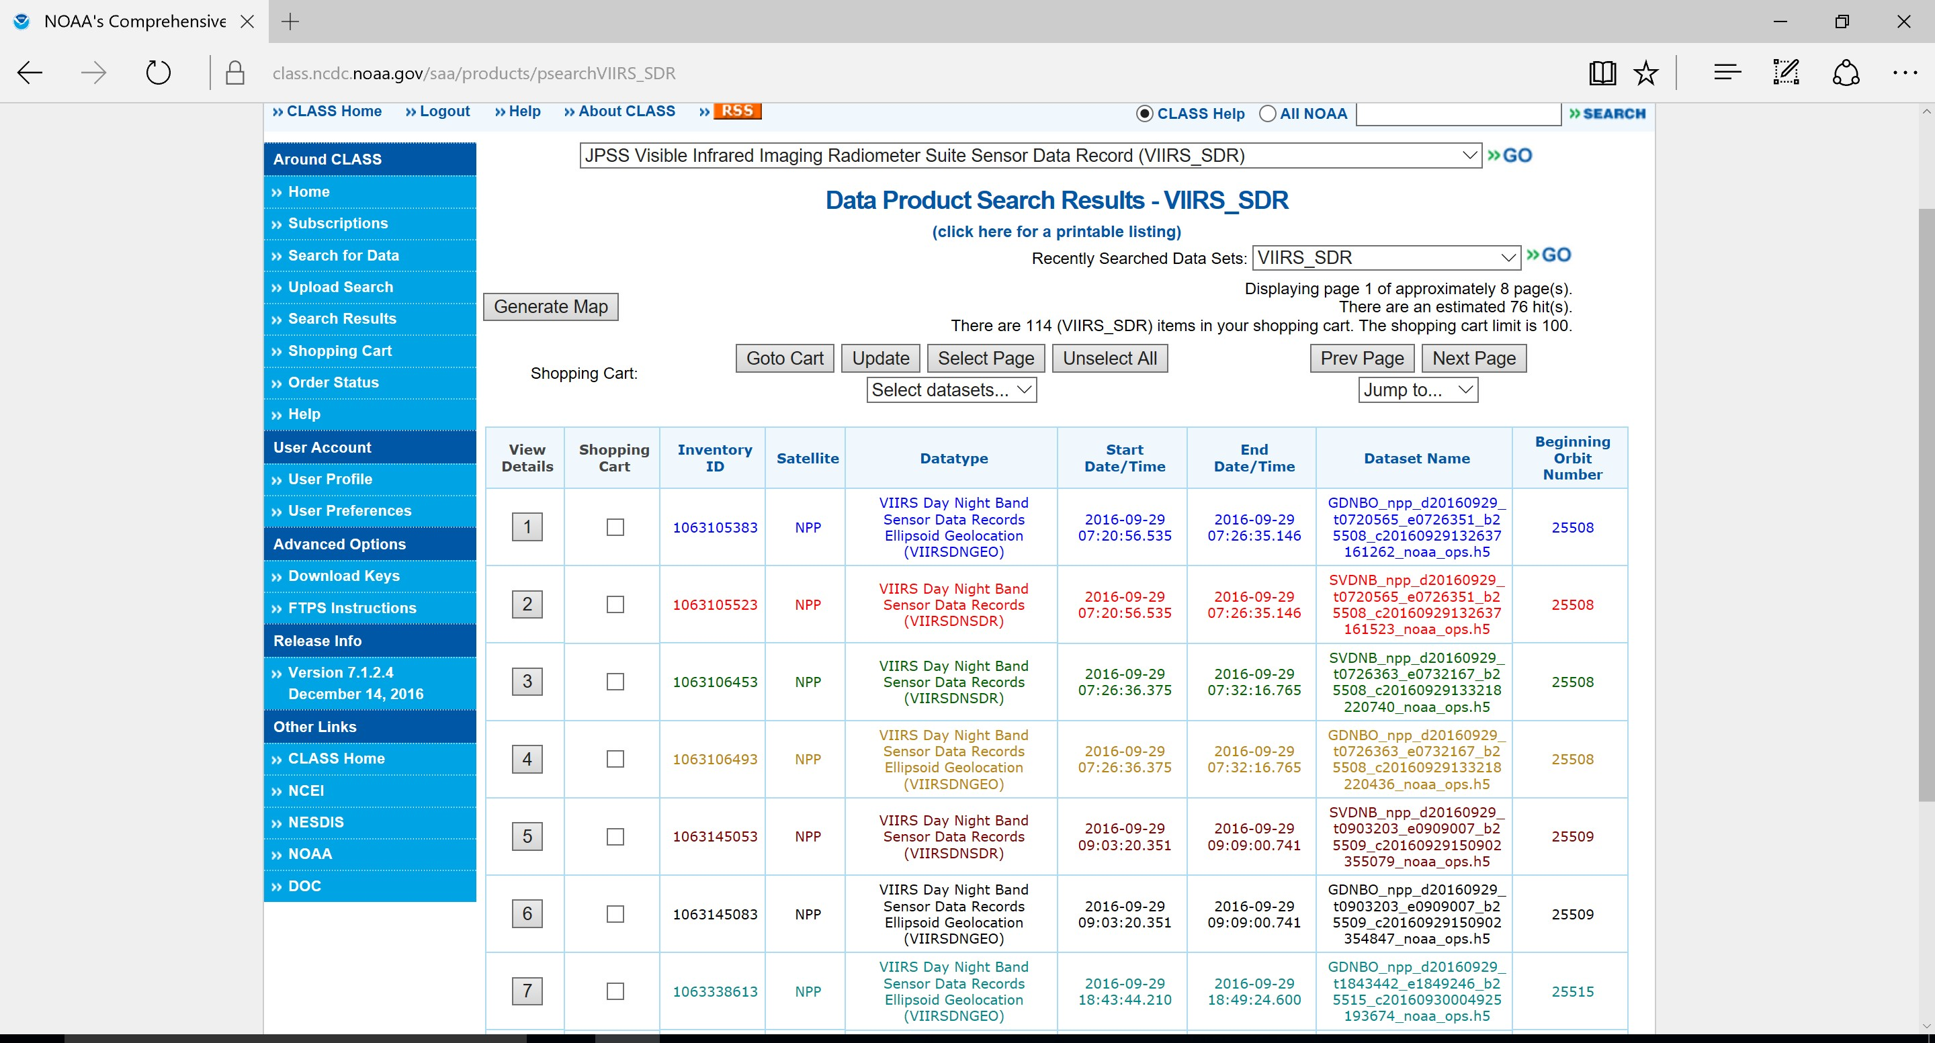
Step 16: A list of the data products will be shown and you can pick which files you want to order. Each page of data will contain 10 individual files.

Slide 19

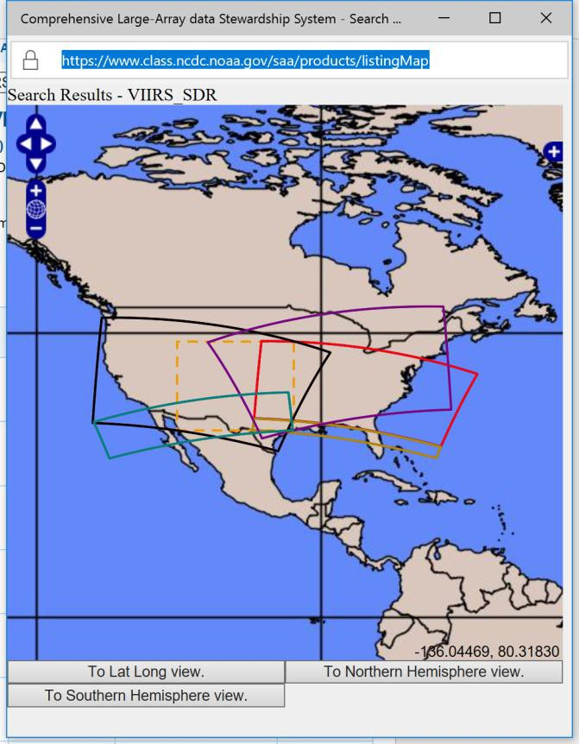
Step 17: If you click on ‘Generate Map’. The Map will highlight which files correspond to their respective swaths (i.e., green swaths correspond with green datafiles).

Slide 20

Step 18: Once your data is selected, you can then ‘Goto Cart’.

Slide 21
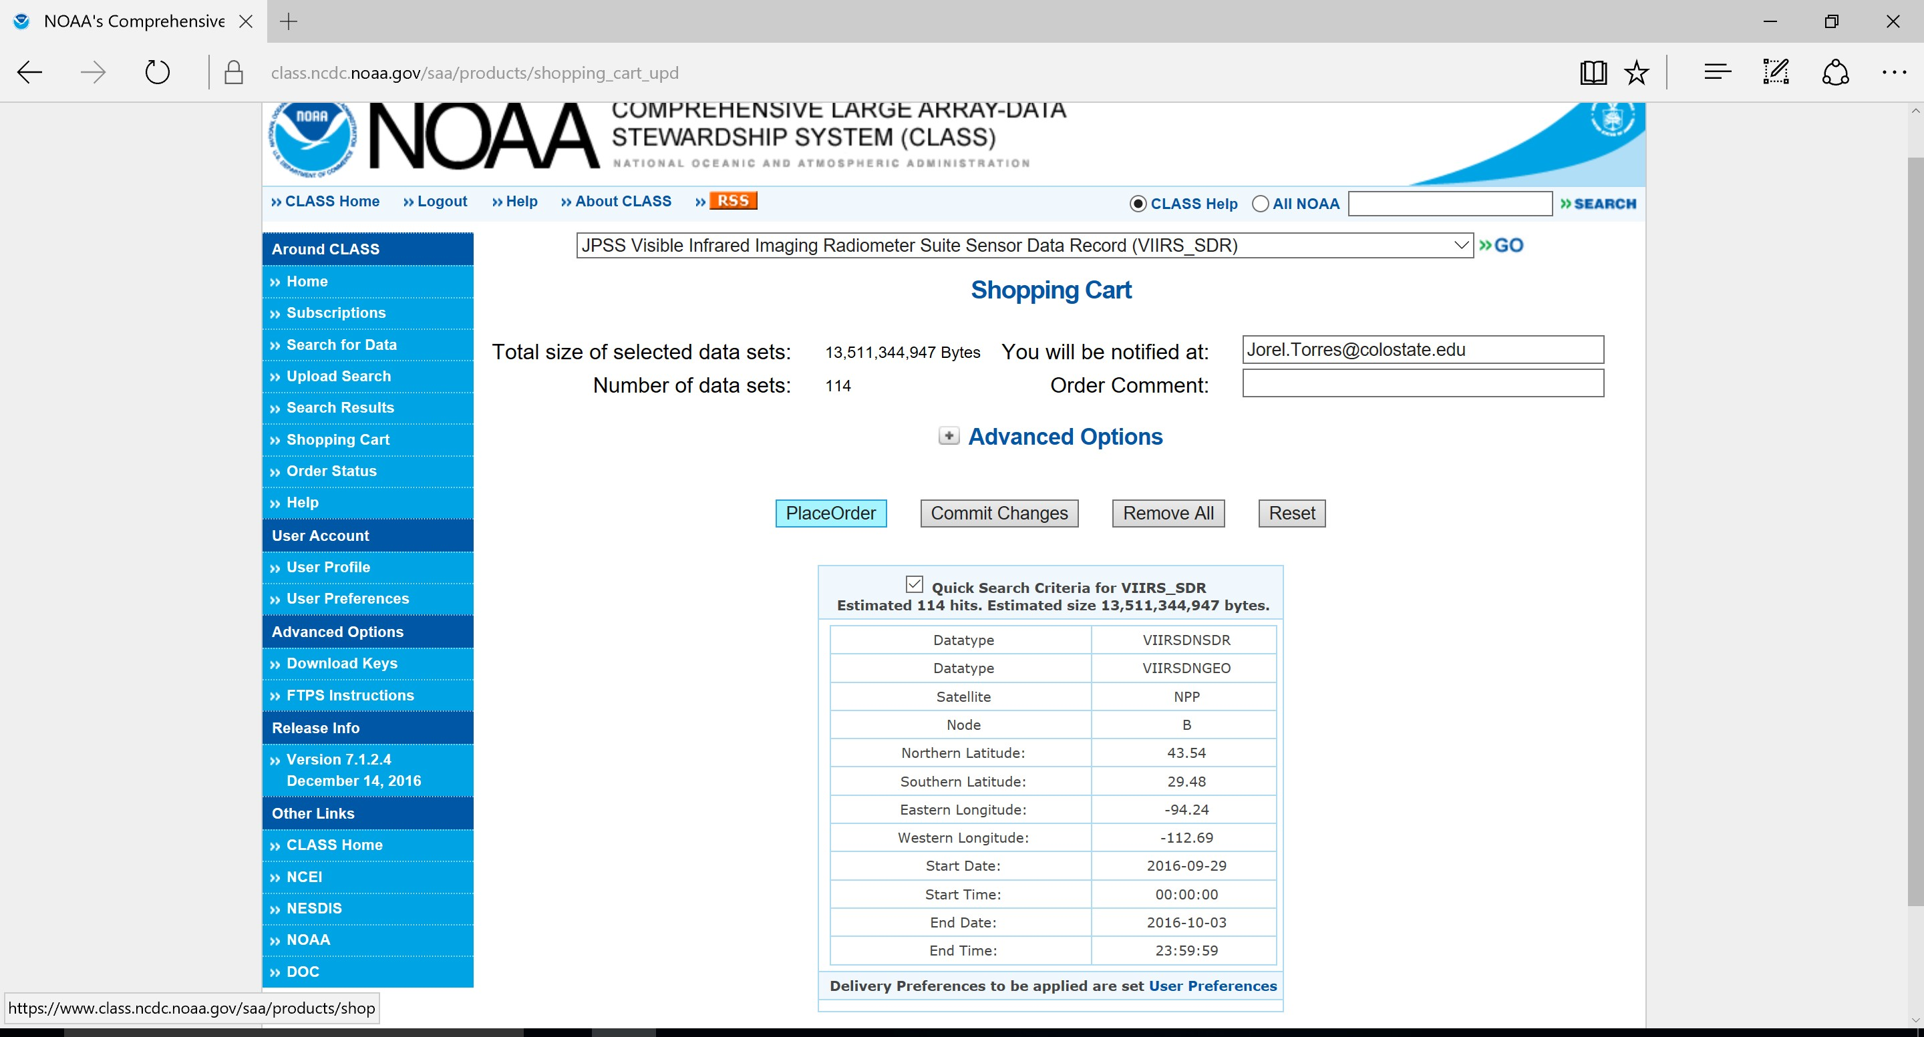
Step 19: Lastly click ‘Place Order’. You will then be notified by e-mail from NOAA CLASS about your ‘CLASS order summary’ and then approximately 24-48 hours later you will be notified by second e-mail that the order process has been complete.

Slide 22

Your Done!

Slide 23
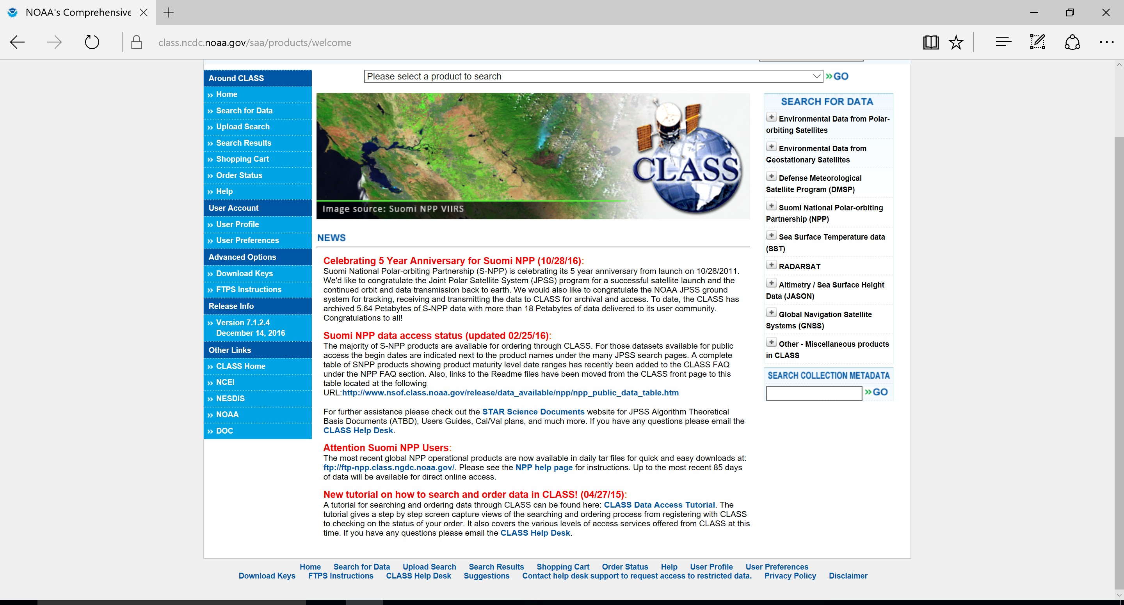
NOAA Class Data Access Tutorial Link
Side Note: A NOAA CLASS tutorial link can also be found via the www.class.noaa.gov website, located at the bottom of the home page (highlighted by the red-box).

Slide 24
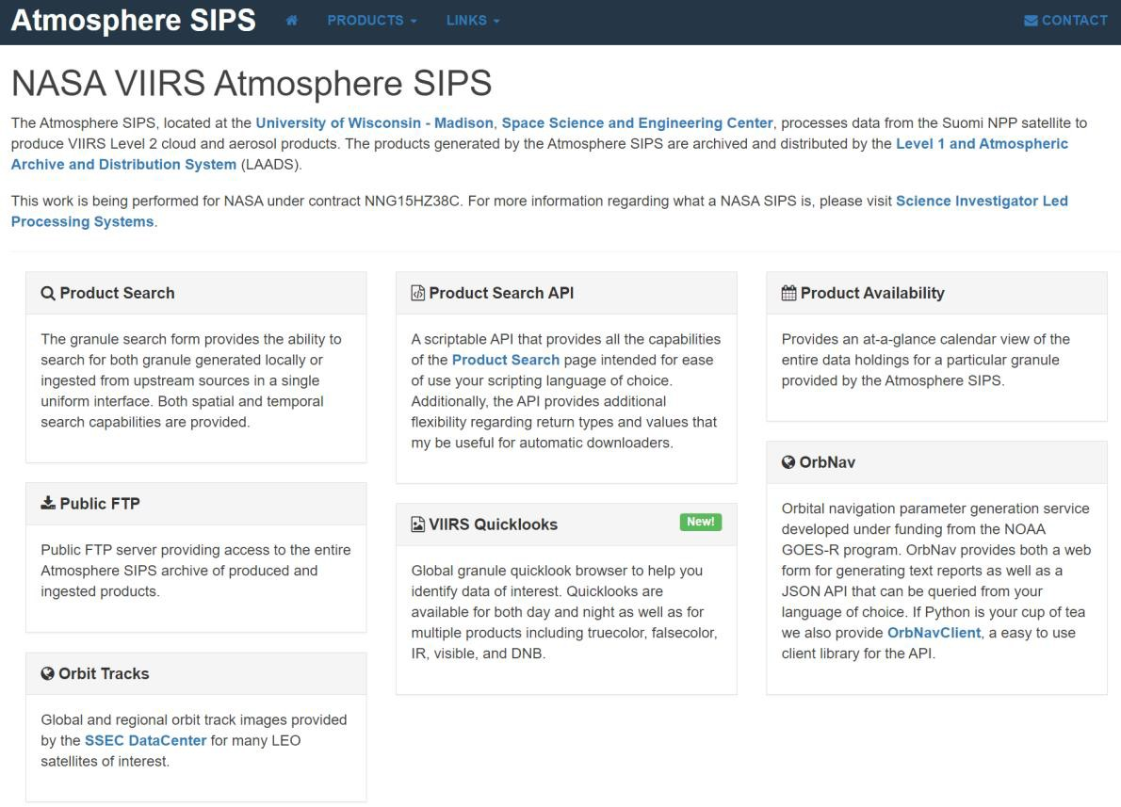
Additional Methods for Data Acquisition
◆ Data Access via ICVS at STAR
-Data cannot be acquired on-line yet. Contact Fuzhong Weng for data inquiries. For more information, click the ‘Data Access via ICVS at STAR’ web-link on JPSS Short Course Webpage.
◆ Product Distribution and Access (PDA)
-NESDIS PDA System for real-time users while it supports secure transfer protocols. More information on PDA can be accessed via the following web-link. https://www.star.nesdis.noaa.gov/jpss/DataAccess.php
◆ GRAVITE
-For the JPSS science team usage to do evaluations of the algorithms for the ground system.
-If you are not one of the JPSS Science Teams or an authorized user, do not worry about it.
-If you need access, contact your science team lead or GRAVITE
personnel.
◆ SIPS Archive
-NASA funded project. Be cognizant that data is formatted in a different way than NOAA CLASS. Data does not follow the same calibration as NOAA data as well. Web-link below.
http://sips.ssec.wisc.edu/#/
Reference: William Straka III (CIMSS)

Slide 25
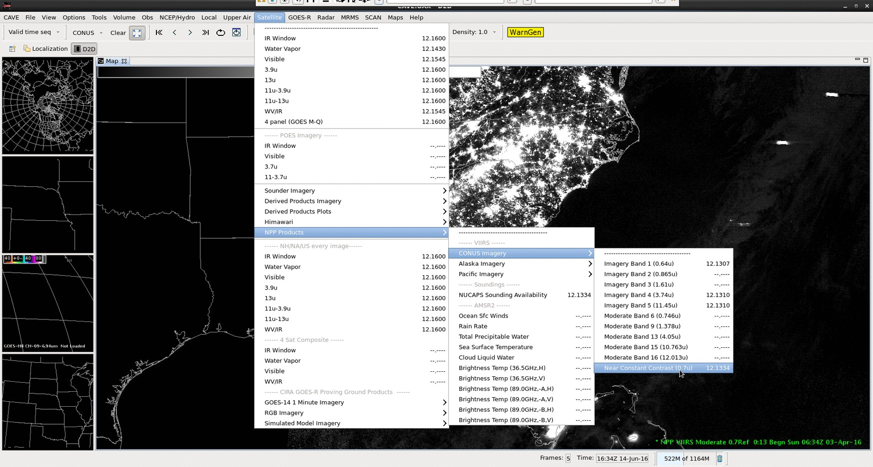
AWIPS-II: Data Acquisition

Slide 26
Questions?
Contact Information
Jorel Torres Jorel.Torres@colostate.edu Jorel.Torres@noaa.gov

