Slide 1
Ordering EPS AOD and ADP Products from NOAA CLASS

Slide 2
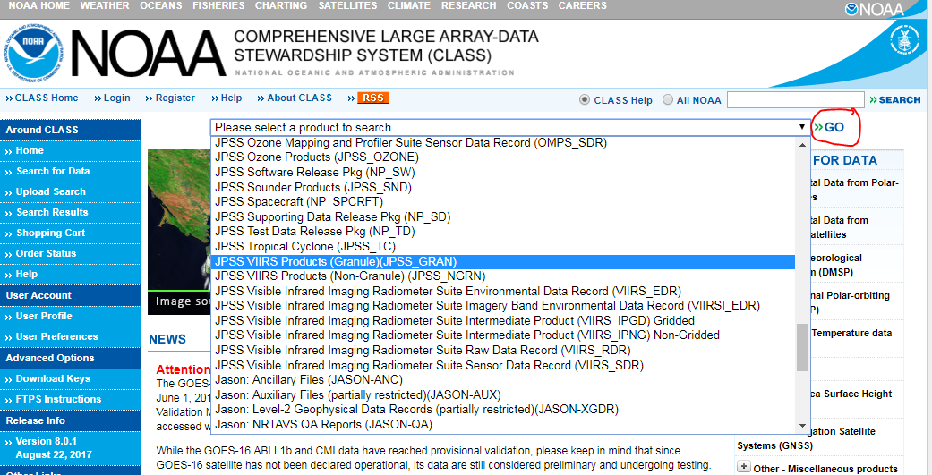
Ordering EPS AOD and ADP files from CLASS (https://www.class.ncdc.noaa.gov)
Select JPSS VIIRS Products (Granule)(JPSS_GRAN) from the drop-down list at the top of the CLASS page and click GO;

Slide 3
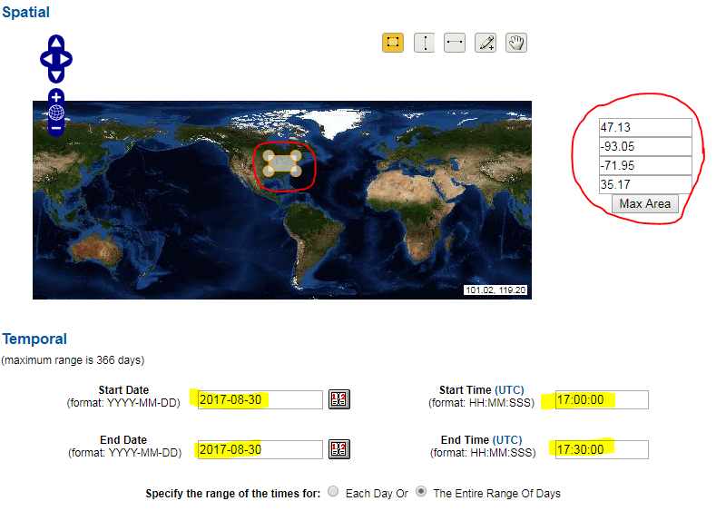
Ordering EPS AOD and ADP files from CLASS (https://www.class.ncdc.noaa.gov)
On the resulting page select the desired geographic area from the map and the date/time period;

Slide 4
Ordering EPS AOD and ADP files from CLASS (https://www.class.ncdc.noaa.gov)
Select VIIRS Aerosol Optical Depth and Aerosol Particle Size EDRs from the Datatype section under Advanced Search;
Ordering VIIRS Aerosol Detection EDR is similar; AOD is shown in the examples

Slide 5
Ordering EPS AOD and ADP files from CLASS (https://www.class.ncdc.noaa.gov)
Click the Search or the Quick Search & Order button depending on the volume (small/large) of order;

Slide 6
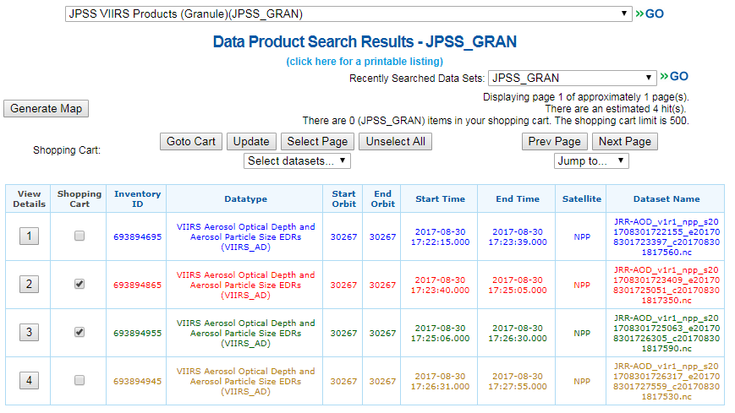
Ordering EPS AOD and ADP files from CLASS (https://www.class.ncdc.noaa.gov)
On the page that opens select the files you want from the list;
AOD (ADP) filenames will start with the string JRR-AOD_ (JRR_ADP_)
Selection can be made manually or by using the Select Page, Unselect Page buttons, or the Select datasets… drop down menu

Slide 7
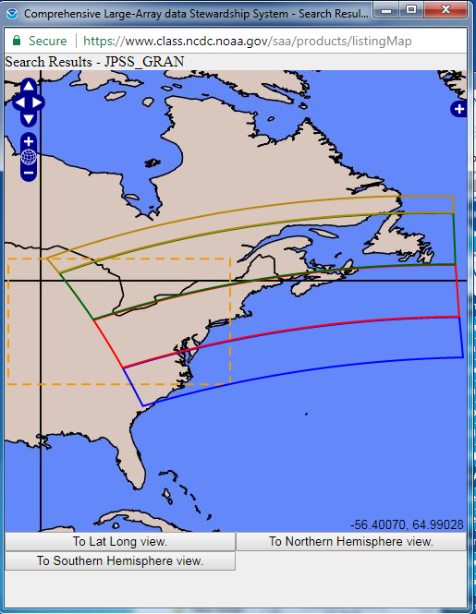
Ordering EPS AOD and ADP files from CLASS (https://www.class.ncdc.noaa.gov)
You can also plot a map of the actual area covered by the individual files in the list by clicking the Generate Map button;
After selecting the files click Goto Cart;

Slide 8
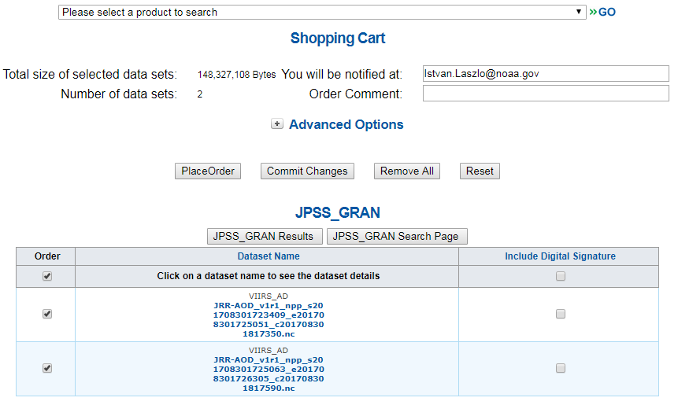
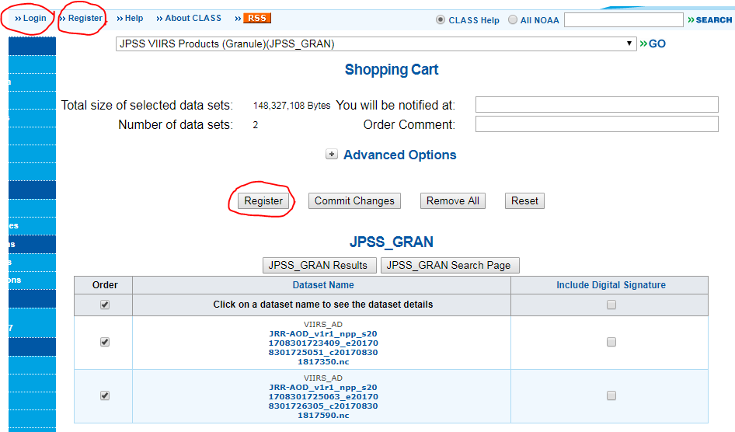
Ordering EPS AOD and ADP files from CLASS (https://www.class.ncdc.noaa.gov)
On the Shopping Cart page check the file selection again if needed and click the Place Order button to place your order;
IMPORTANT: For ordering you must be registered at CLASS and must be logged in. You can register by clicking the Register button or menu and log in by clocking the Login menu.

Slide 9
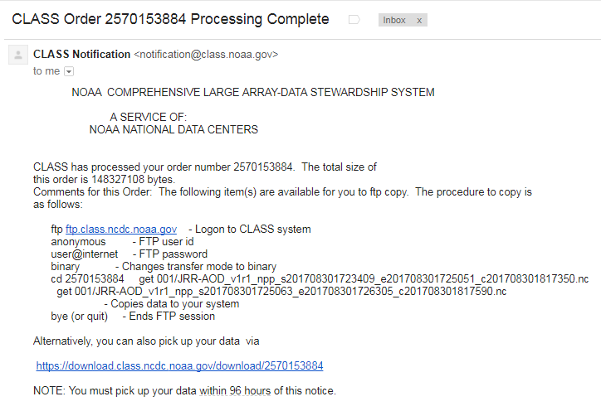
Ordering EPS AOD and ADP files from CLASS (https://www.class.ncdc.noaa.gov)
Once CLASS is done preparing your order you will receive an email from them with instructions on how to download the files.

