Slide 1
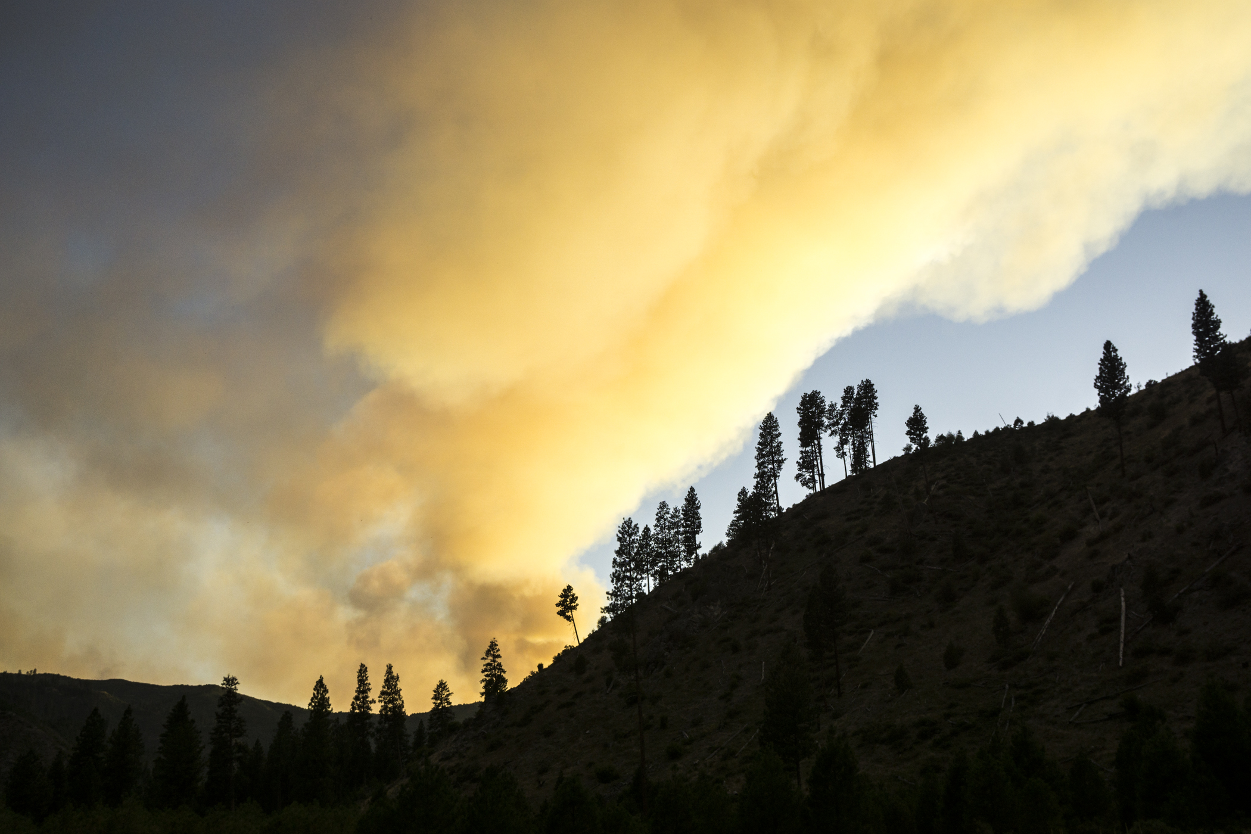



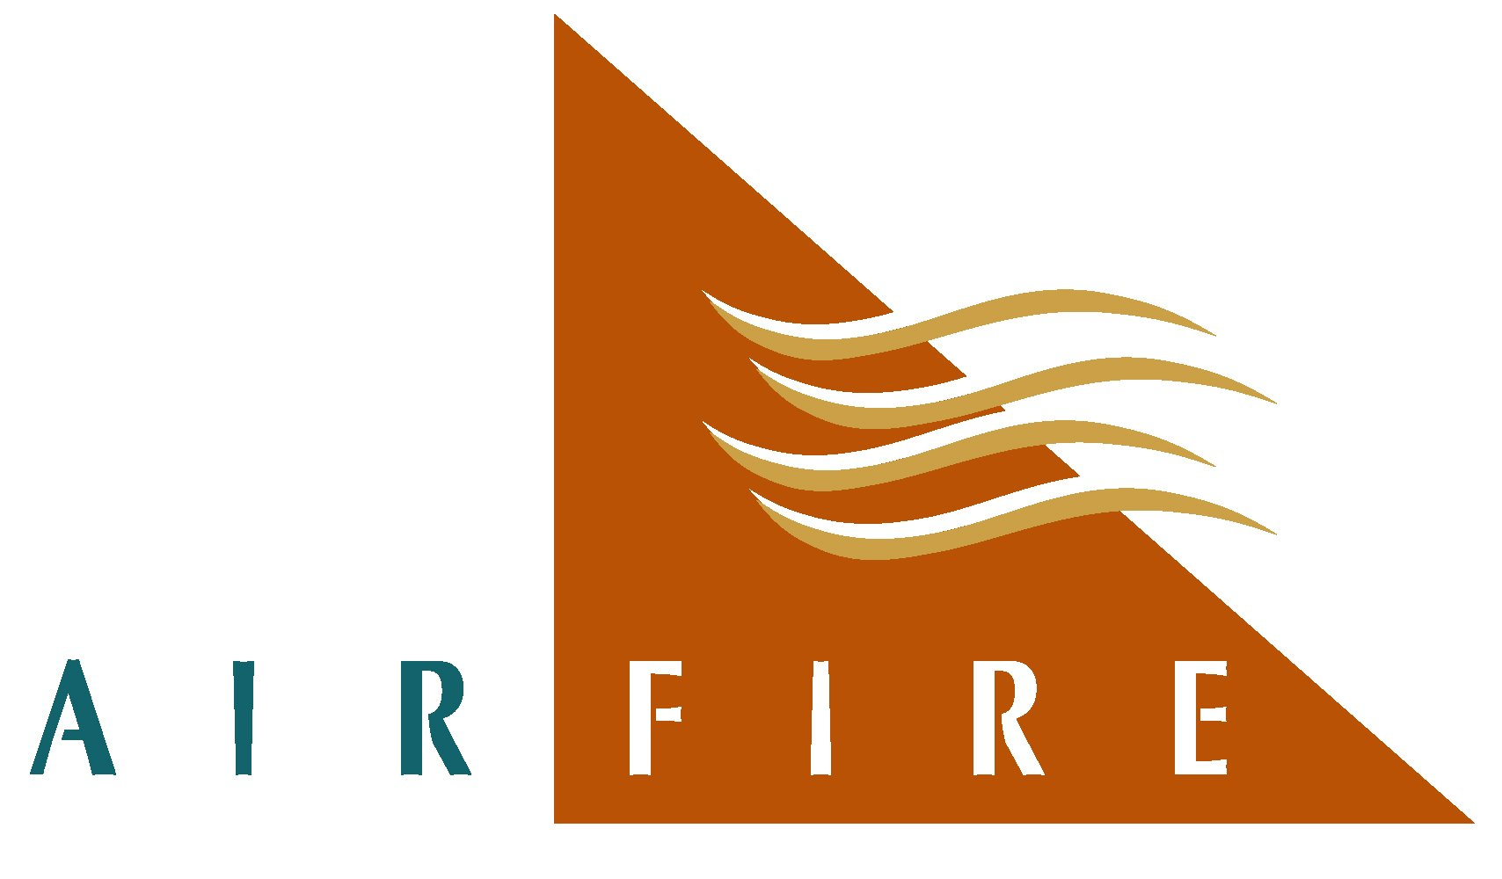
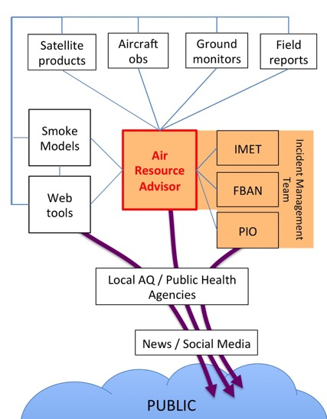
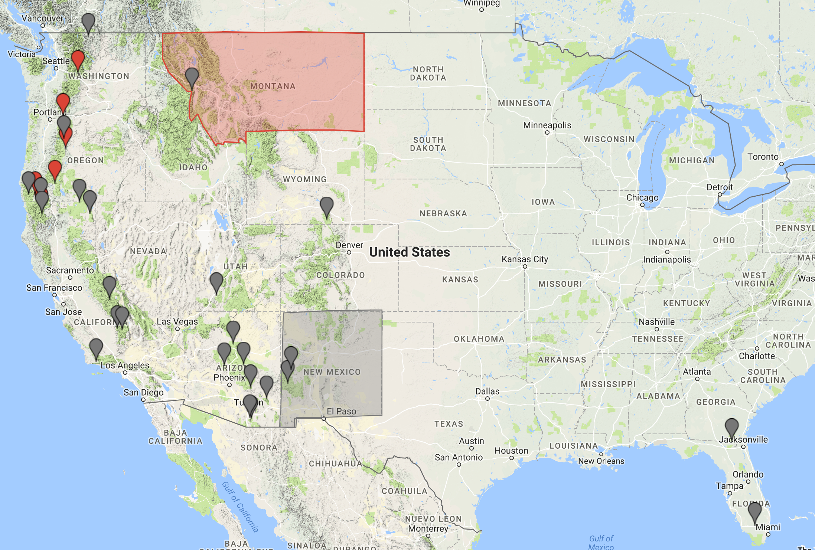
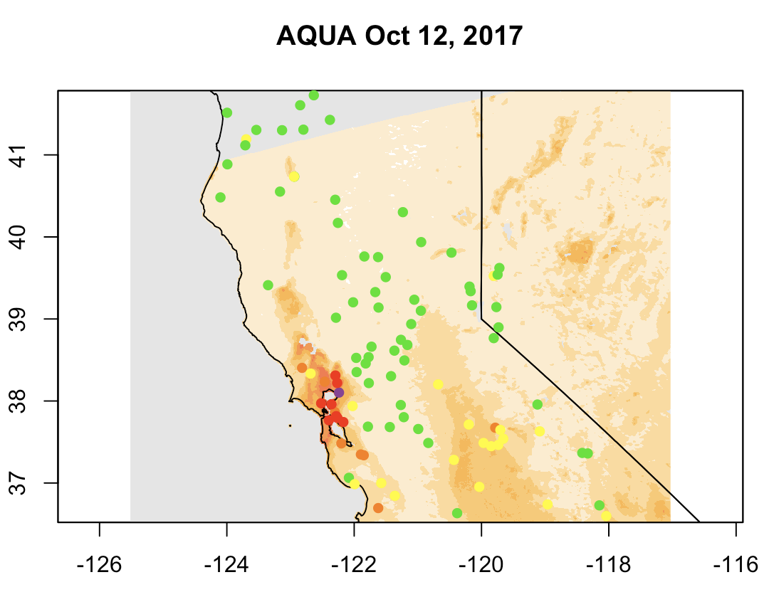
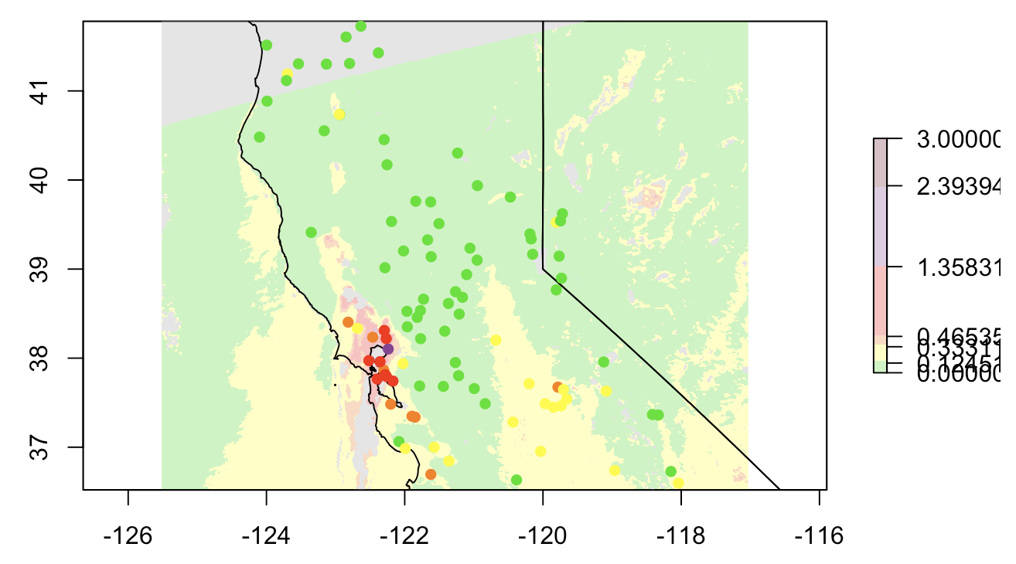
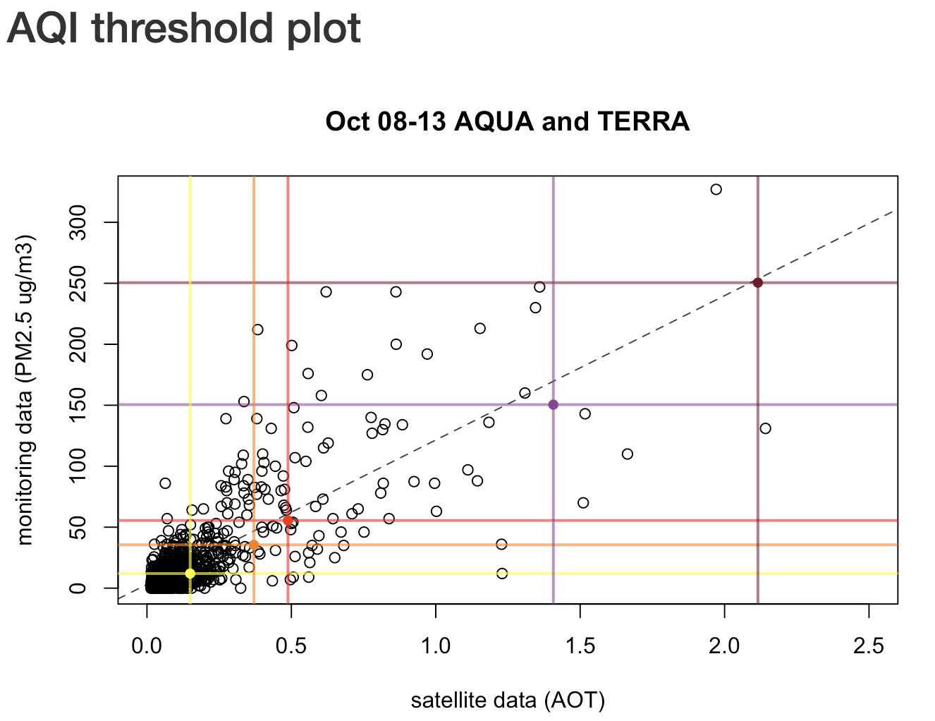
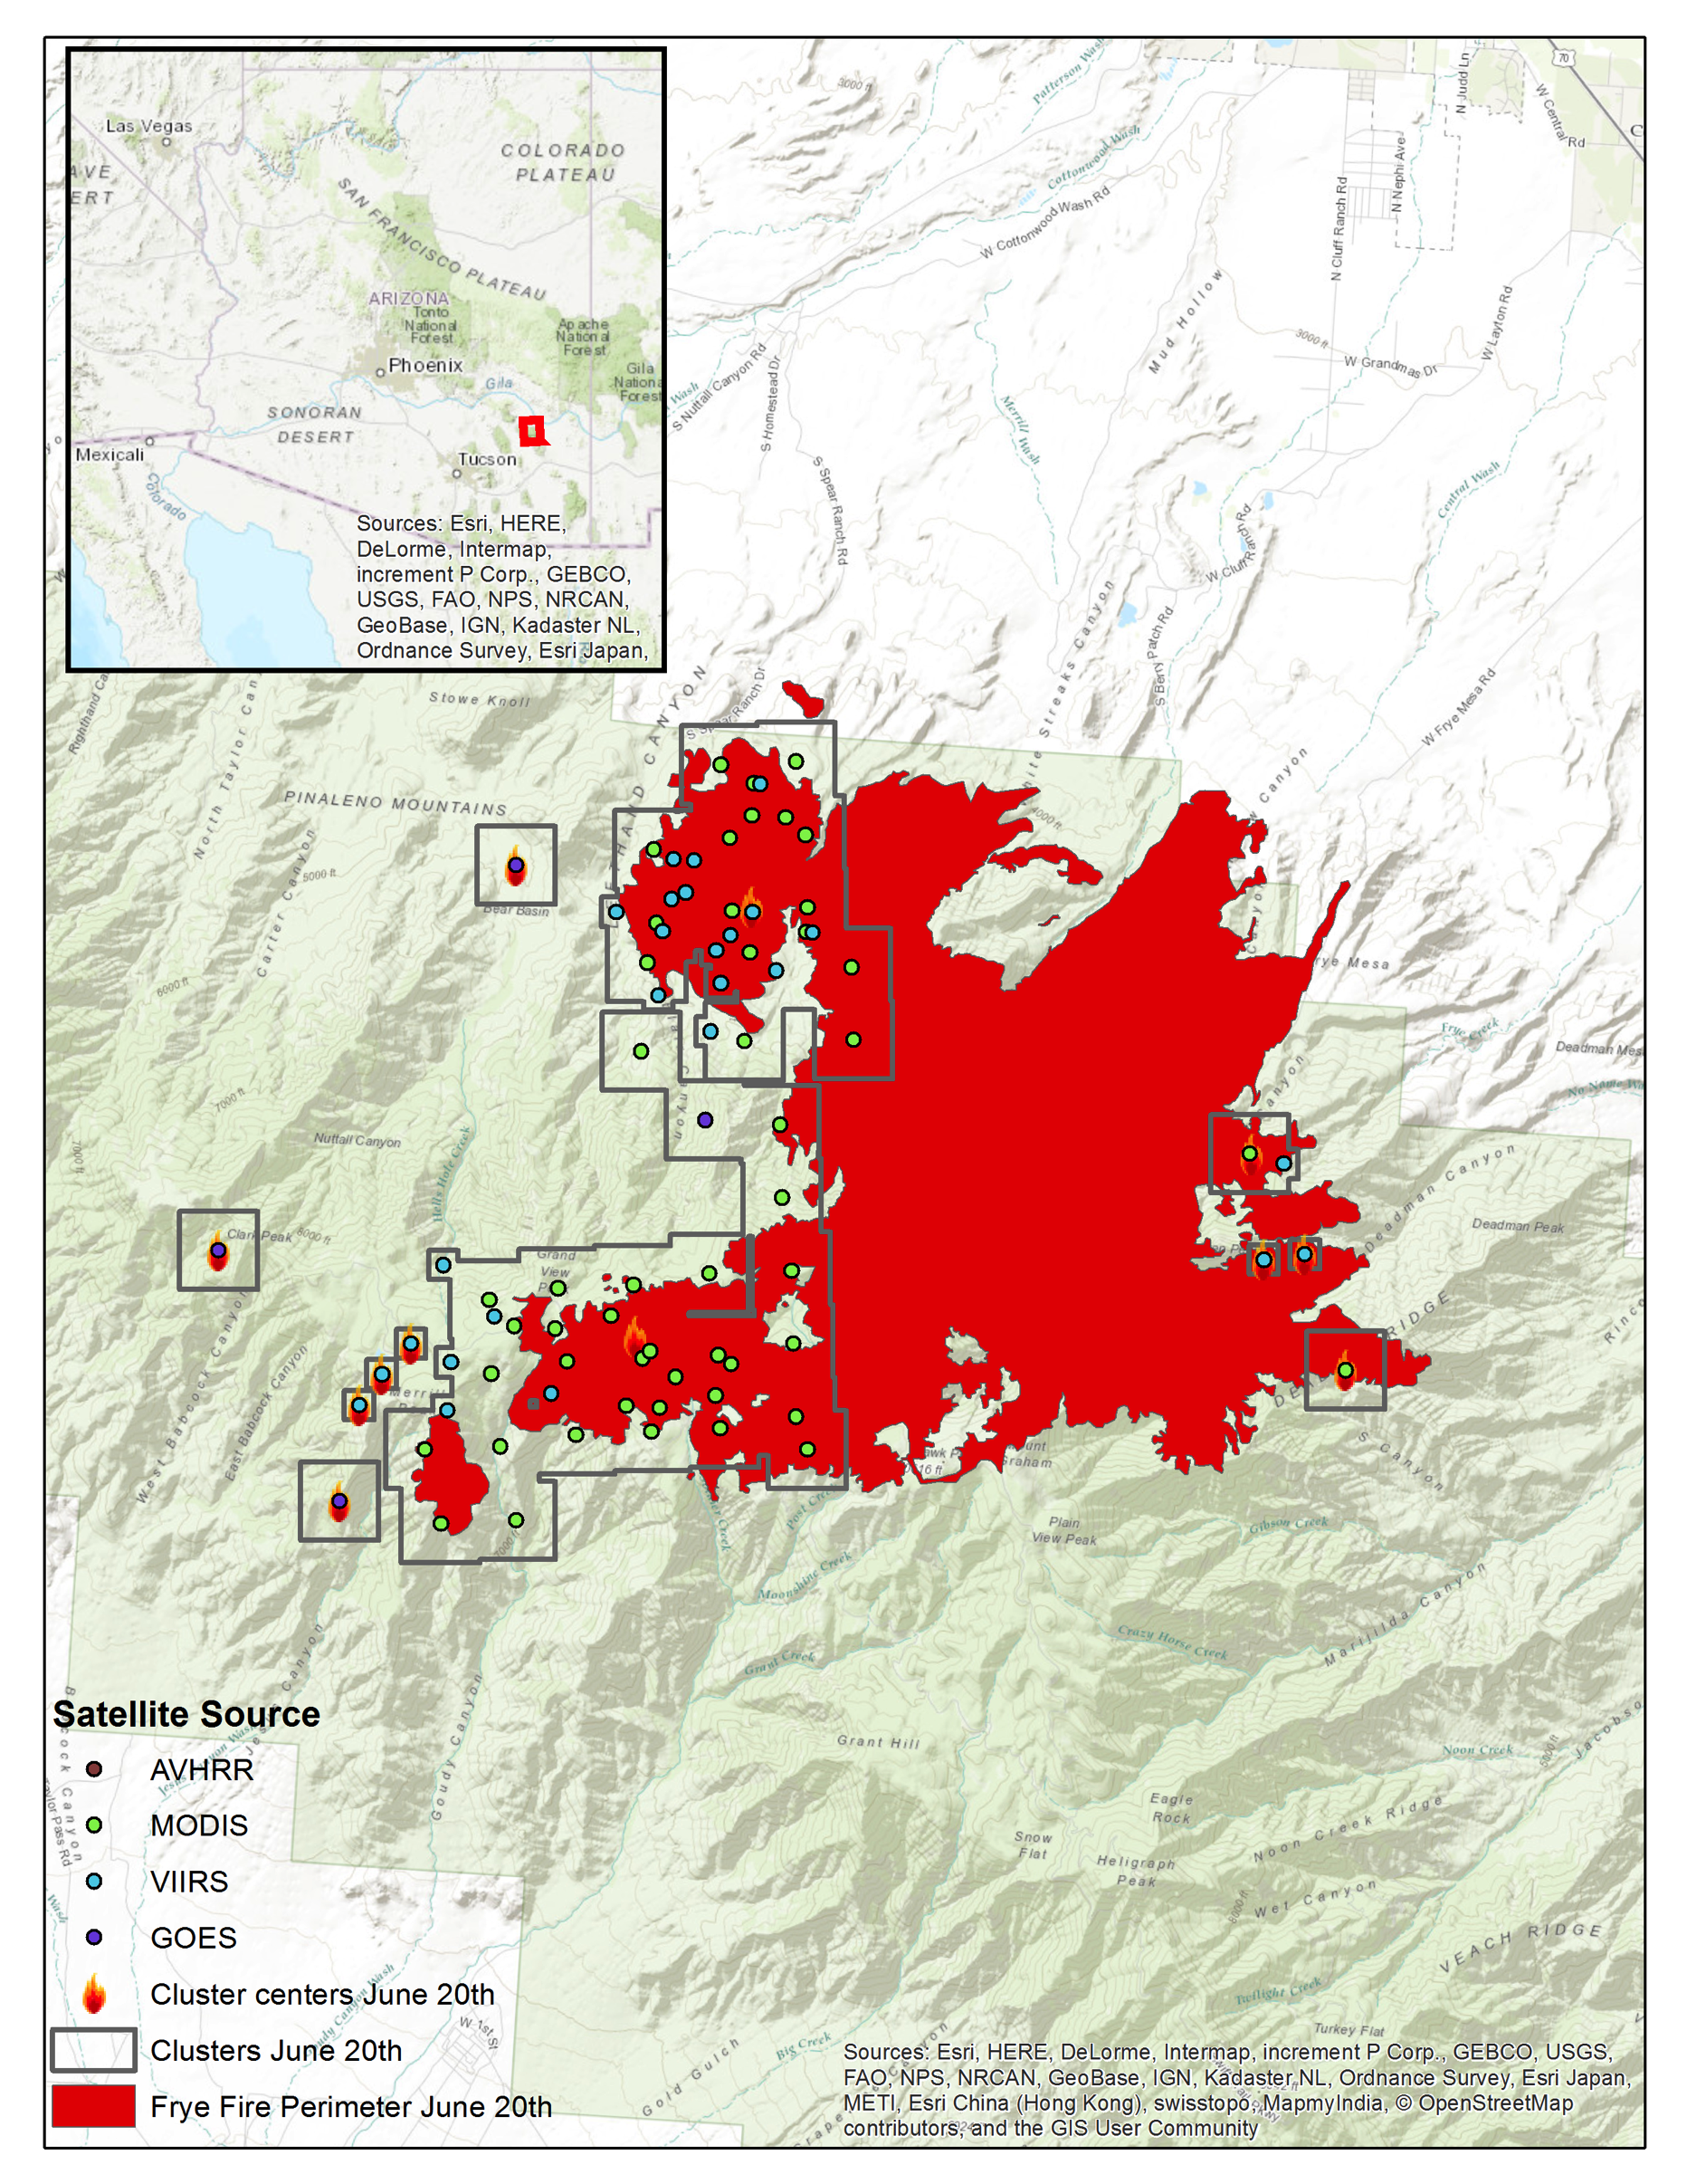
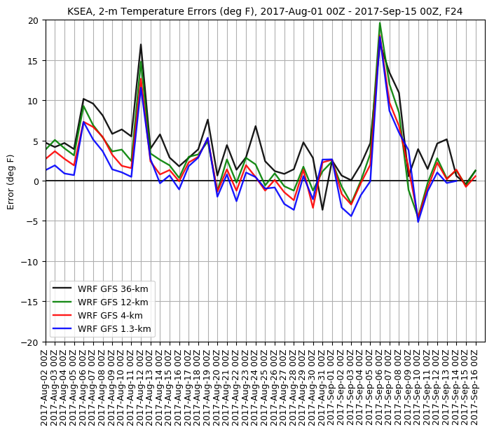
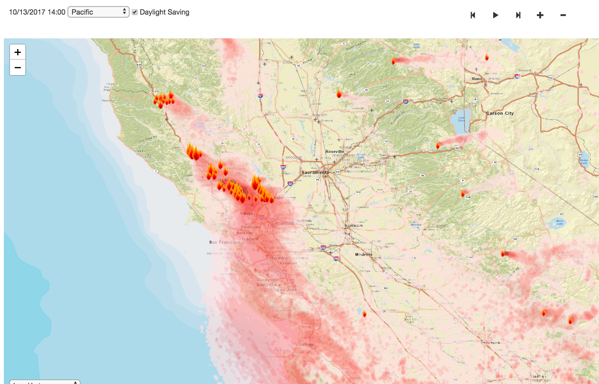
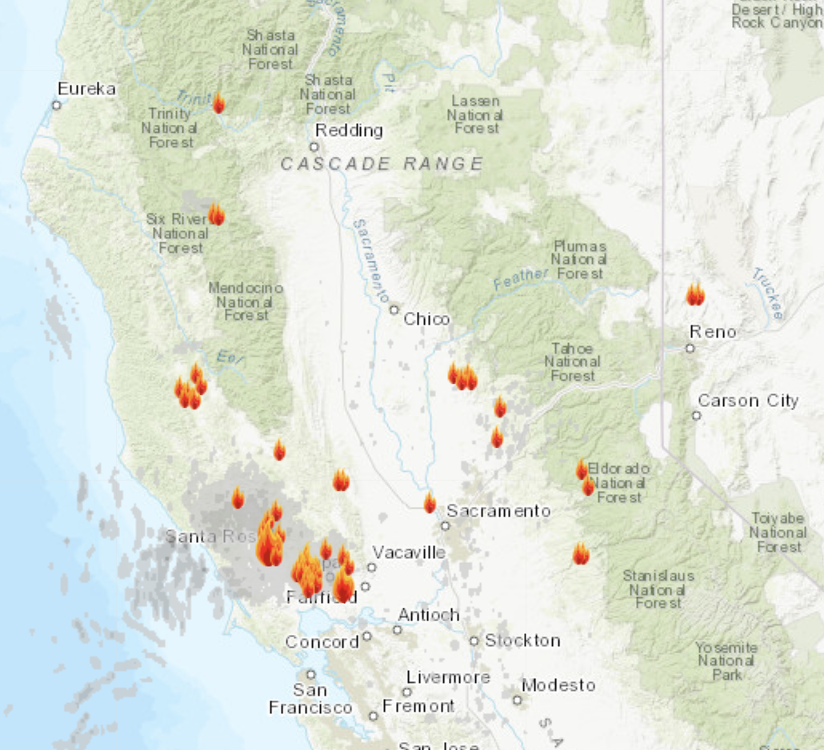
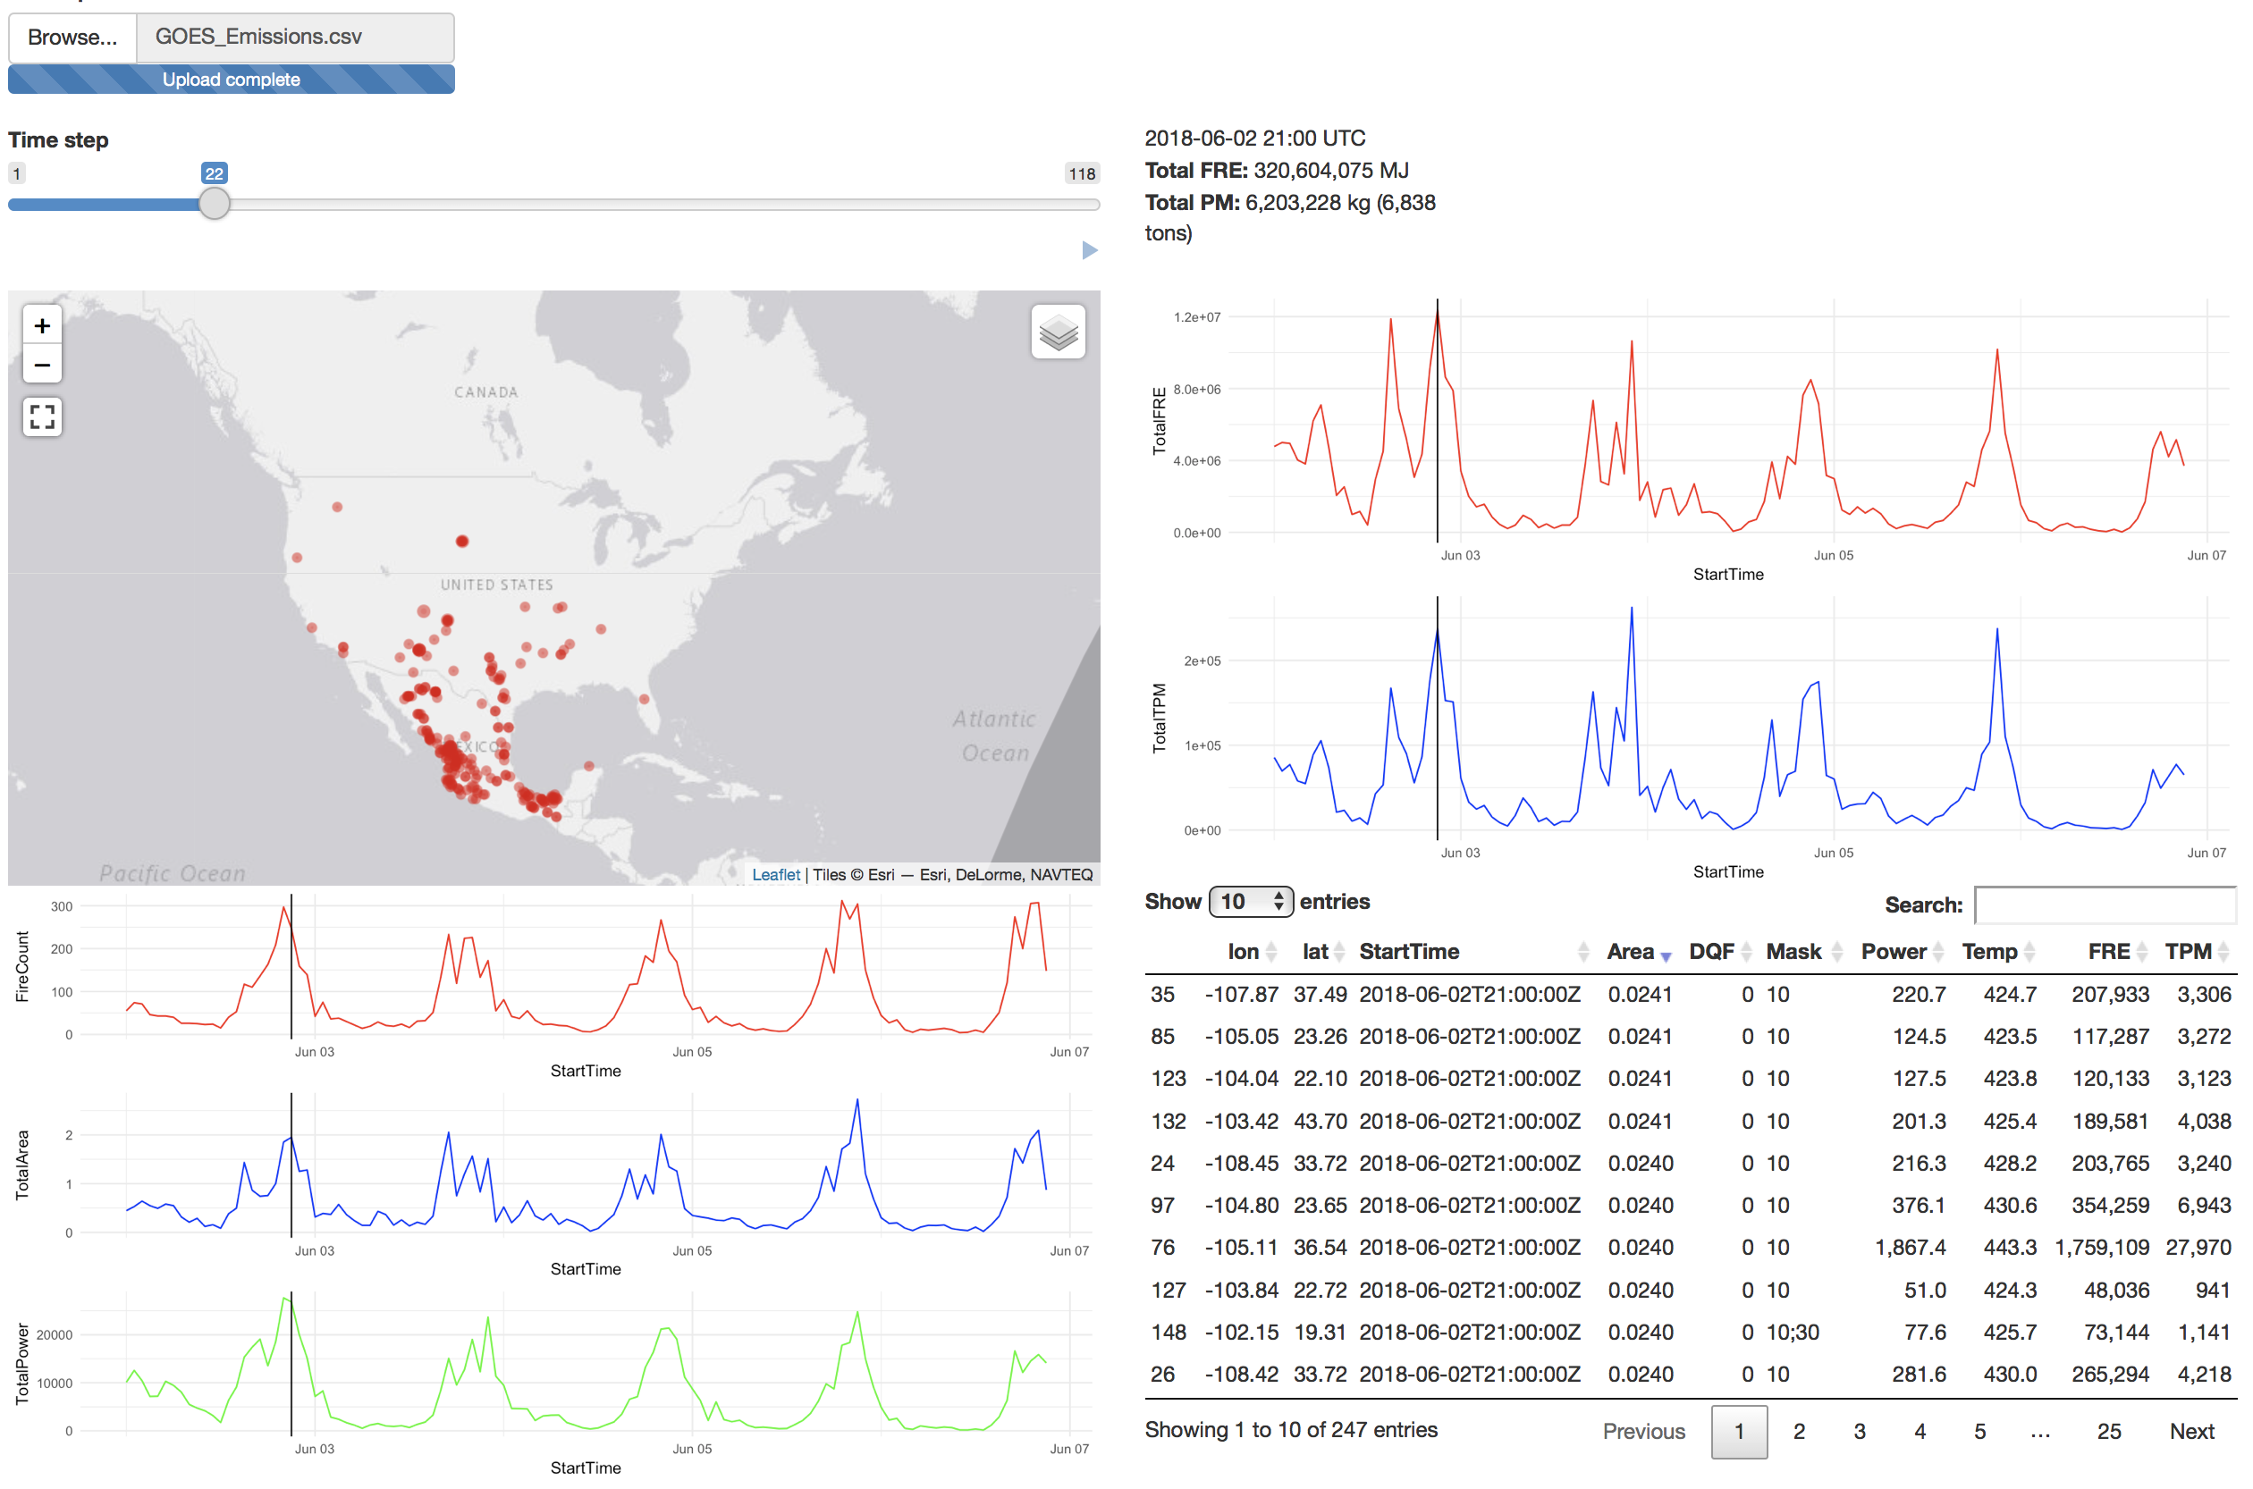

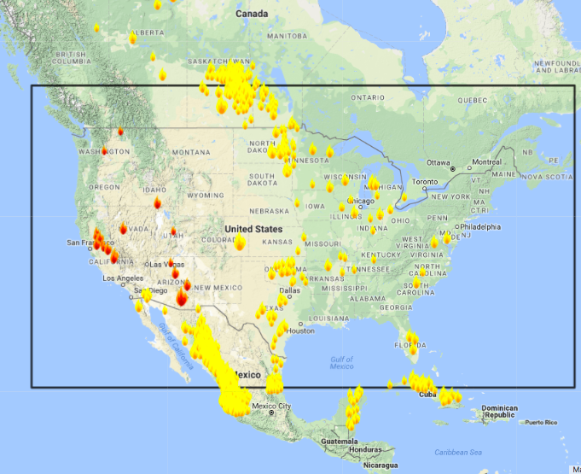
Satellite Products for Decision Support During Wildfire Smoke Episodes
– New Developments and Products for 2018 –
Susan O’Neill¹, Sim Larkin¹, Pete Lahm¹, Sean Raffuse⁴, Amy Marsha², Jonathan Callahan³, Hellen Miller³, Yufei Zou², Robert Solomon², Joel Dubowy², Gina Wing¹, Marlin Martinez², Miriam Rorig¹, David Askov²
¹USDA Forest Service, Seattle, WA, Washington DC
²University of Washington, Seattle, WA
³Mazama Science, Seattle, WA
⁴University of California, Davis, CA
Goal: Facilitate the adoption and use of earth observations into the decisions, communications and response of wildfire Incident Management Teams (IMT) and local public health and air quality agencies during wildfire smoke events.
Baseline Activities: (1) mine, analyze, synthesize, and deliver earth observations in tailored formats to Air Resource Advisors (ARAs) and health and air quality agencies; (2) enhance the use of earth observations for smoke model evaluation and validation; and (3) enhance the use of earth observations within the smoke prediction modeling chain.
Collaborators/Stakeholders
Wildland Fire Air Quality Response Program (WFAQRP)
National Oceanic and Atmospheric Administration (NOAA)
USDA Forest Service
US DOI National Park Service
Environment and Climate Change Canada
Natural Resources Canada
Smoke Blogs – Public
2017 WILDFIRE SEASON
DISSEMINATION OF SMOKE INFORMATION
MODIS: MAIAC AEROSOL OPTICAL THICKNESS – OCTOBER 2017 NORTHERN CALIFORNIA
WEB DELIVERY
1.4 million hits
144K hits, Sept 4, 2017
260,000 unique visitors
Substantial increase (greater than x2) over 2016
Health and Air Quality Agencies in: CA, OR, WA, ID, MT, NV, AZ, NM, CO, WY, FL, GA
GOES-16: REAL-TIME SMOKE FORECAST INITIALIZATION
VIIRS/MODIS/GOES Fire Activity
New clustering approach for retrospective studies
OMI NO2 Tiger Team
Canadian Fire Emissions (CWFIS, MODIS)
NASA GEOS – A SOLUTION FOR COUPLED SMOKE-METEOROLOGICAL IMPACTS
Problem: Dense smoke resulted in substantial cooling across PNW – not picked up in the WRF forecast modeling
FDC Product, 5-min CONUS
Variables: Fire Radiative Power, Fire Area, Fire Temperature, Smoke Mask, Data Quality Flag
Aggregate data to hourly
Fire Emissions:
1) Area/Location-based,
2) FRP-based (Ichoku et al.)
Potential Solution: GEOS 3-hr AOD initial conditions and forecast.
Implications for Smoke: Higher PM2.5 concentrations, some extended impacts, some not extended
Top to Bottom: 1) MAIAC AOT and EPA AIRNOWTech, 2-3) AOT/AQI threshold relationship, 4) 1-hr PM2.5 Concentrations, BlueSky near-surface 1-hr PM2.5 concentrations.
University of Washington: Cliff Mass, David Ovens
Photo Andrea Holland
Notes:
MAIAC AOT Agua 2016, day of year 210 (July 28), 2045 GMT (1345 PDT)

