Slide 1
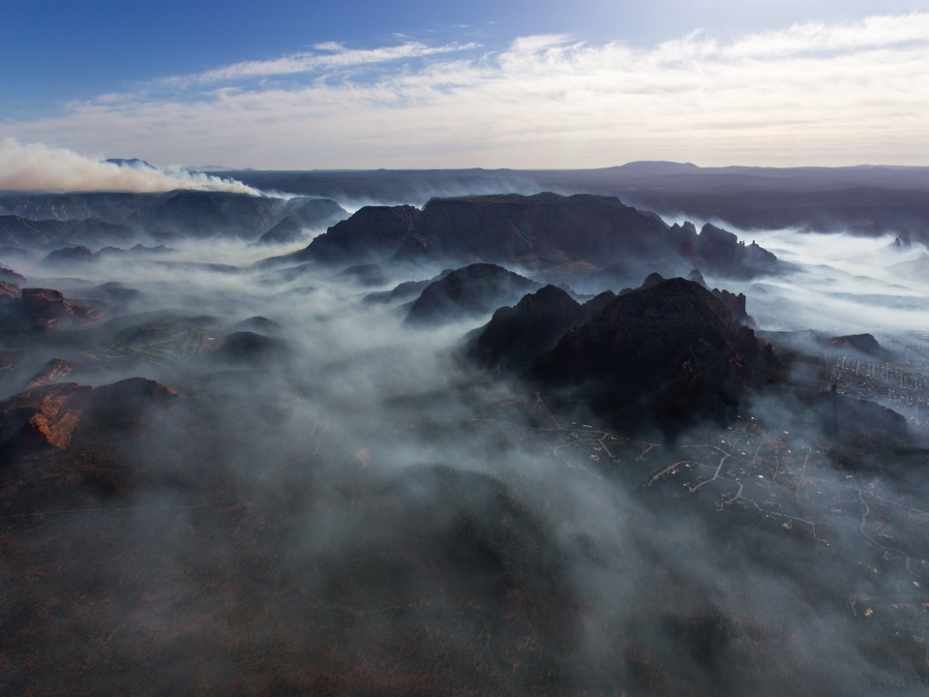

Smoke Tools and Information for Prescribed Fire and Wildfire
Susan O’Neill, AirFire Team
USDA Forest Service, PNW Research Station
Photo – Ted Grussing

Slide 2
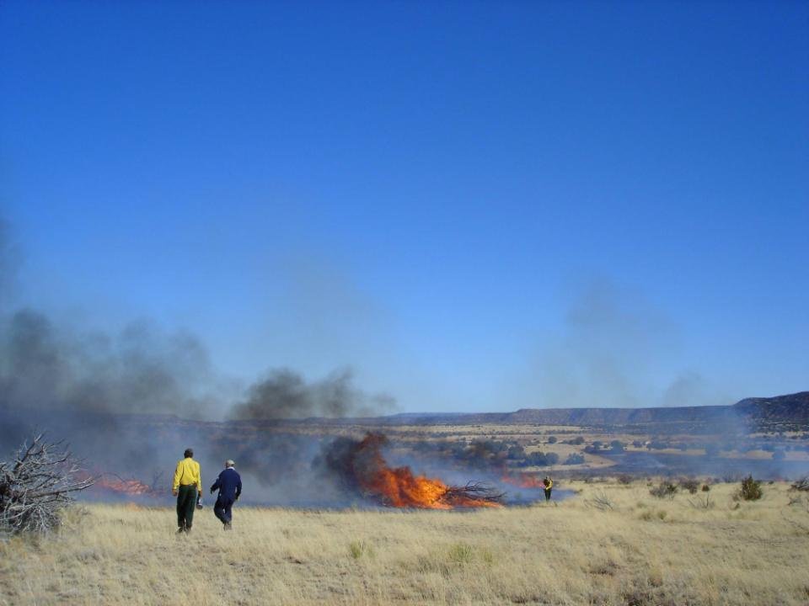
Overview
Smoke Forecasting Systems
  Details of the BlueSky Smoke Modeling Framework
  Others: NOAA, HRRR-Smoke, AIRPACT, Canada Firework, Canada BlueSky
Monitoring Data Tool
Satellite Data
Wildland Fire Air Quality Response Program (WFAQRP) and Air Resource Advisors (ARA’s)
Do your own Smoke Modeling

Slide 3
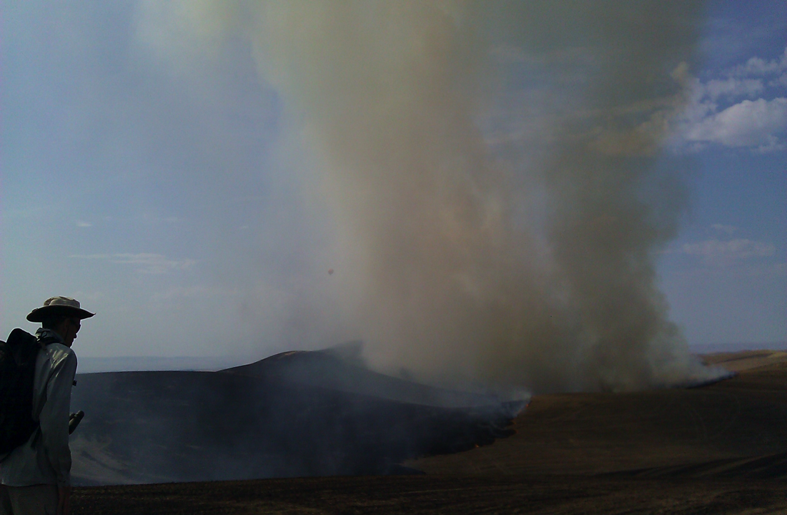
Smoke Forecasting Systems
BlueSky Daily Operational Runs
http://www.airfire.org/data/bluesky-daily/
AIRPACT – Northwest US
http://lar.wsu.edu/airpact/
High Resolution Rapid Refresh (HRRR) – Smoke
https://rapidrefresh.noaa.gov/hrrr/HRRRsmoke/
NOAA Air Quality
http://www.nws.noaa.gov/airquality/ww.shtml
Firework – Canada
https://weather.gc.ca/firework/index_e.html
BlueSky – Canada
http://firesmoke.ca/
“Picking a model of choice for the day is a little like speed-dating: too little time/information to make up the mind leading to regrets by the end of the date/shift.”
- Wes Adkins, Meteorologist, National Weather Service, Juneau, AK
Notes:
Links in Lesson Plan

Slide 4
BlueSky Smoke Modeling Framework
Components to Calculating Fire Emissions
Fire
Info
Meteorology
SMARTFIRE2
NOAA HMS
GEOMAC
IRWIN
Rx Sys
Manual
Other
WRF
MM5
NARR
Station data
Fuels
FCCS
FCCS-LF
NFDRS
Hardy
GVDS
LANDFIRE
Ag
Other
Total Consumption
CONSUME
FOFEM
FEPS
FLAMBE
FINN
Other
Time
Rate
Rx / WF
FEPS
FOFEM
EPM
WRAP
Other
Emissions
FEPS
Literature
EPM
FOFEM
FLAMBE
FINN
Other
Plume
Rise
Briggs
FRP
Other
Smoke Modeling
HYSPLIT,
CMAQ, VSMOKE
GEM-MACH

Slide 5
Fire
Info
Meteorology
Fuels
Total Consumption
Time
Rate
Emissions
Plume
Rise
Large uncertainties exist with each modeling step
Smoke Modeling

Slide 6
Reality
Reality
Fire
Info
Fire
Info
Fuels
Fuels
Total Consumption
Total Consumption
Time
Rate
Time
Rate
Emissions
Emissions
Plume
Rise
Plume
Rise
Dispersion /
Trajectories
Dispersion /
Trajectories
right answer, wrong reasons
right answer, right reasons

Slide 7
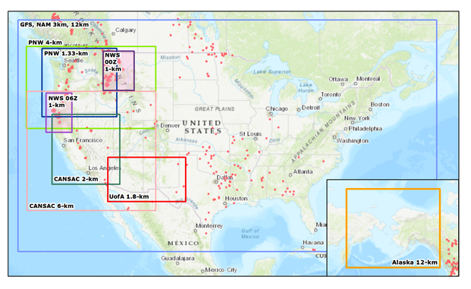
Tailored Smoke Predictions Delivered to Incident Management Teams
Domains
  2-km CA/NV
  6-km Western US
  1.33-km WA/ID
  4-km PNW
  12-km CONUS
  12-km Alaska
  3-km CONUS
  1.8-km AZ/NM
  1-km FW (moveable)
Partnerships: NWS, UW, DRI, UofA
HYSPLIT – Primary near-surface 1-hr PM2.5
Notes:
Partnerships!

Slide 8
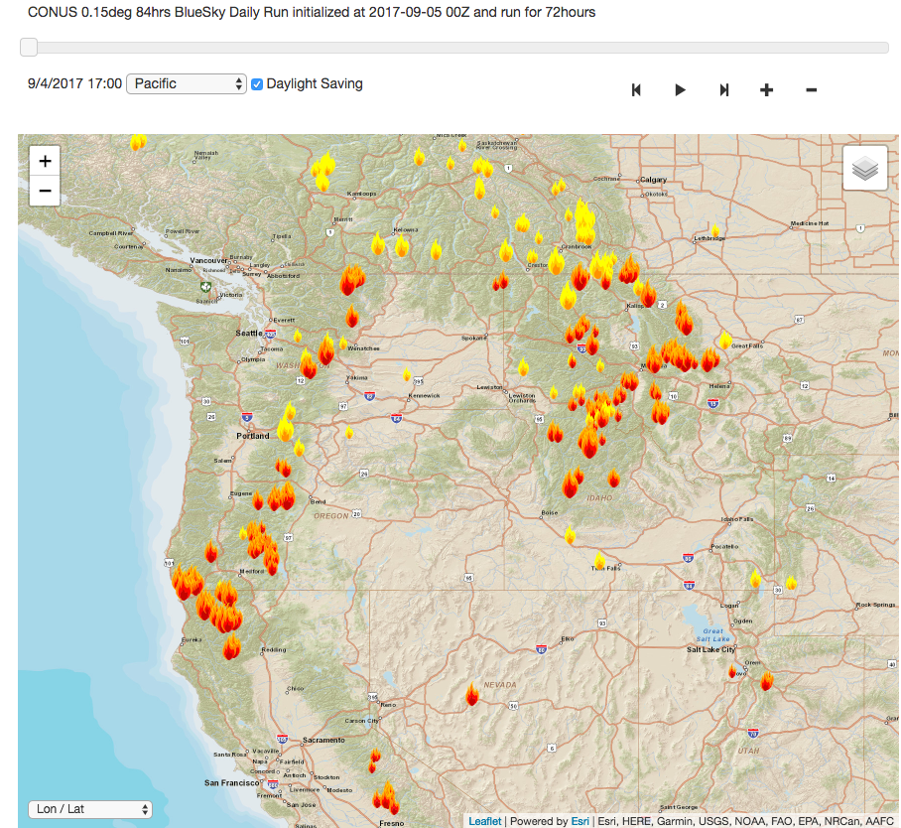
Tailored Smoke Predictions Delivered to Incident Management Teams
Fire Activity Information
NOAA Hazard Mapping System (HMS) Satellite Fire Detections
SmartFire v2 (SF2) augments (fire type, fire size, aggregation)
Notes:
Partnerships!

Slide 9
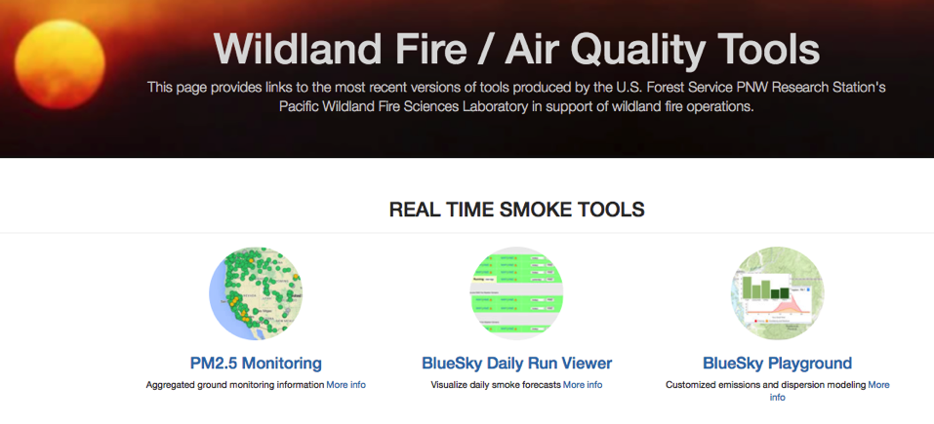
Tools for Wildfire and Rx Fire Smoke https://tools.airfire.org/

Slide 10
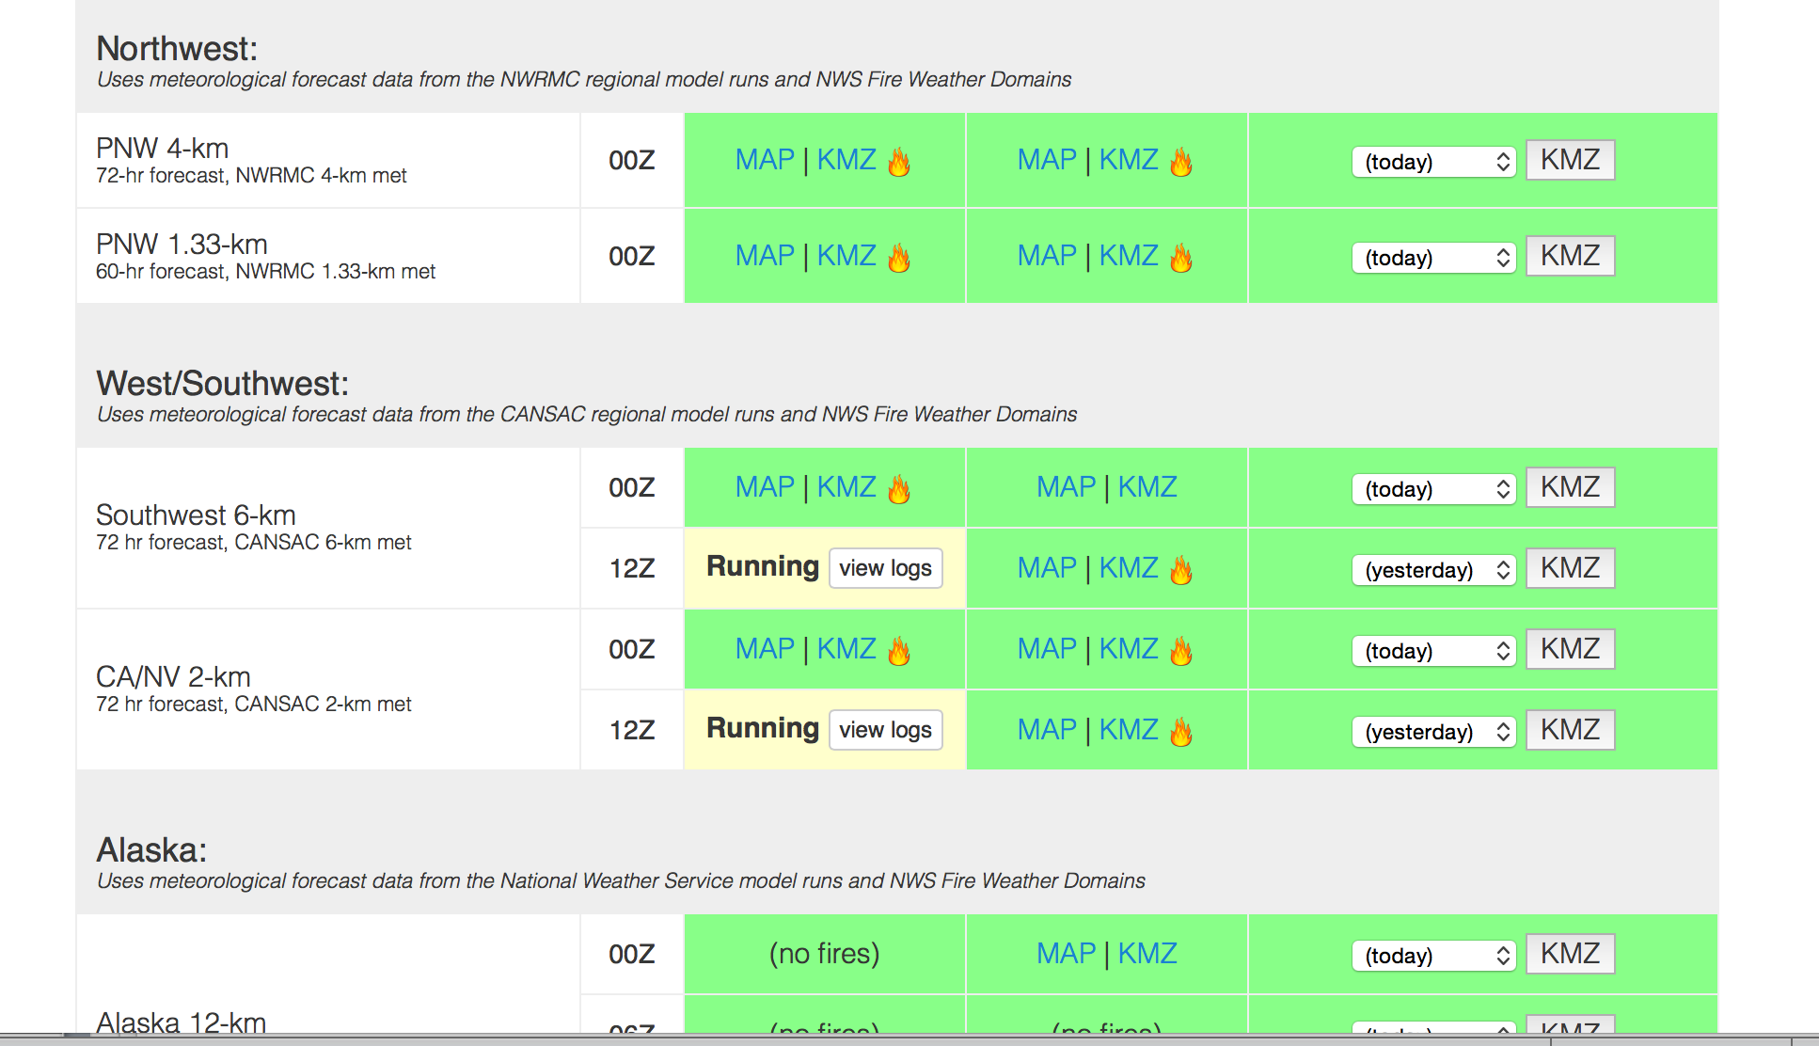

http://www.airfire.org/data/bluesky-daily/
Number of Fires
Running (click on “view logs” for run progress)
Successful!
Failures show up in red.
Website shows status of current runs
Notes:
12 domains per day, 6 are run twice a day (00Z, 12Z) – 18 hysplit particle runs. Many puff runs too.
This does not include custom runs.

Slide 11
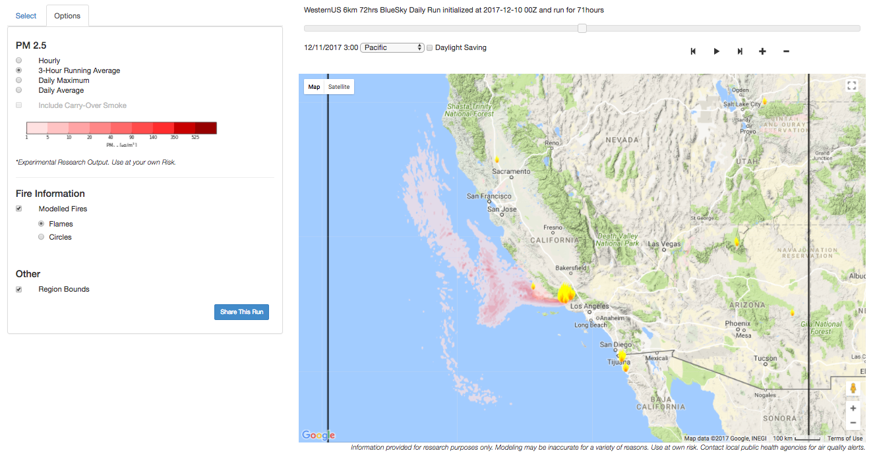
Daily BlueSky Production Runs
12/10/2017 Satellite Fire Detections & PM2.5, 6-km http://www.airfire.org/data/bluesky-daily/

Slide 12
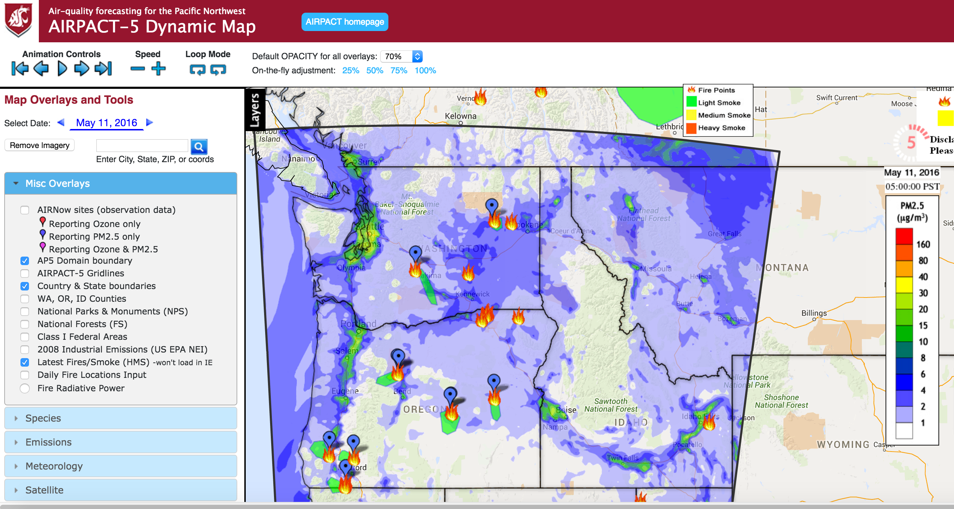
AIRPACT – Northwest
CMAQ
4-km
72-hours
Ozone, PM2.5
BlueSky Fire Emissions

Slide 13
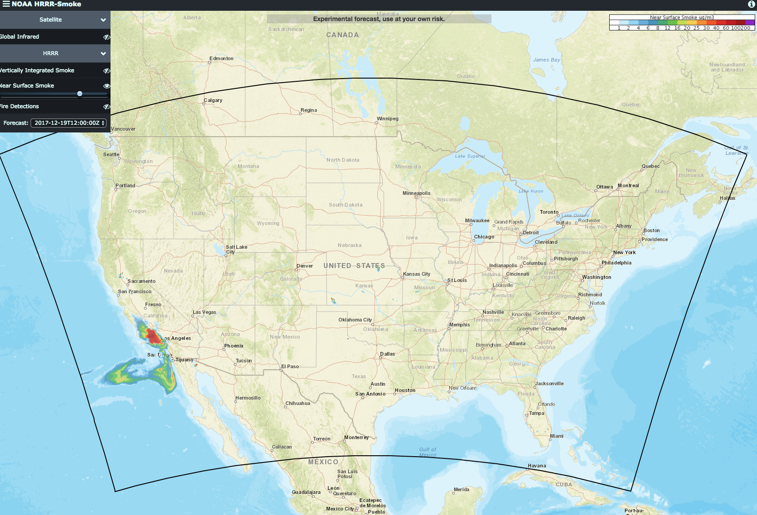
NOAA HRRR-Smoke
(High Resolution Rapid Refresh)
Coupled Meteorology/Smoke (WRF-Chem)
3-km, CONUS, Alaska
Primary PM2.5
Visible Infrared Imaging Radiometer Suite (VIIRS)
  fire activity
  fire radiative power (FRP)
Plume Rise – FRP
Emissions – FRP
00Z, 06Z, 12Z, 18Z
36-hrs
https://rapidrefresh.noaa.gov/hrrr/HRRRsmoke/

Slide 14
HRRR-Smoke Near-Surface PM2.5

Slide 15
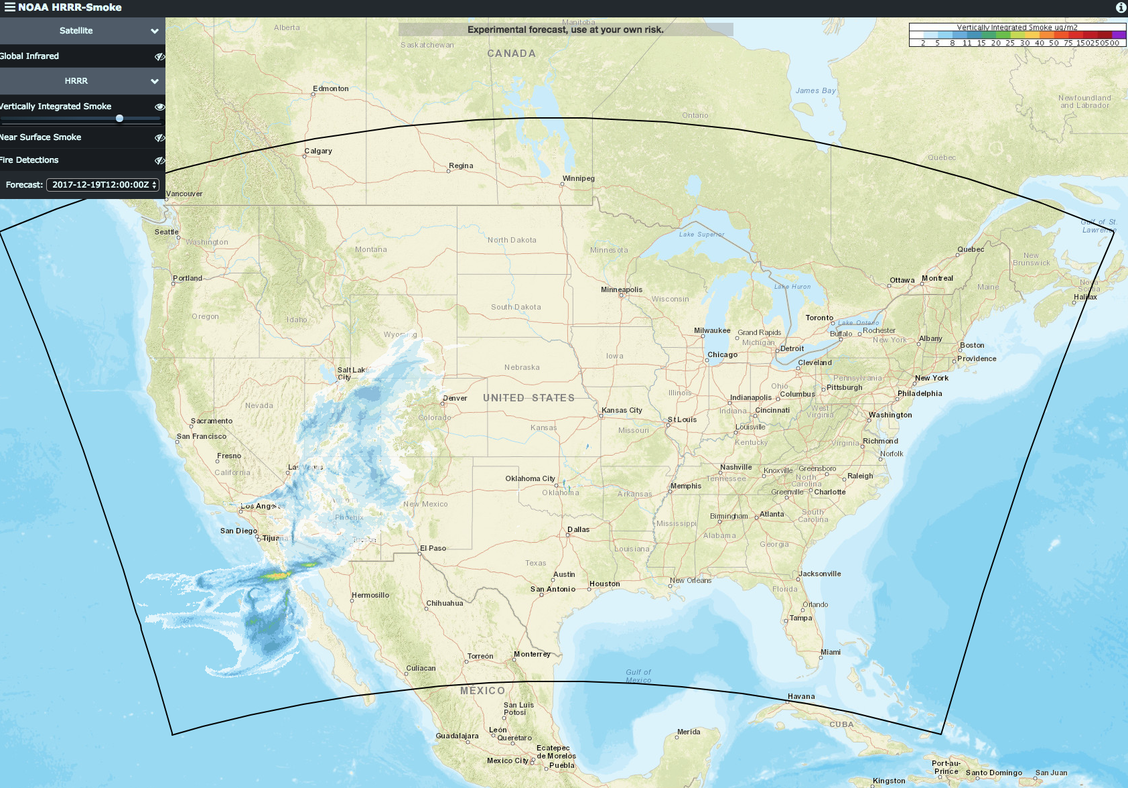
HRRR-Smoke Vertically Integrated PM2.5

Slide 16
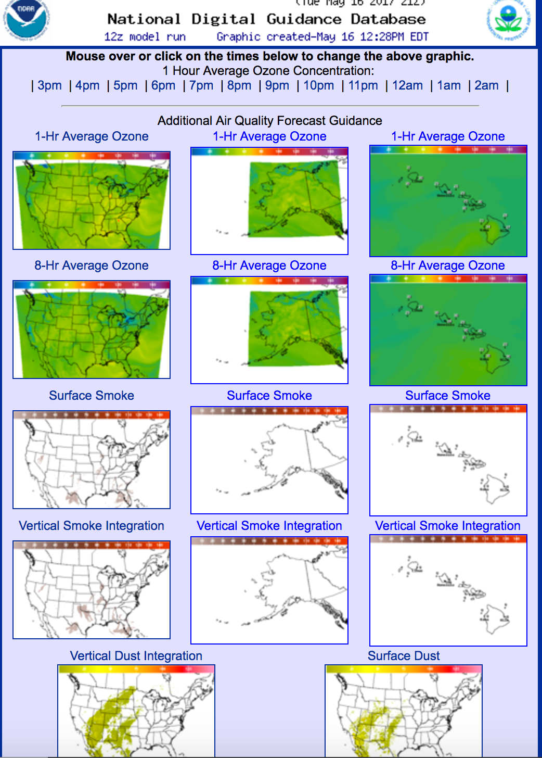
National Weather Service
HYSPLIT
CMAQ
Ozone, PM2.5
12-km
84-hours
BlueSky Fire Emissions

Slide 17
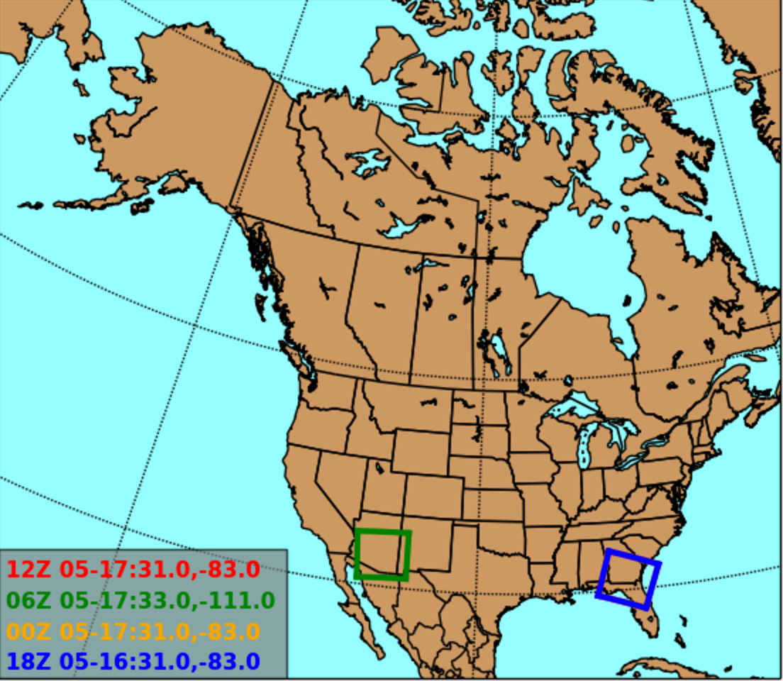
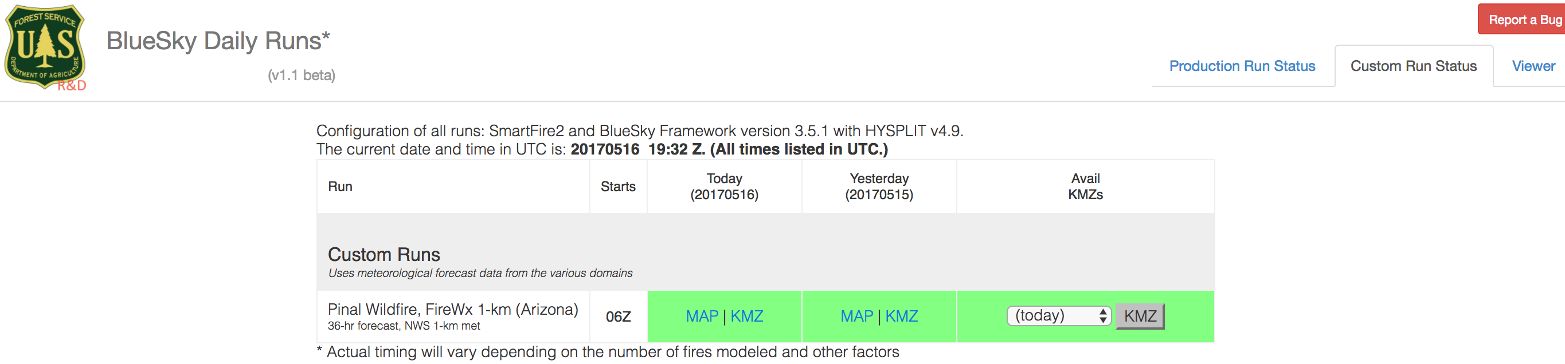
National Weather Service Fire Weather 1.27-km Domains
00Z, 06Z, 12Z, 18Z
36-hr
Custom BlueSky Runs - 2-hr setup
Meteorological Products available with the NWS 1km Domains
  http://www.emc.ncep.noaa.gov/mmb/mmbpll/firewx/

Slide 18
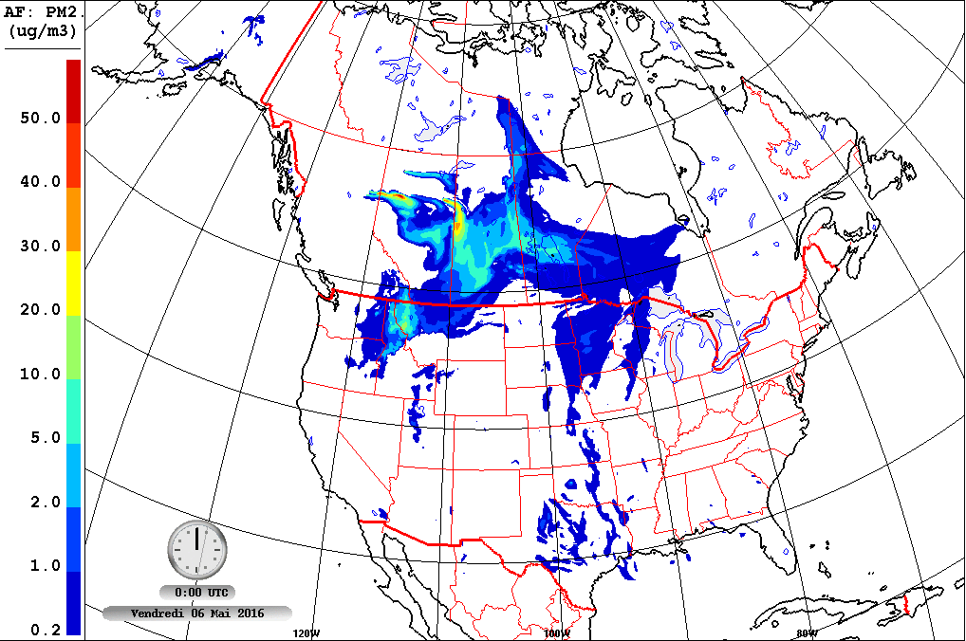

Firework – Canada
GEM-MACH
10-km
48-hrs
PM2.5 from only fires
CWFIS – Canadian Emissions
BlueSky – US Emissions
North America
Notes:
GEM-MACH Air Quality Model
00Z, 12Z
Using CWFIS and BlueSky for fire emissions
Ozone too, but that is not publically available

Slide 19
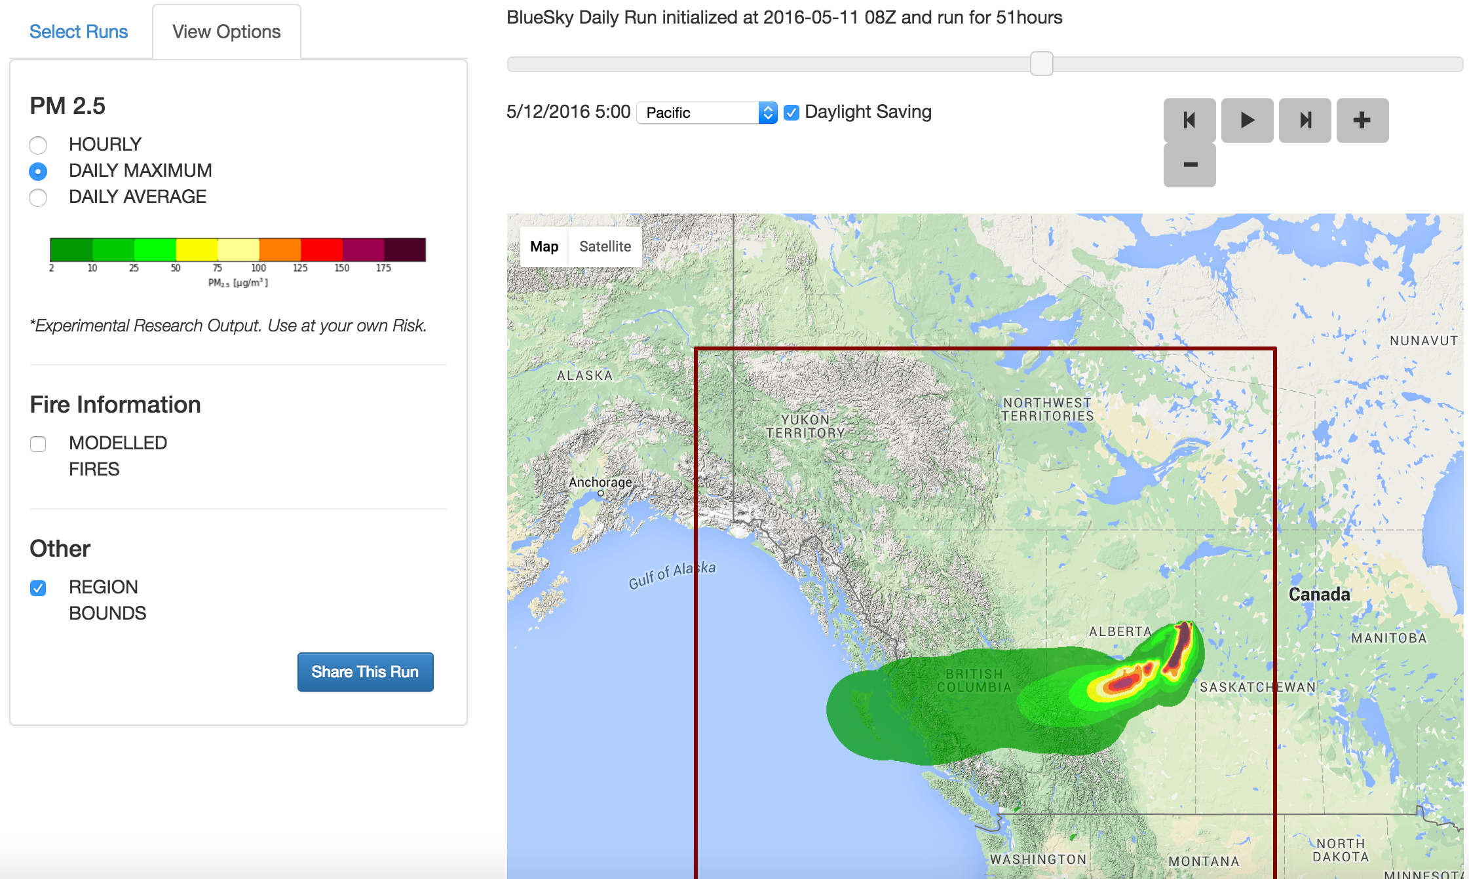

BlueSky Canada
BlueSky – Emissions and HYSPLIT
4-km, 12-km
48-hrs
CWFIS – Canadian Emissions
PM2.5 from fires
Notes:
12km national,
4km – west and east
HYSPLIT puff mode
00Z, 12Z

Slide 20
Smoke Monitoring Tool (Permanent and Temporary Monitors) https://tools.airfire.org/

Slide 21
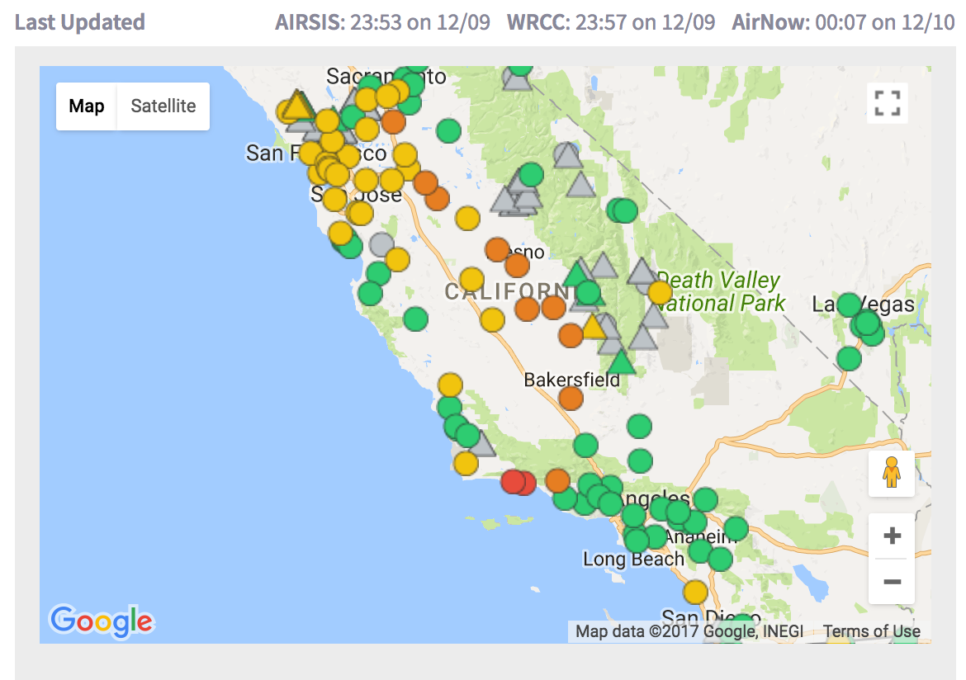
Monitoring Data Tool – Real-time PM2.5 Permanent and Temporary Monitors
https://tools.airfire.org/
Notes:
Data as of 20171210 8am PST

Slide 22
Monitoring Data Tool – Real-time PM2.5 Permanent and Temporary Monitors
https://tools.airfire.org/
Notes:
Data as of 20171210 8am PST

Slide 23
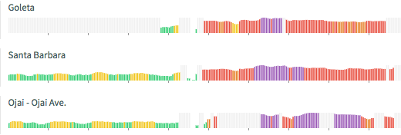
Monitoring Data Tool – Real-time PM2.5 Permanent and Temporary Monitors
https://tools.airfire.org/
Notes:
Data as of 20171210 8am PST

Slide 24
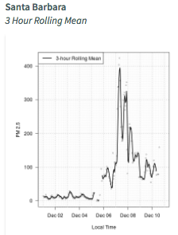
Monitoring Data Tool – Real-time PM2.5 Permanent and Temporary Monitors
https://tools.airfire.org/
Notes:
Data as of 20171210 8am PST

Slide 25
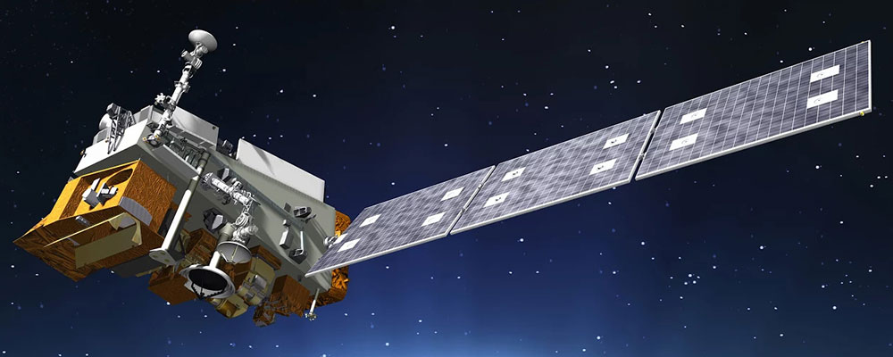
Satellite Information
Infusing Satellite Data into Environmental Applications (IDEAS)
https://www.star.nesdis.noaa.gov/smcd/spb/aq/
Enhanced Infusing Satellite Data into Environmental Applications (eIDEAS)
https://www.star.nesdis.noaa.gov/smcd/spb/aq/eidea/index.php
GOES-16
http://rammb-slider.cira.colostate.edu/
NASA Worldview
https://worldview.earthdata.nasa.gov/
Stay tuned for more
  GOES-16 Launched 11/2016 – in GOES East Position
  NOAA-20 Launched 11/18/2017
  GOES-S Launched 03/2018 – will be GOES-17 in GOES-West Position
Notes:
eIDEAS training video: https://www.youtube.com/watch?v=ctaLtcbJ6YY&feature=youtu.be

Slide 26
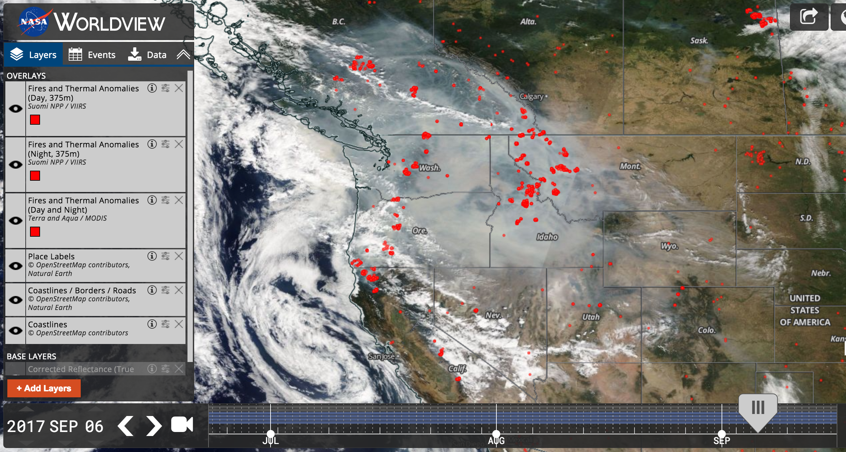
NASA WORLDVIEW

Slide 27
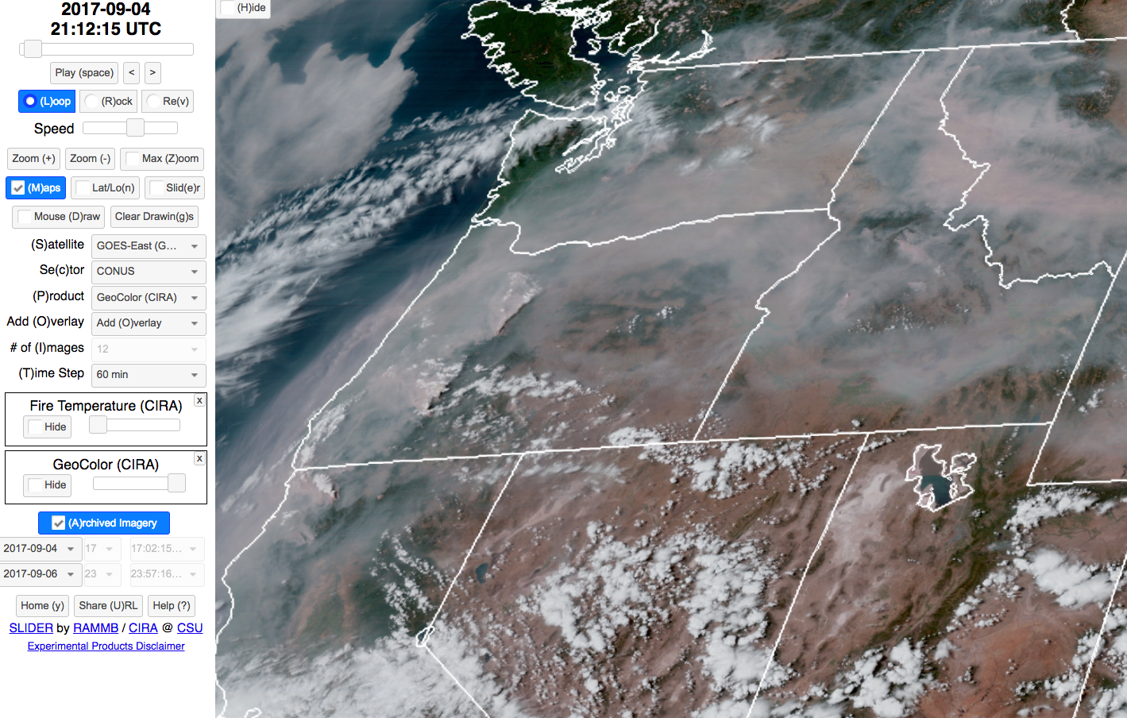
GOES-16 9/4/2017 14:12 PDT

Slide 28
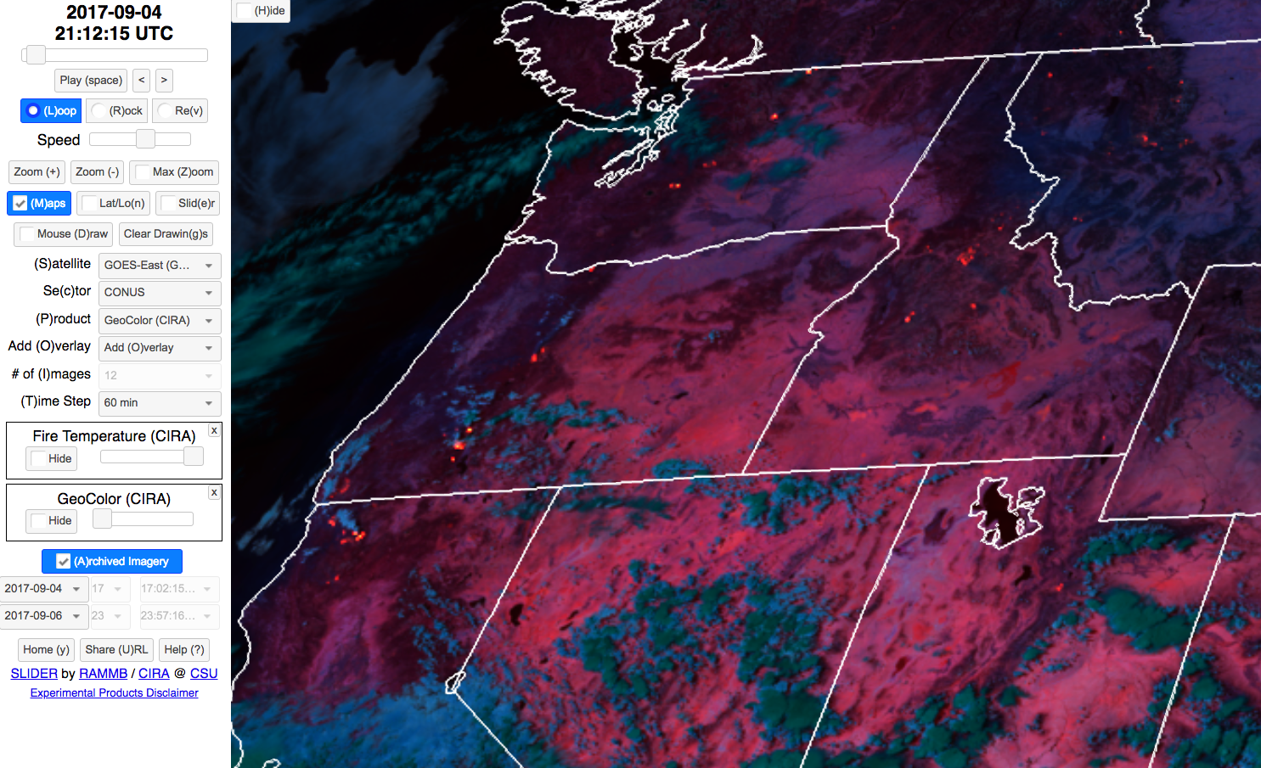
GOES-16 9/4/2017 14:12 PDT

Slide 29
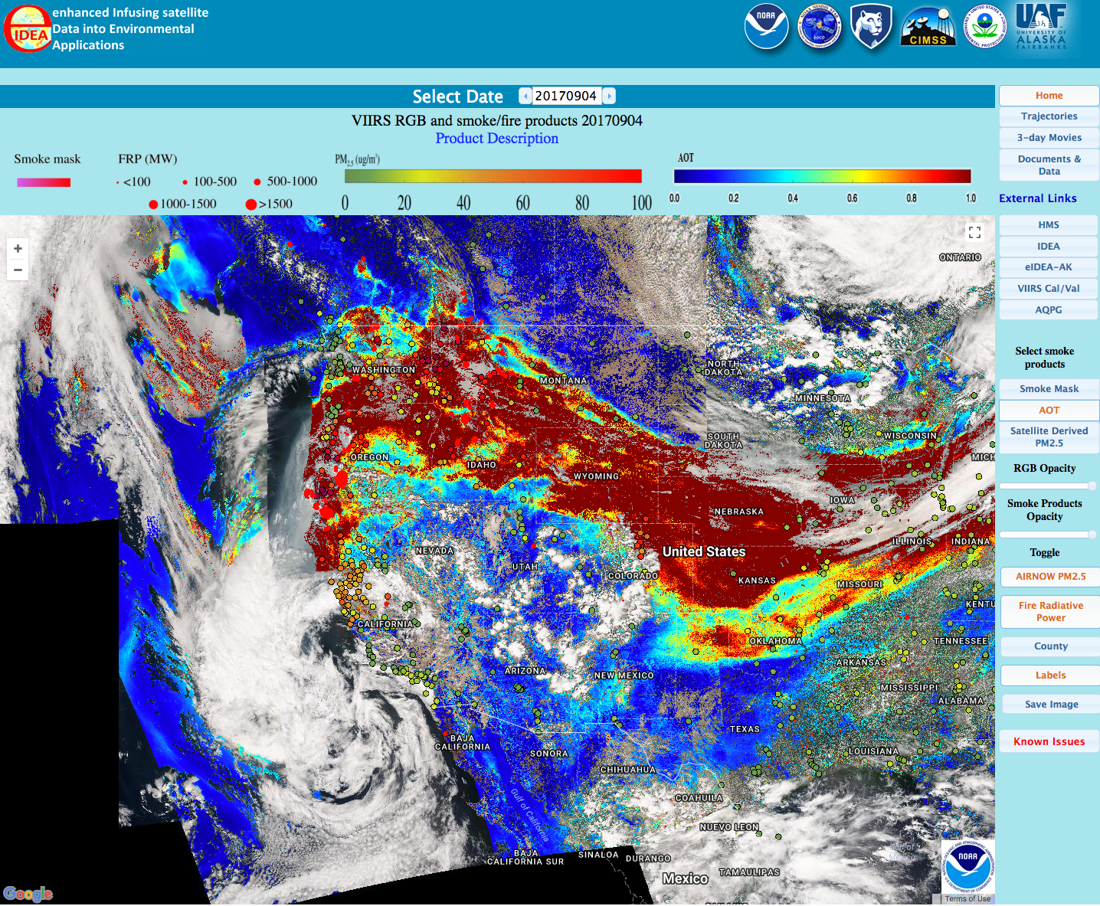
Enhanced Infusing Satellite Data for Environmental Applications (eIDEAS)

Slide 30
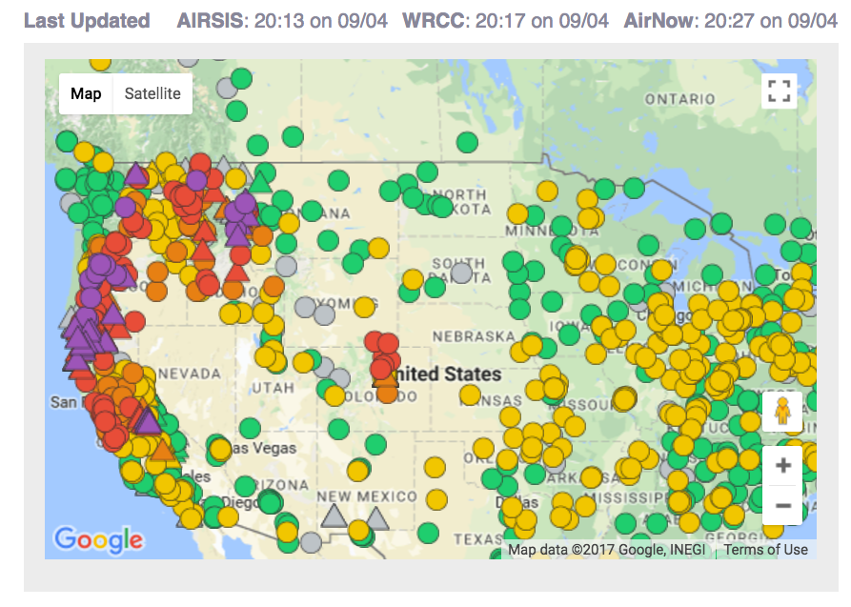
Notes:
TODO: get GOES-16, do a CANSAC-2km analysis, 2017090300, 2017090312, 2017090400

Slide 31
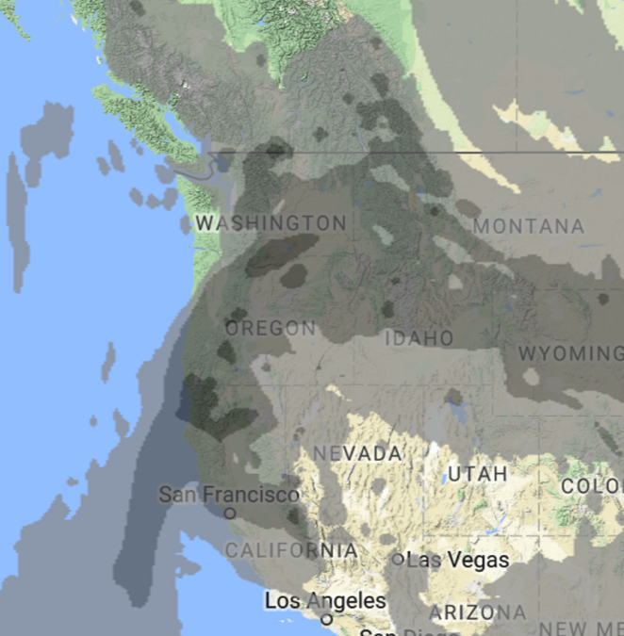
9/4/2017 13:00 PDT
BlueSky
Global Forecast System (GFS)
Column Average

Slide 32
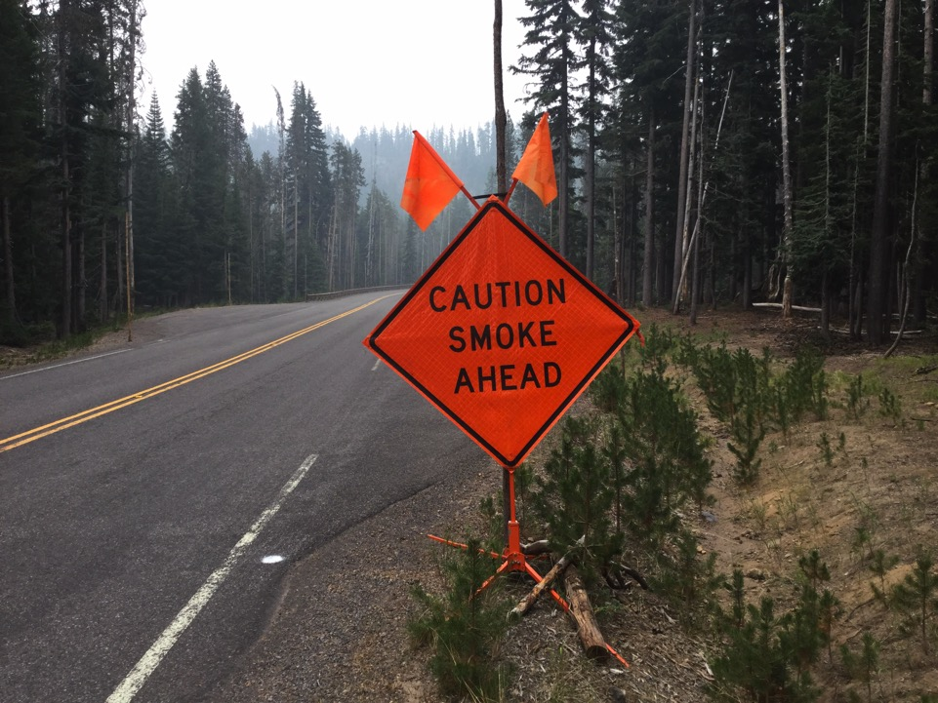

Putting on Your Smoke Glasses

Slide 33
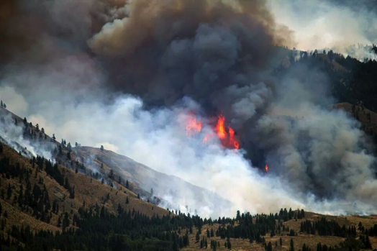
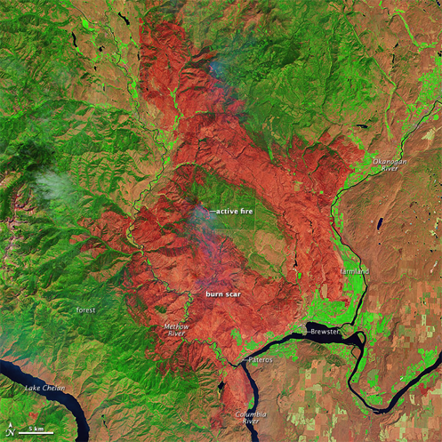
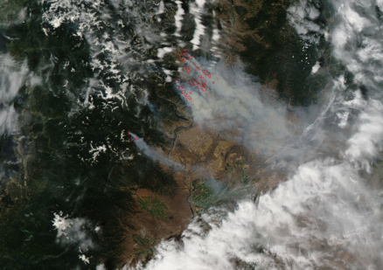
Carlton Complex Washington State 2014
250,000 acres
http://en.wikipedia.org/wiki/2014_Washington_state_wildfires
Notes:
Use this example to talk about: grid resolution, comparing with monitoring data, timing of impacts and met models being off, calibrating your brain/experience
Example of: our production runs, how they get used by the ARA program for wildfires

Slide 34
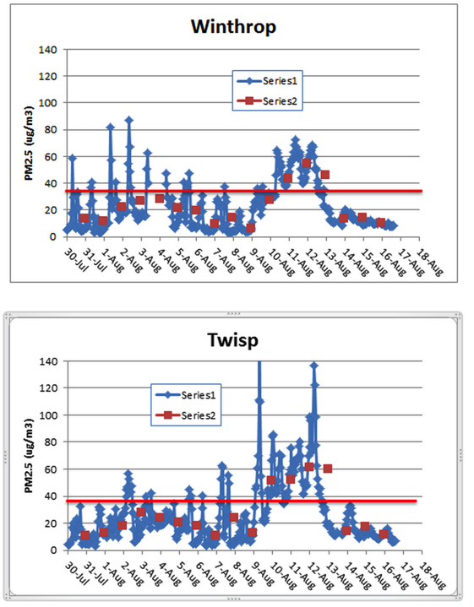
Carlton Complex August 2014
Washington Smoke Blog
On this gorgeous, clear day with no smoke, let's take a look at the differences between two air quality monitors located less than 9 miles apart in the same Methow Valley. The blue graphs indicate 1-hr average concentrations of PM2.5 while the red data points are 24-hr averages. Note that while the 24-hr values trended rather similar for the two sites (expected as they are spatially close) the peak 1-hr values differed greatly!
Posted by Mike Broughton, FWS, ARA
Notes:
Read the smoke blog to the class, then say, lets take it a step further and look at the models.
http://www.wasmoke.blogspot.com/search?updated-max=2014-08-18T11:08:00-07:00&max-results=8&start=4&by-date=false
Talk about 1-hr and 24-hr concentrations. NAAQS are a 24-hr std. Does smoke stay the same over a 24-hr period? Why or why not?
Use this example to talk about: grid resolution, comparing with monitoring data, timing of impacts and met models being off, calibrating your brain/experience
http://kcts9.org/programs/in-close/environment/wildfires-and-climate-change
http://kcts9.org/programs/in-close/environment/carlton-complex-progression-map

Slide 35
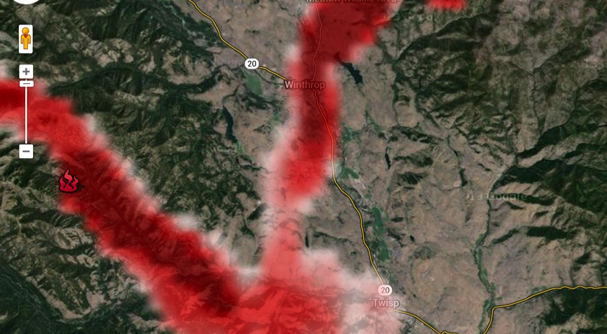
Carlton Complex, 8/4/2014 6am, 1.33 km Domain
Winthrop
Twisp
Notes:
Meteorology – what if it is off by 30 degrees?
The obs showed Twisp getting hit harder, yet BlueSky typically hit Winthrop harder – work in process

Slide 36
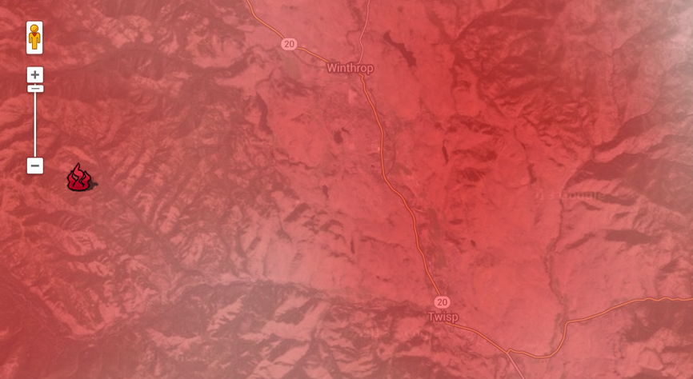
Carlton Complex, 8/4/2014 6am, 12 km Domain
Winthrop
Twisp
Notes:
Meteorology – what if it is off by 30 degrees? Does it matter so much with this resolution?

Slide 37
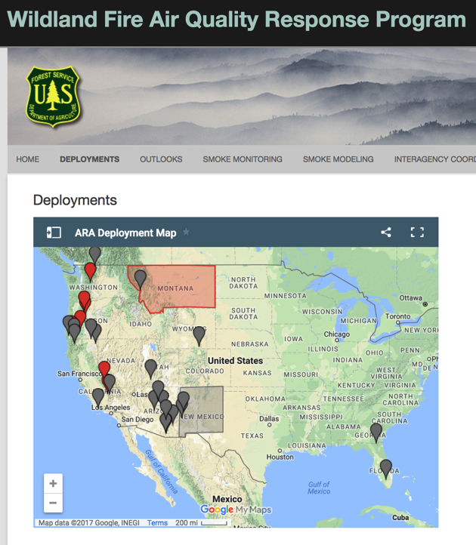
http://www.wildlandfiresmoke.net/
Air Resource Advisors
Deployed to Incident Management Teams & Geographic Area Commands
Modeling, Monitoring, Messaging
Smoke Monitoring Cache: 20 E-Samplers
6 EBAMS
Carbon Monoxide
Trainings: 2013 – 2017
Pete Lahm, USFS WO, Coordinator
Notes:
Screen dump of deployments
Add 2017 bar

Slide 38
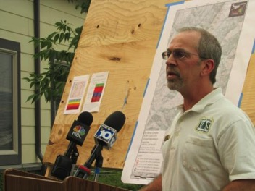
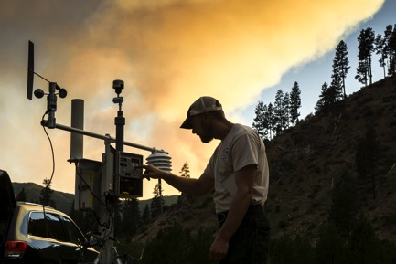
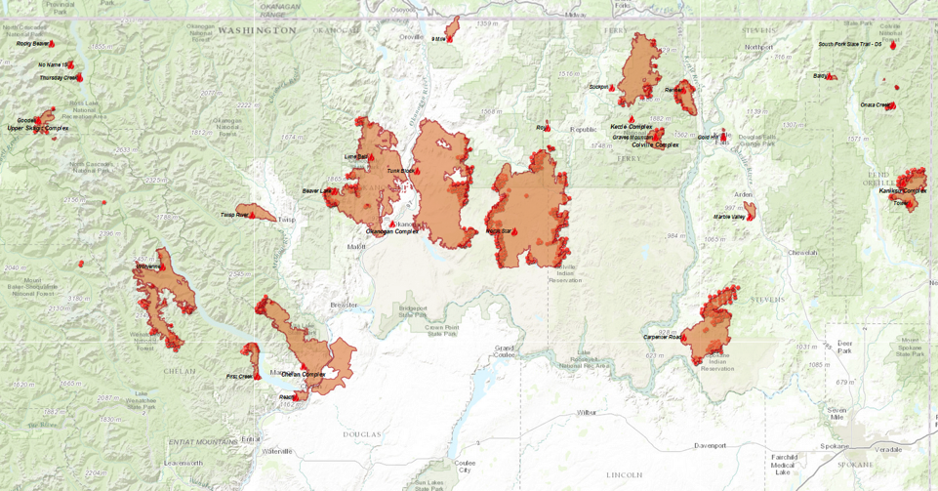
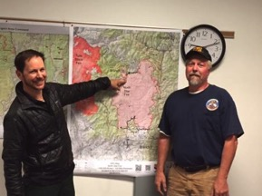
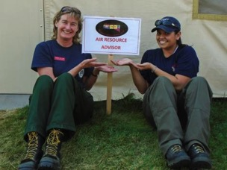
Air Resource Advisors
Notes:
burnouts

Slide 39
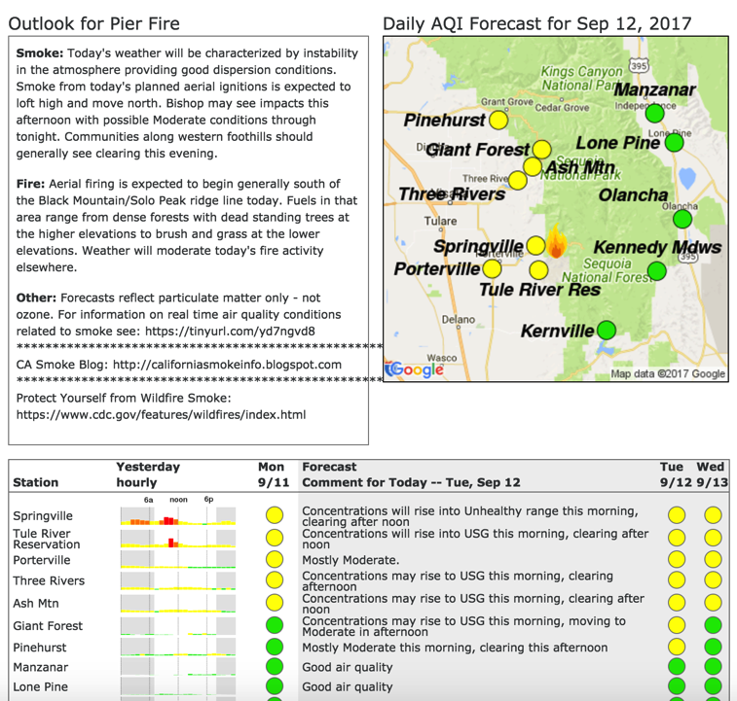
Smoke Outlooks
Smoke outlook for next 2 days
1-2 pages
Aimed for public dissemination/posting:
Smokeblogs
Public Meetings
Public bulletin boards
AQ/Health agencies email lists & daily coordination calls

Slide 40
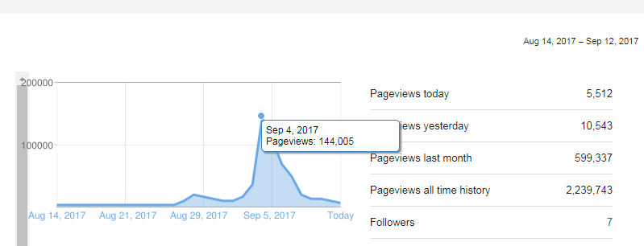
Smoke Blogs
http://wasmoke.blogspot.com/
http://oregonsmoke.blogspot.com/
http://californiasmokeinfo.blogspot.com/
http://idsmoke.blogspot.com/
Figure: Janice Peterson
Notes:
WA (from Janice): Max day was 144,000+ And we're over 2.2 million lifetime views.

Slide 41
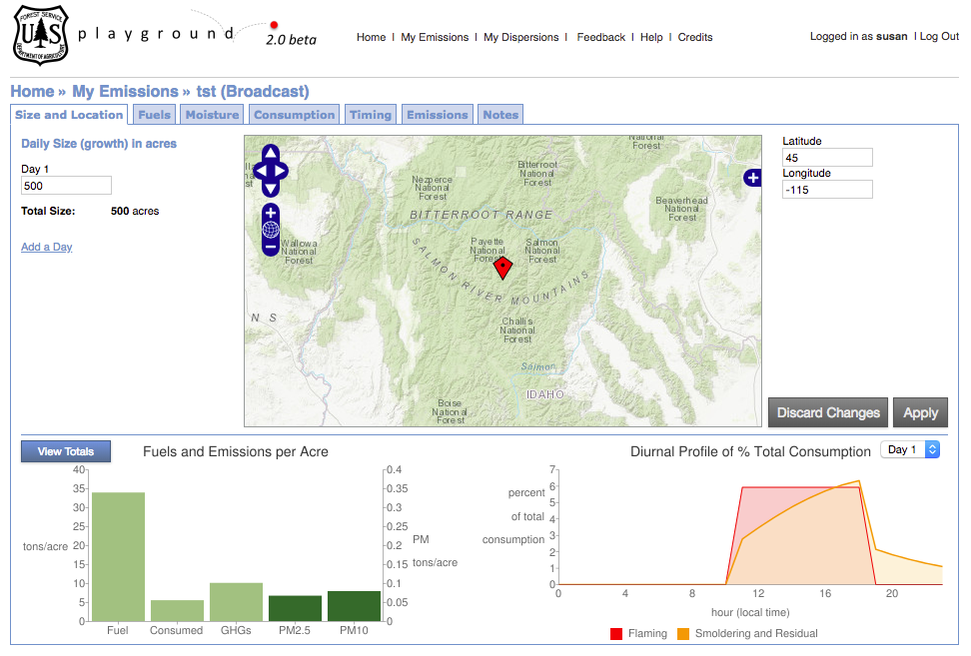
BlueSky Playground
Do your own Smoke Modeling
https://tools.airfire.org

Slide 42
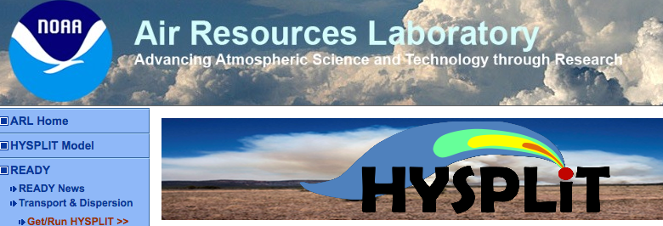
HYSPLIT Trajectories
Parcel of Air Travels in the Wind Field
Same Trajectory for a 50 acre burn as a 500 acre burn
Simulate Effect of Plume Rise
Spot Weather Forecasts
https://ready.arl.noaa.gov/HYSPLIT.php

Slide 43
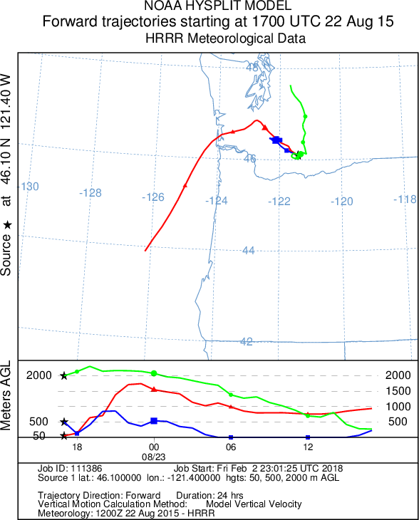
HYSPLIT Trajectory Example

Slide 44
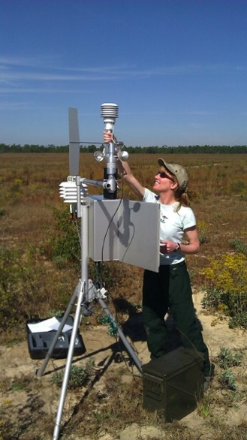






Thank you!
Susan O’Neill
smoneill@fs.fed.us
206-732-7851
US Forest Service, F&AM, FERA
National Park Service
National Weather Service
Environmental Protection Agency
Environment and Climate Change Canada
Joint Fire Science Program
NASA
University of Washington
Desert Research Institute
University of Arizona
many others

