Slide 1
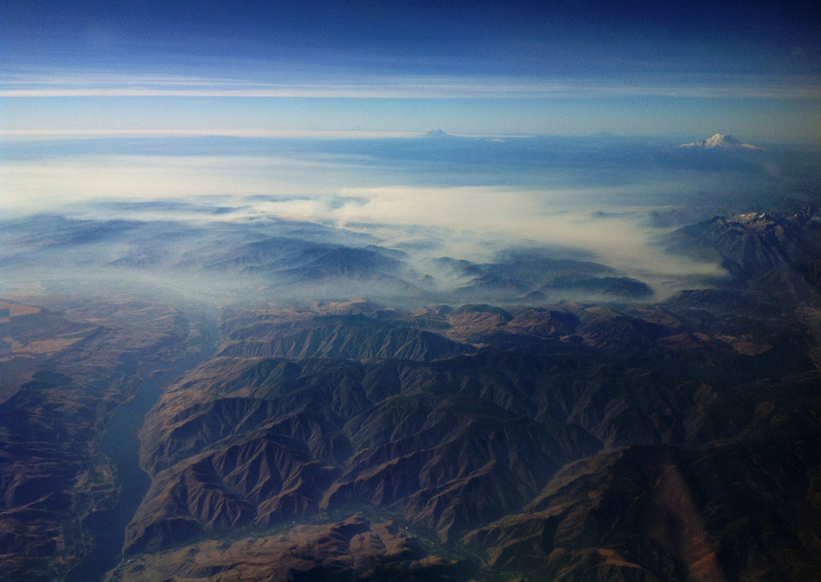
Tools for Wildfire Smoke Management
Miriam Rorig, Research Meteorologist
USDA Forest Service, AirFire Team
Photo Seattle Times, 9/2012

Slide 2
Objectives
Update on existing Tools available to FBANs and LTANs
How to work with ARAs
Available help if there is no ARA on your incident (how to get custom runs)
Interpreting BlueSky output

Slide 3
Collaborative Partnerships
DRI (CANSAC) – WRF output
UW Atmos Sci – WRF output
NOAA/NCEP – NAM & GFS output
Wildland Fire Management RD&A – WRF output (hoping to incorporate soon)
NOAA Satellite and Information Service – Fire locations
Sonoma Tech Inc.

Slide 4
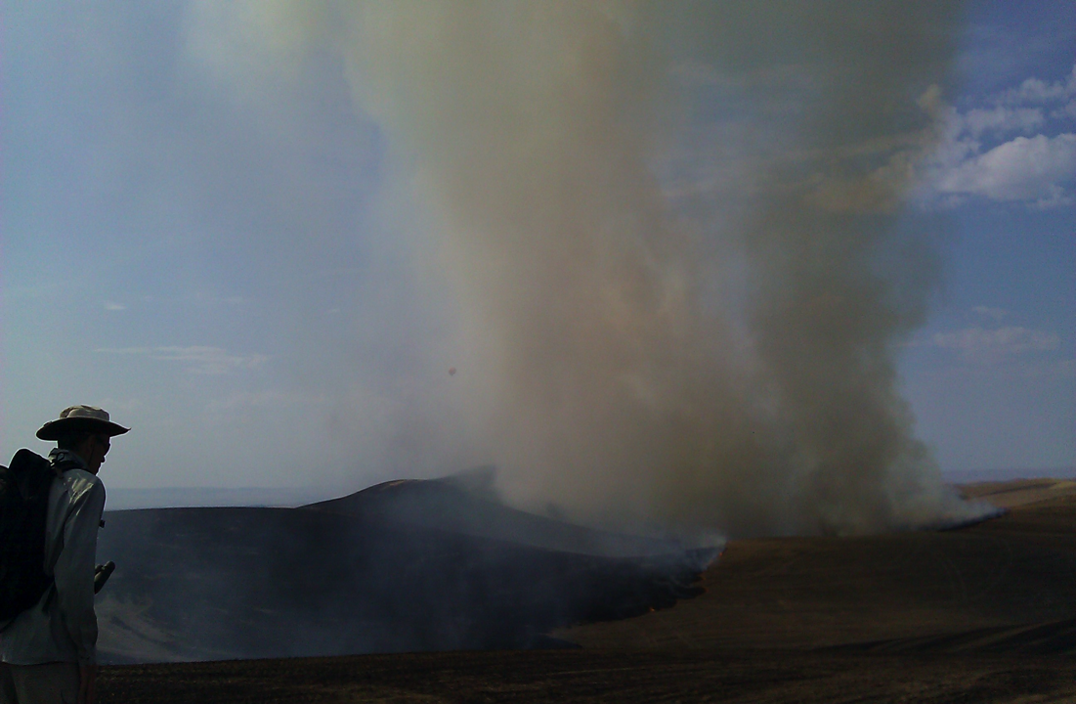
Models Available Online
BlueSky Wildfire Operational Runs
http://www.airfire.org/data/bluesky-daily/
BlueSky Playground – Do your own smoke (PM2.5) modeling
http://playground.airfire.org/
NOAA HYSPLIT (Dispersion and Trajectories)
http://ready.arl.noaa.gov/HYSPLIT.php
AIRPACT (Physical and Chemical processes)
http://lar.wsu.edu/%5C/airpact/
“Picking a model of choice for the day is a little like speed-dating: too little time/information to make up the mind leading to regrets by the end of the date/shift.”
- Wes Adkins, Meteorologist, National Weather Service, Juneau, AK

Slide 5
BlueSky Modeling Framework v 3.5
Fire
Info
Met
WRF
MM5
NARR
Station data
Idealized
SMARTFIRE2
IRWIN
Rx Sys
Manual
Other
Fuels
FCCS
FCCS-LF
NFDRS
Hardy
GVDS
LANDFIRE*
Ag*
Other
Total Consumption
CONSUME 3
FOFEM
FEPS
EPM
FLAMBE
FINN
ClearSky (Ag)*
Satellite*
Other
Time
Rate
Rx / WF
FEPS
FOFEM
EPM
WRAP
Idealized
Manual
Other
Emissions
FEPS
Literature
EPM
FOFEM
FLAMBE
FINN
Other
Plume
Rise
Large uncertainties exist with each modeling step
Briggs
SEV
Manual
Other
Dispersion /
Trajectories
HYSPLIT
CalPuff
CMAQ
VSMOKE
Notes:
Go over how each step is full of variability.

Slide 6
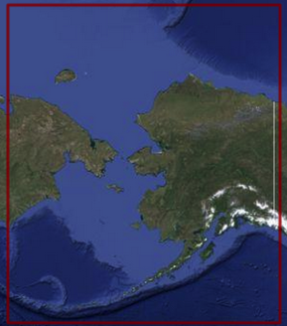
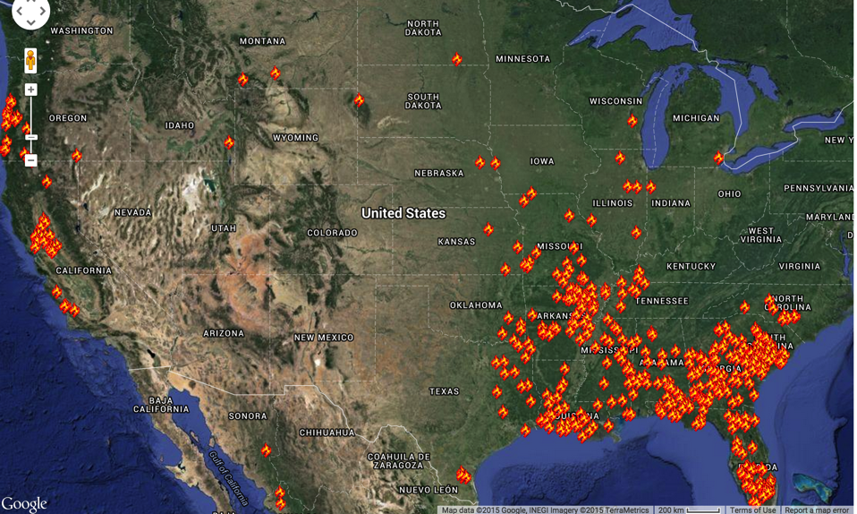
Daily BlueSky Production Runs
1/31/2015 Satellite Fire Detections http://www.airfire.org/data/bluesky-daily/
1.33 km
1 km
12 km
4 km
2 km
6 km
4 km,
12 km
4 km
Notes:
12 domains per day, 6 are run twice a day (00Z, 12Z) – 18 hysplit particle runs. Many puff runs too.
This does not include custom runs.
Forecast lengths are 24-84 hrs.
Fires are persisted into the future.

Slide 7
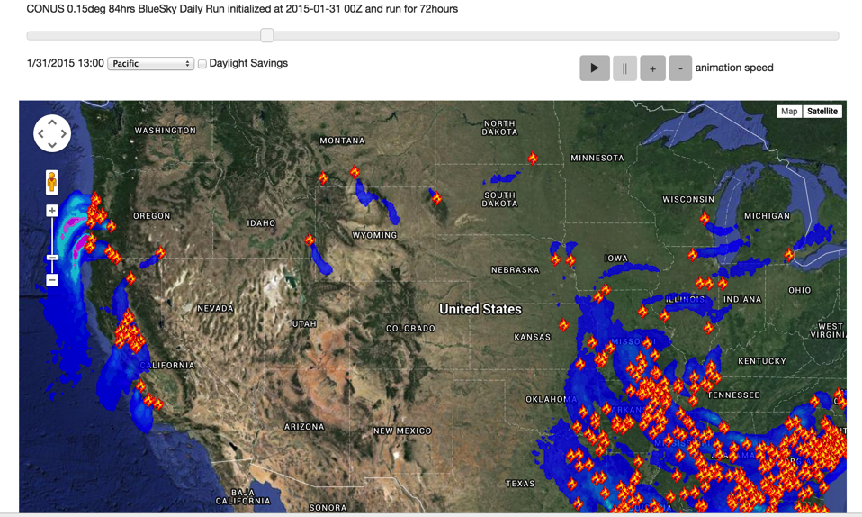
Daily BlueSky Production Runs
1/31/2015 Satellite Fire Detections & PM2.5, 12km http://www.airfire.org/data/bluesky-daily/

Slide 8
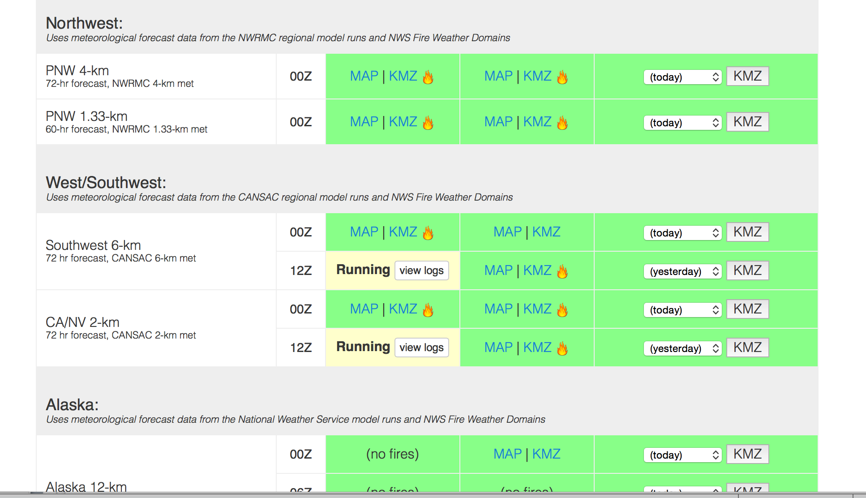

http://www.airfire.org/data/bluesky-daily/
Number of Fires
Running (click on “view logs” for run progress)
Successful!
Failures show up in red.
Website shows status of current runs
Notes:
12 domains per day, 6 are run twice a day (00Z, 12Z) – 18 hysplit particle runs. Many puff runs too.
This does not include custom runs.

Slide 9
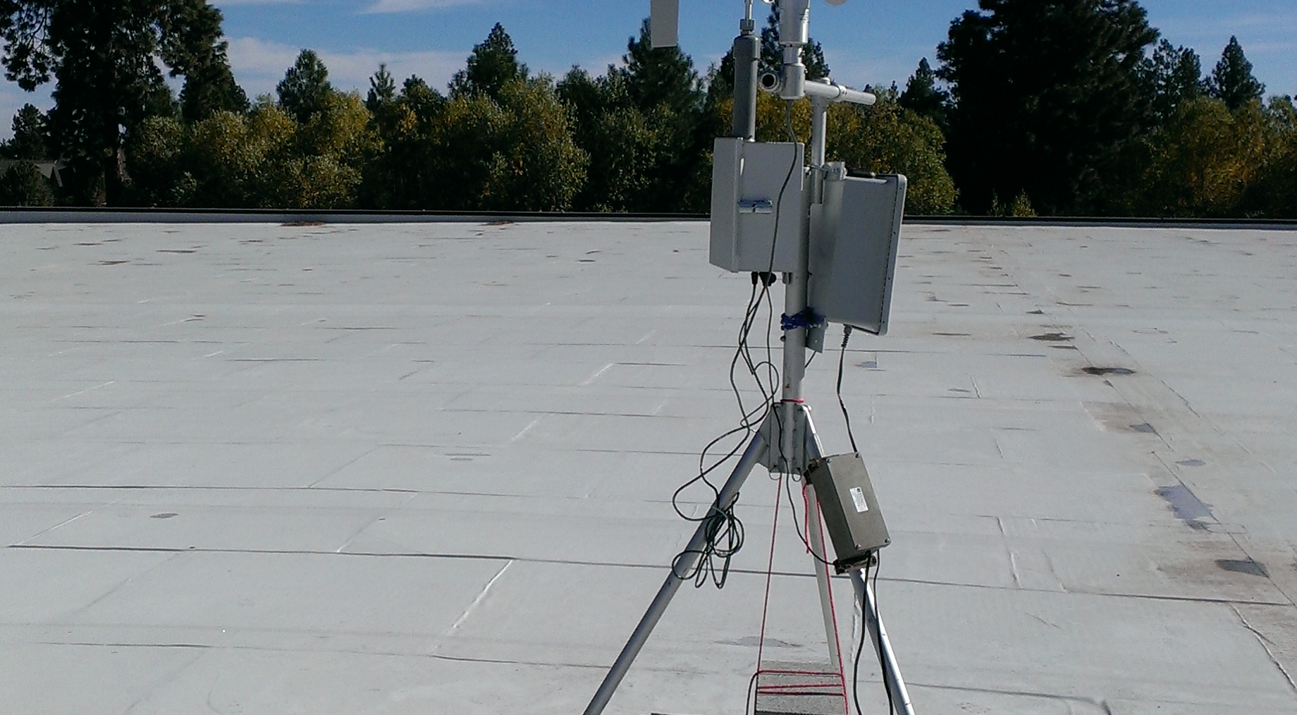
Additional Online Tools
Monitoring report page - NEWhttp://smoke.airfire.org/monitoringReport/
Smoke values at risk page – in testinghttp://smoke.airfire.org/complexityTest/
“Easy” trajectory page http://smoke.airfire.org/trajectories/
Ventilation Climate Information System http://smoke.airfire.org/vcis/

Slide 10
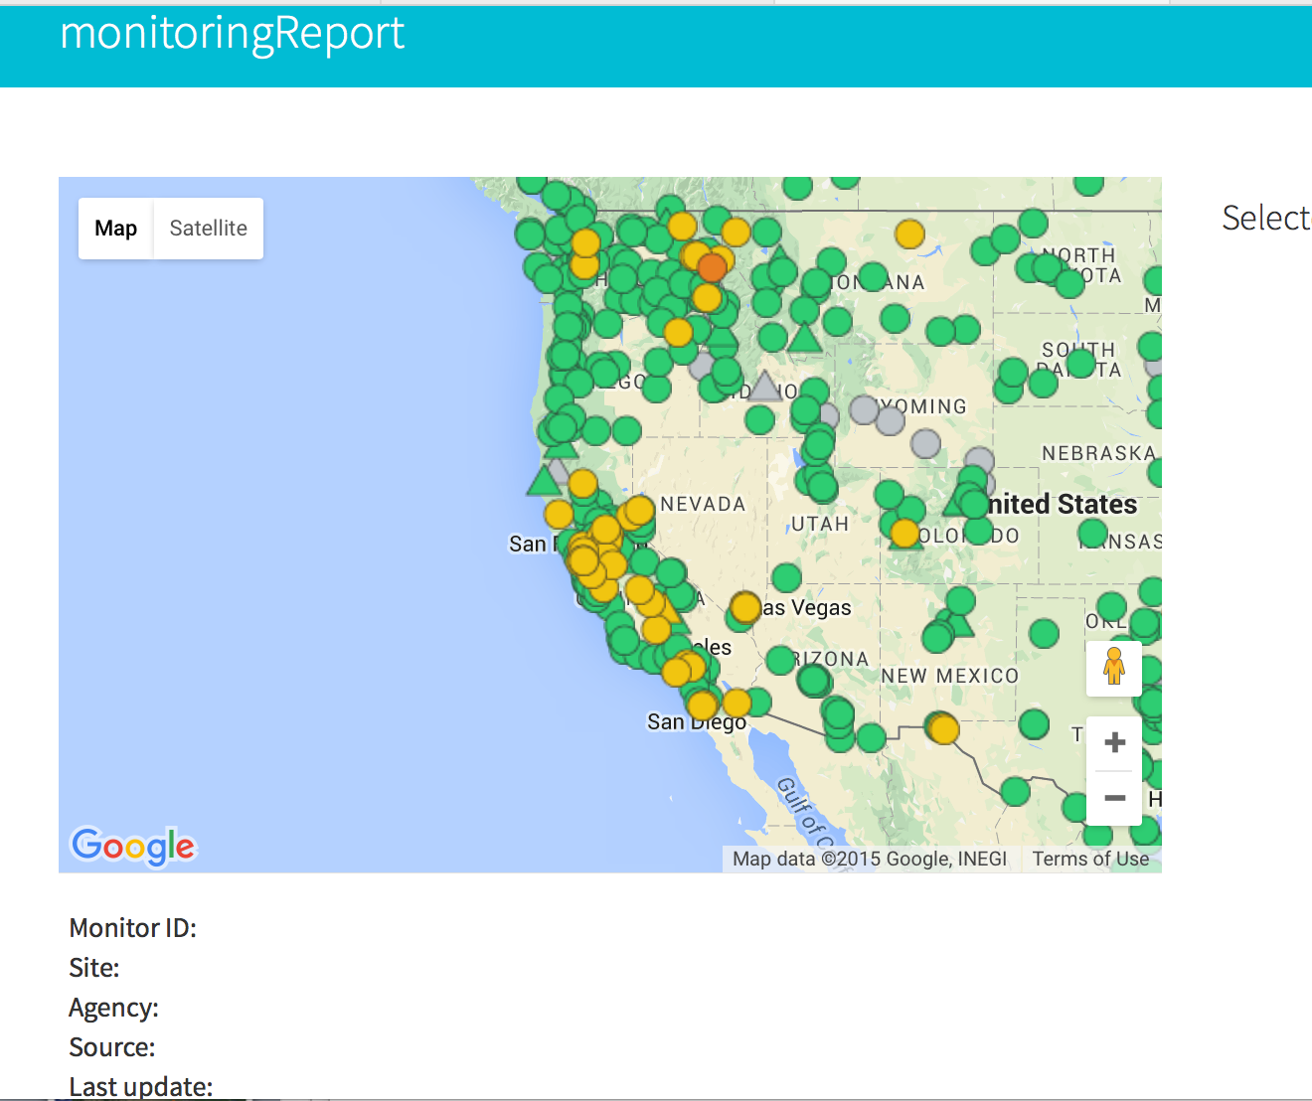
http://smoke.airfire.org/monitoringReport

Slide 11
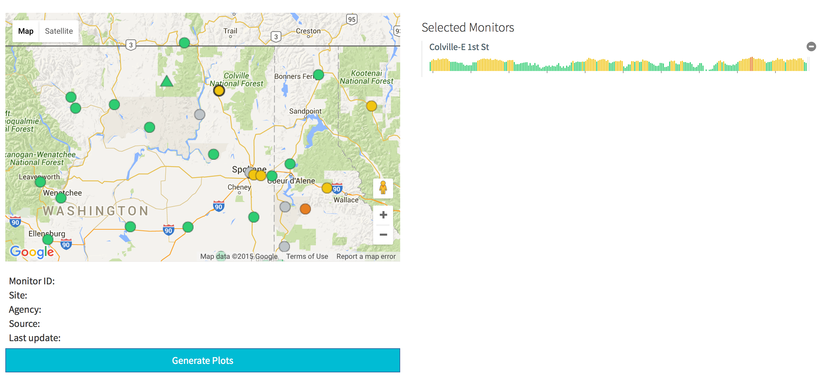
http://smoke.airfire.org/monitoringReport

Slide 12
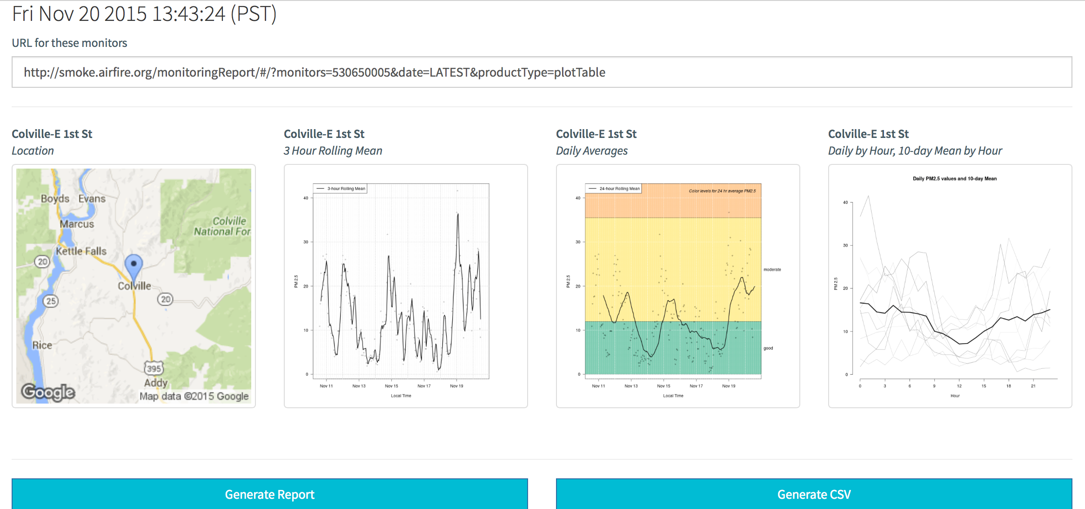
http://smoke.airfire.org/monitoringReport

Slide 13
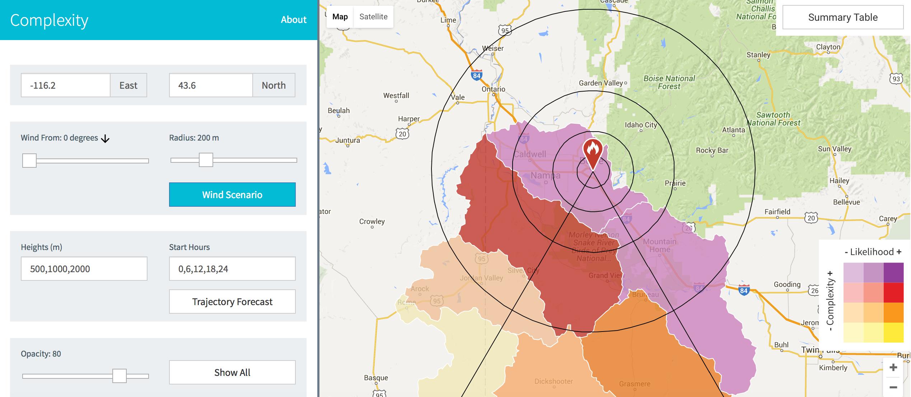
http://smoke.airfire.org/complexityTest/

Slide 14
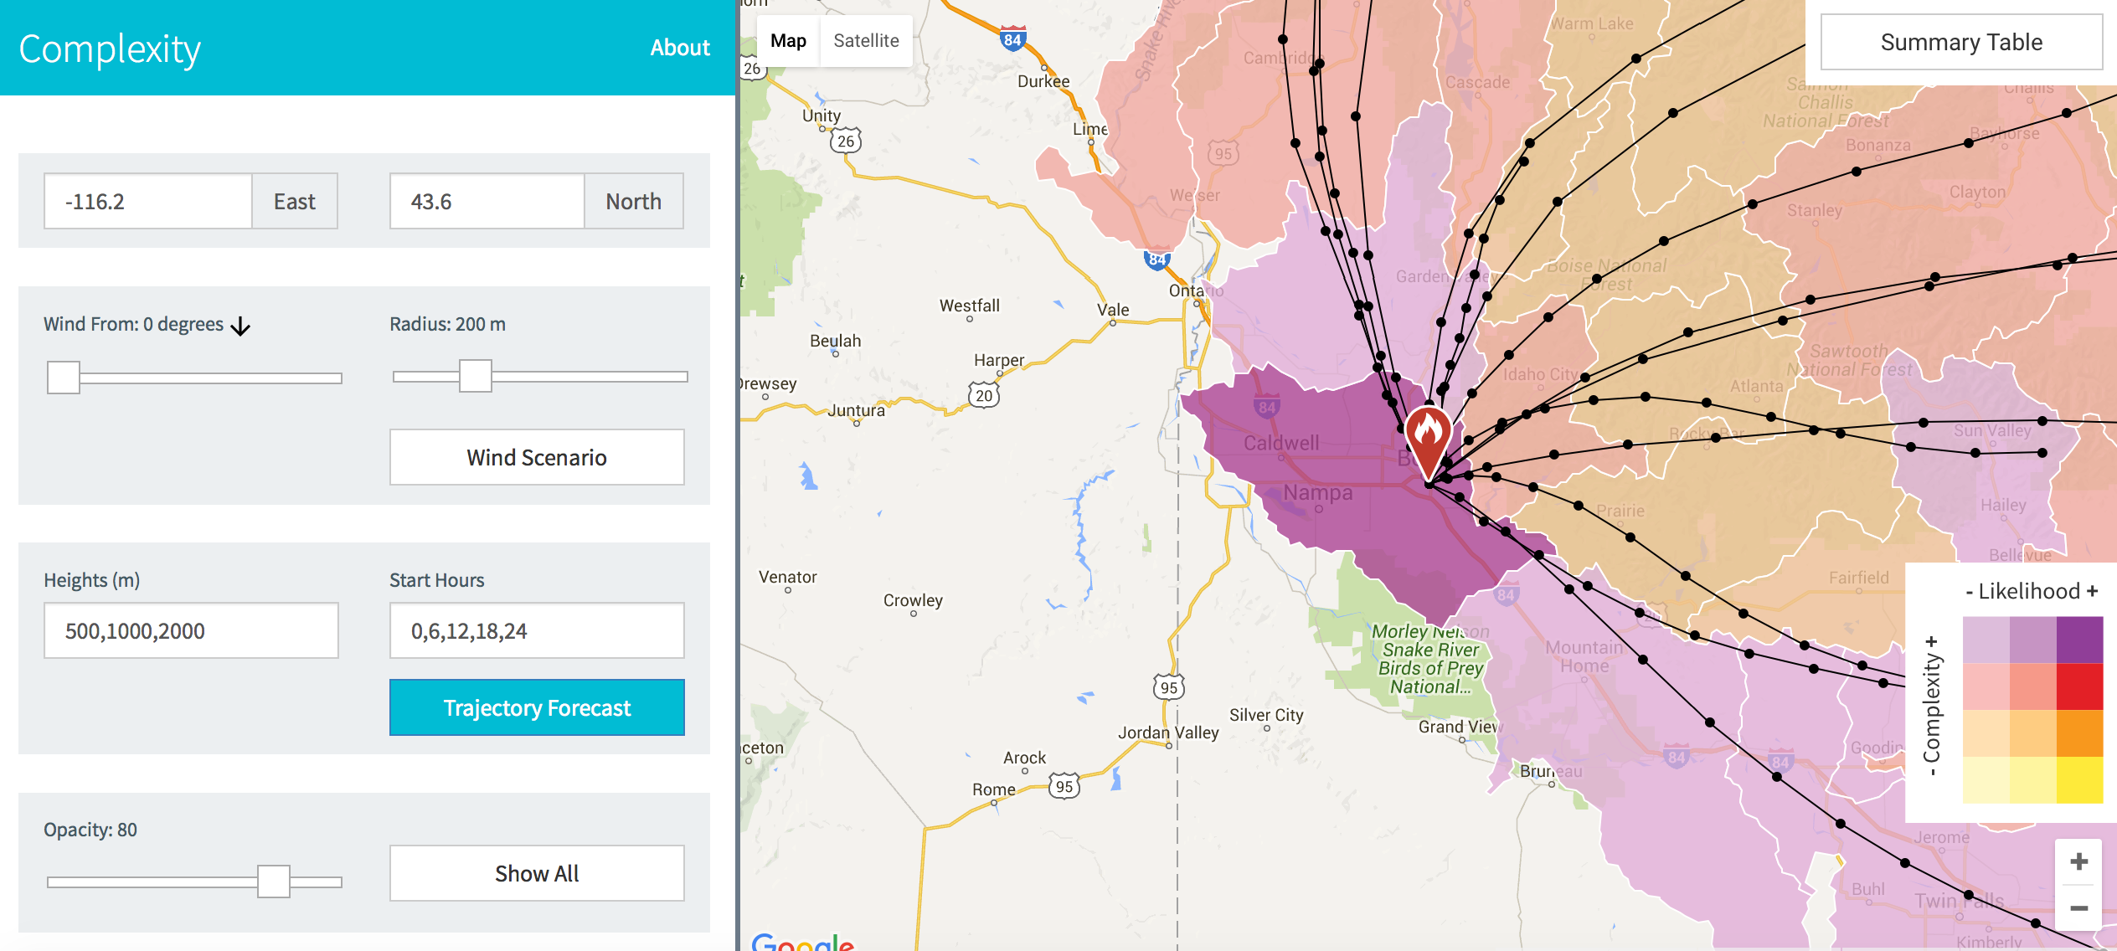
http://smoke.airfire.org/complexityTest/

Slide 15
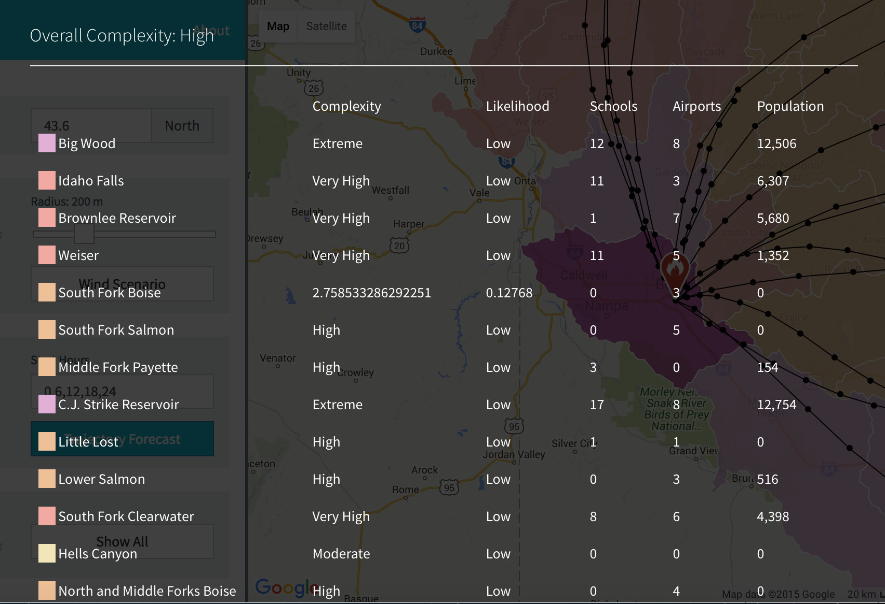
http://smoke.airfire.org/complexityTest/

Slide 16
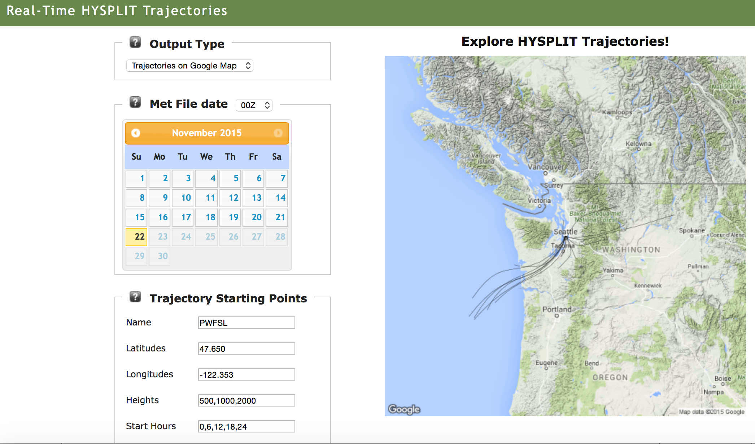
http://smoke.airfire.org/trajectories/
kmz
csv

Slide 17
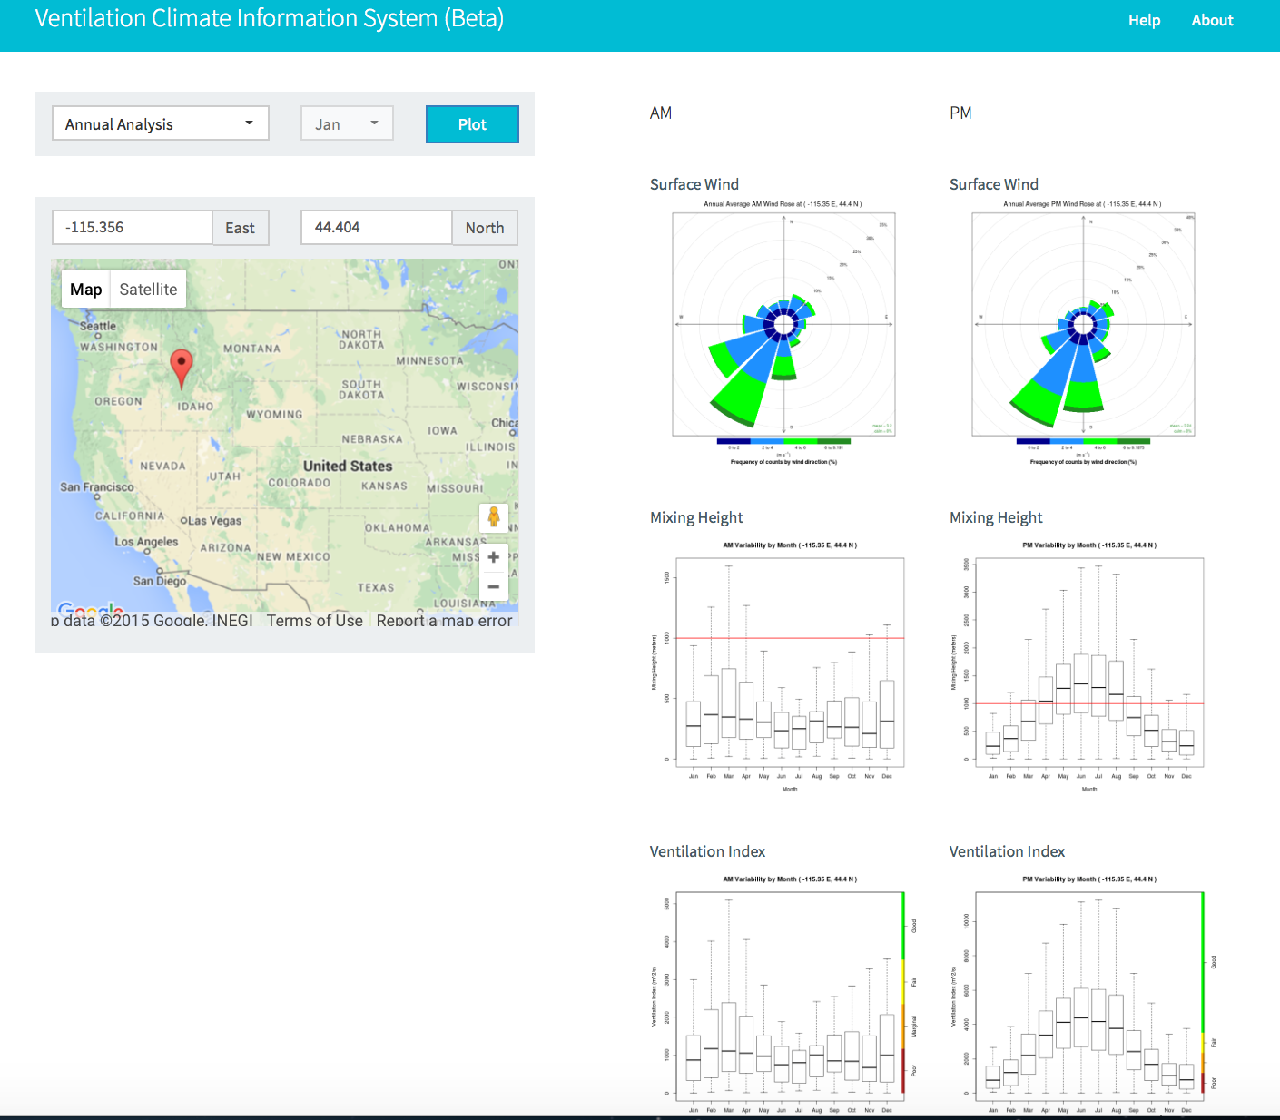
http://smoke.airfire.org/vcis/

Slide 18
State Smoke Blogs
www.wasmoke.blogspot.com
http://www.oregonsmoke.blogspot.com
http://www.idsmoke.blogspot.com
http://californiasmokeinfo.blogspot.com
No smoke blogs in your state? Go to the website of the state agency responsible for regulating and monitoring air quality.

Slide 19
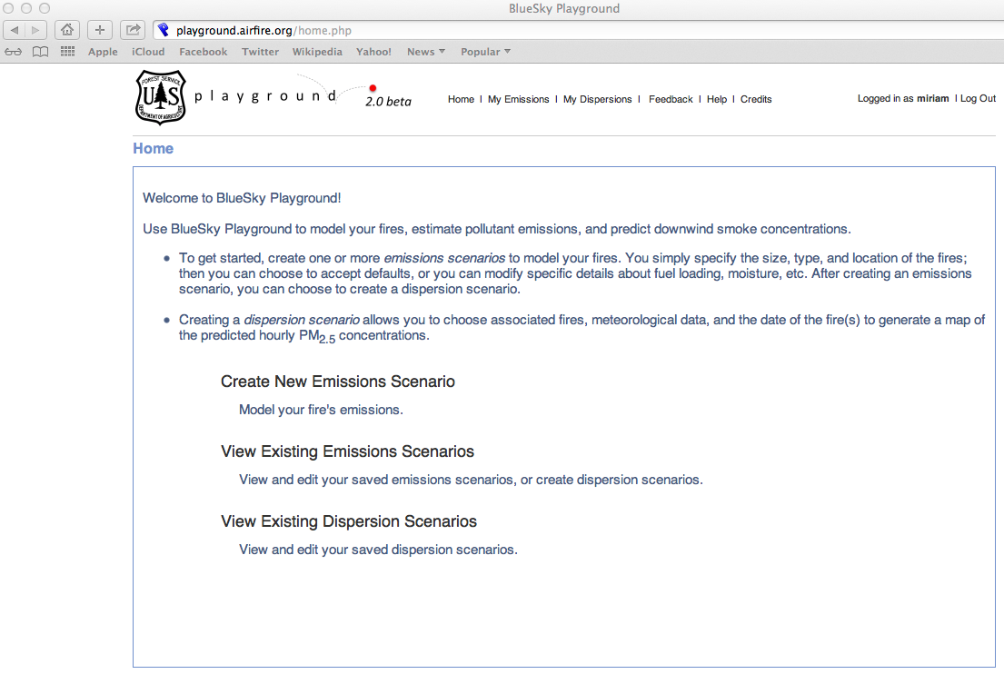
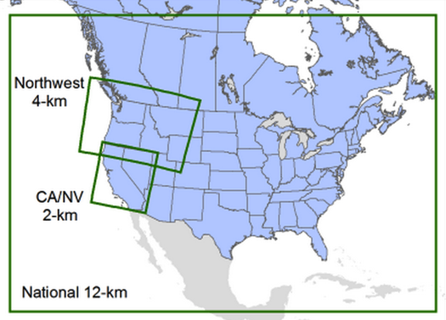
BlueSky Playground – allows users to do custom runs
playground.airfire.org

Slide 20
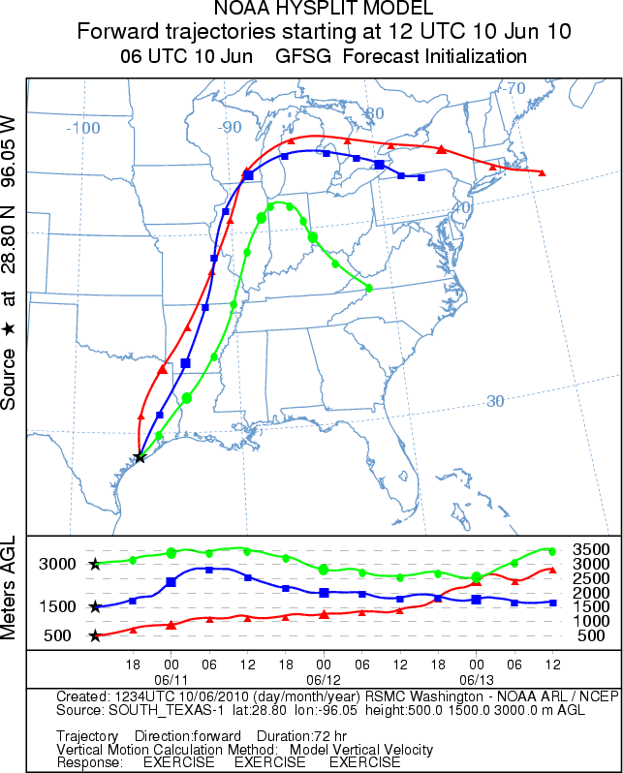
NOAA HYSPLIT
Dispersion
Trajectory – Simulates where a parcel of air would travel, given:
  A Release Location
  Release Height
  Date and Time
Many meteorological choices
http://ready.arl.noaa.gov/HYSPLIT.php
Notes:
Each point is 6 hours out in time.
12-km NAM
The three release heights are not modifiable currently.
Trial product over the last year.
Looking at making operational.

Slide 21
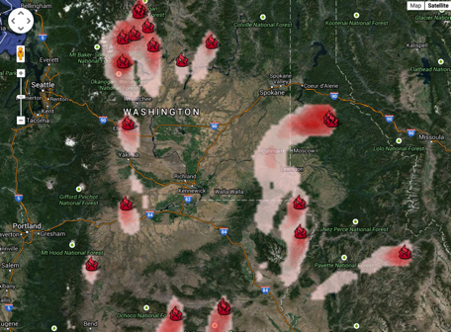
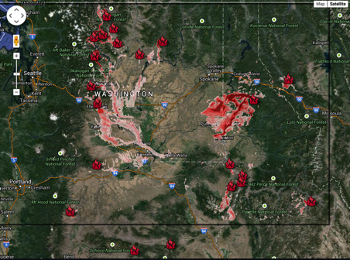
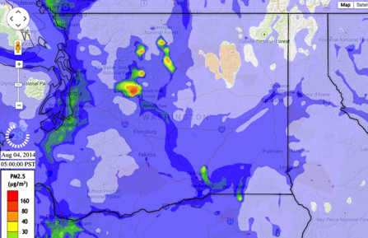
8/4/2014 6am- BlueSky vs. AIRPACT
12 km NWS NAM
1.33 km UW WRF
4 km AIRPACT

Slide 22
BlueSky Custom Runs
Better information on fire location/size/growth rate/timing/fuels (e.g.information coming from WFDSS and/or ARAs)
Higher resolution met available (e.g. NAM 1km FW domains)
Special projects/studies (e.g. Bend smoke intrusions)

Slide 23
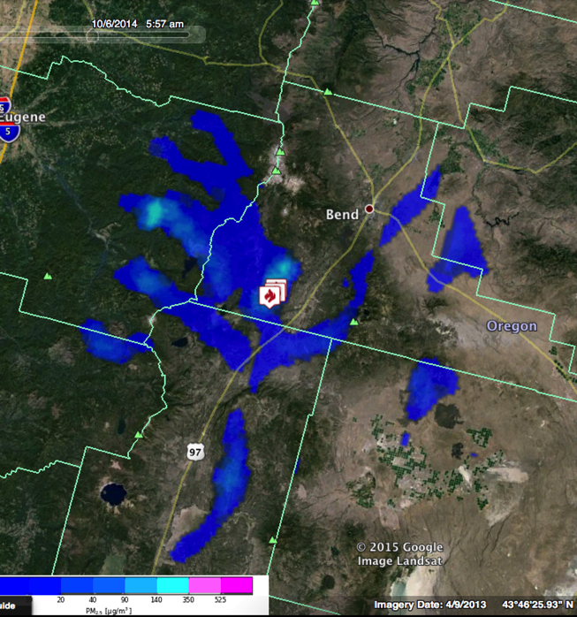
Daily scheduled BlueSky run
PNW
4km
10/6/2014 5am
Notes:
http://viewer.smoke.airfire.org/run/hysplit-pp/PNW-4km-Bend-Intr/2014100500/

Slide 24
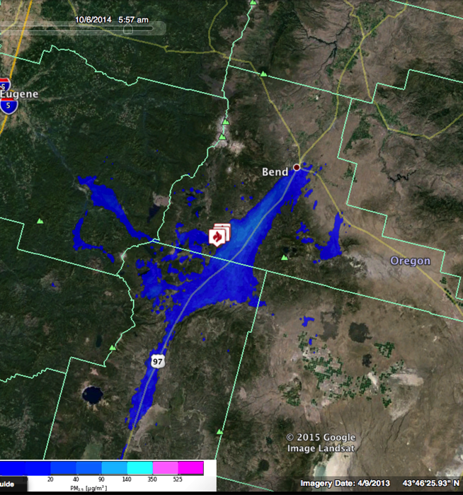
Custom hi-res BlueSky run
NWS 1km
10/6/2014 5am
Notes:
Go interactive with websky if possible.
http://viewer.smoke.airfire.org/run/hysplit-pp/FW06Z-1km-Bend-Intr/2014100506/

Slide 25
Interpreting Model Runs
  What question are you trying to answer?
    When/where will smoke effects occur
    Will there be an exceedence of the AQ standards?
  Get as much information as possible on what went into the model runs – includes fuels, weather, fire location, fire size, etc.
  Familiarize yourself with model limitations
  Familiarize yourself with monitor limitations
  Compare different model outputs (different domains, resolutions, etc.)
  Mentally adjust output to compensate for known inaccuracies (too many acres, dispersion down wrong drainage, etc.)
Example: Carleton Complex, Washington State, 2014

Slide 26
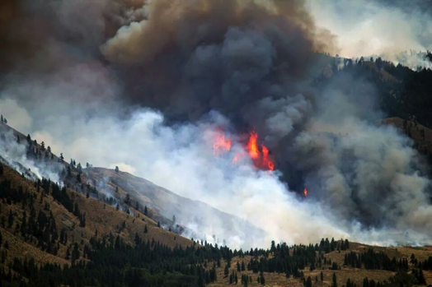
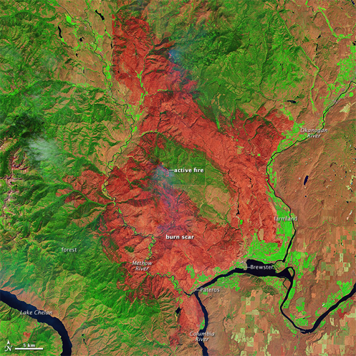
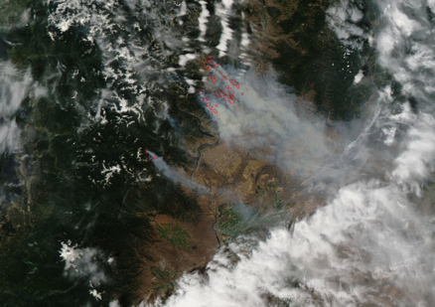
Carlton Complex Washington State 2014
250,000 acres
http://en.wikipedia.org/wiki/2014_Washington_state_wildfires
Notes:
Use this example to talk about: grid resolution, comparing with monitoring data, timing of impacts and met models being off, calibrating your brain/experience
Example of: our production runs, how they get used by the ARA program for wildfires

Slide 27
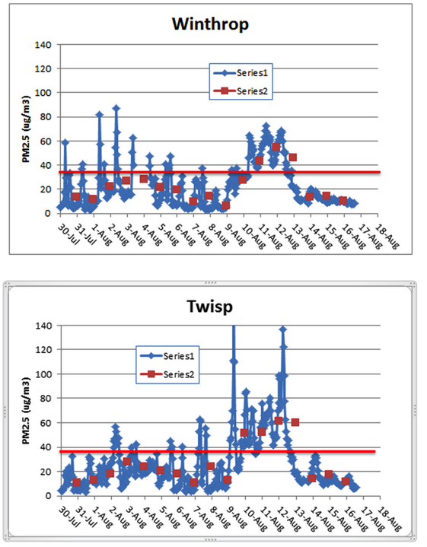
Carlton Complex August 2014
Washington Smoke Blog
On this gorgeous, clear day with no smoke, let's take a look at the differences between two air quality monitors located less than 9 miles apart in the same Methow Valley. The blue graphs indicate 1-hr average concentrations of PM2.5 while the red data points are 24-hr averages. Note that while the 24-hr values trended rather similar for the two sites (expected as they are spatially close) the peak 1-hr values differed greatly!
Posted by Mike Broughton, FWS, ARA
Notes:
Read the smoke blog to the class, then say, lets take it a step further and look at the models.
http://www.wasmoke.blogspot.com/search?updated-max=2014-08-18T11:08:00-07:00&max-results=8&start=4&by-date=false
Talk about 1-hr and 24-hr concentrations. NAAQS are a 24-hr std. Does smoke stay the same over a 24-hr period? Why or why not?
Use this example to talk about: grid resolution, comparing with monitoring data, timing of impacts and met models being off, calibrating your brain/experience
http://kcts9.org/programs/in-close/environment/wildfires-and-climate-change
http://kcts9.org/programs/in-close/environment/carlton-complex-progression-map

Slide 28
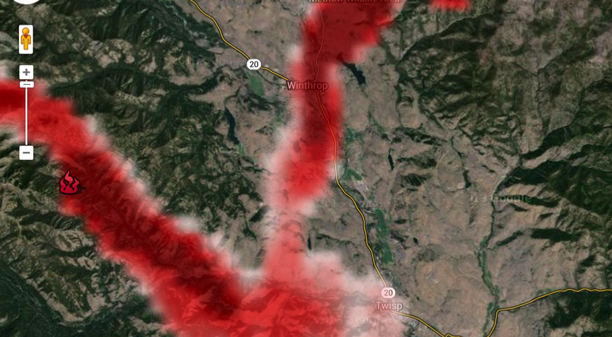
Carlton Complex 2014080400Z, 8/4/2014 6am, 1.33 km Domain
Winthrop
Twisp
Notes:
Meteorology – what if it is off by 30 degrees?
The obs showed Twisp getting hit harder, yet BlueSky typically hit Winthrop harder – work in process

Slide 29
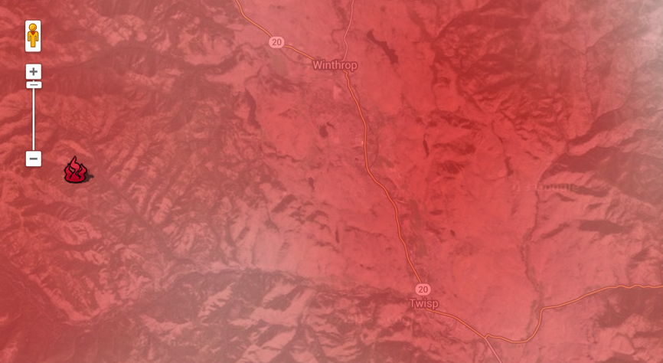
Carlton Complex 2014080400Z, 8/4/2014 6am, 12 km Domain
Winthrop
Twisp
Notes:
Meteorology – what if it is off by 30 degrees? Does it matter so much with this resolution?

Slide 30
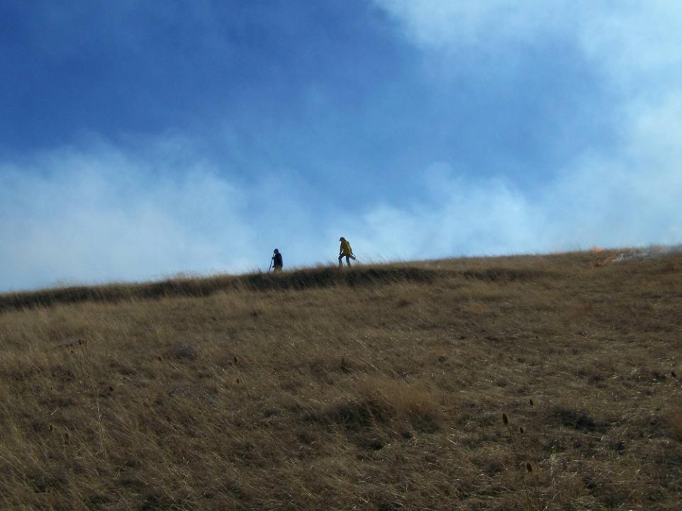
Current & Future Work/Activities
Ongoing BlueSky improvements/updates
BlueSky Canada & include Canadian Emissions
Closer collaboration with Wildland Fire Management RD&A (improving both daily and custom runs)
NOAA HYSPLIT – Updating BSF
Updated Emission Factors
Continue working with the Interagency Wildfire Air Quality Response Program
Cloud computing to make predictions much faster
Notes:
OTHER STUFF??? Talk with Miriam, talk with Sim if possible

Slide 31
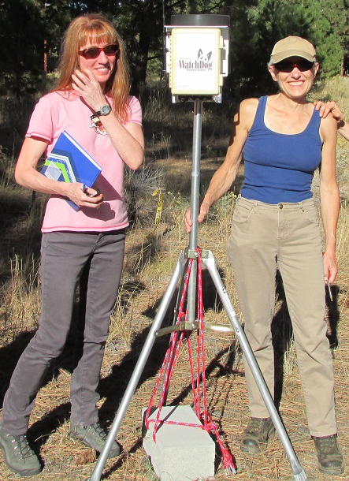









Many thanks to a cast of thousands (OK, maybe 10’s). Here’s an incomplete list (in no particular order):
Sue Ferguson Janice Peterson
Sim Larkin Miriam Rorig
Susan O’Neill Robert Solomon
Candace Krull Joel Dubowy
Ramesh Narasimhan Pete Lahm
Roger Ottmar Susan Prichard
Sonoma Tech, Inc.
Thank you!
Miriam Rorig
mrorig@fs.fed.us
mrorig@gmail.com
206-732-7843
Susan O’Neill
smoneill@fs.fed.us
susan.m.oneill@gmail.com
206-732-7851

