Slide 1
Weather Forecasting Fundamentals
Meteorology for ARAs
Unit 4

Slide 2
Objectives
Discuss advantages and limitations of different forecasting approaches
Describe common meteorological observations
Know how to convert between standard time used for weather analyses, satellite imagery, and radar products to your local time
Know frequency that weather analyses and products become available for review

Slide 3
Forecasting Methodology
Climatology
Mean observed values for a location over a specific time range
Persistence
Assumption that weather conditions won’t change significantly for a period of time
Trends
Assumption that current change in weather conditions will continue into the future
Numerical Weather Prediction (NWP)
Quantitatively modeled forecast derived from solving complex equations
Must account for conservation of mass, momentum, and energy on a rotating body
Too complex to do by hand (A six-hour forecast took six weeks to create!)
Ensemble Forecasting
Range of NWP forecasted “scenarios” based on tweaking initial conditions
Analogs
“Case-Study” approach…noting impacts that occur with similar weather patterns to anticipate future weather conditions
Empirical Prediction
Forecaster draws from past observation and experience…includes rules of thumb, lore, and deductive reasoning

Slide 4
Types of Forecast Products
Descriptive (e.g. forecast discussion)
Graphics (e.g. weather model output)
Charts (e.g. skew-T)
Tables (e. g. ventilation index)

Slide 5
Common Meteorological Observations
Altitude: feet (ft), meters (m), kilometers (km), miles (mi).
Cloud Cover: % in oktas (e.g., 0/8 oktas = clear skies)
Moisture: % relative humidity (Rh), dewpoint (Td - °C, °F), dewpoint depression (Tdd - °C, °F = T - Td), mixing ratio (w – grams of water vapor per kg of dry air)
Precipitation: inches (in), millimeters (mm)
Pressure: millibars (mb), hectopascals (hpa), inches of mercury (inHg)
Temperature: Celsius (°C), Fahrenheit (°F), Kelvin (K)
Wind Speed: miles per hour (mph), meters per second (m/s), knots (kts)
Conversions can be tedious! Use online tools to save time:
The Weather Calculator

Slide 6
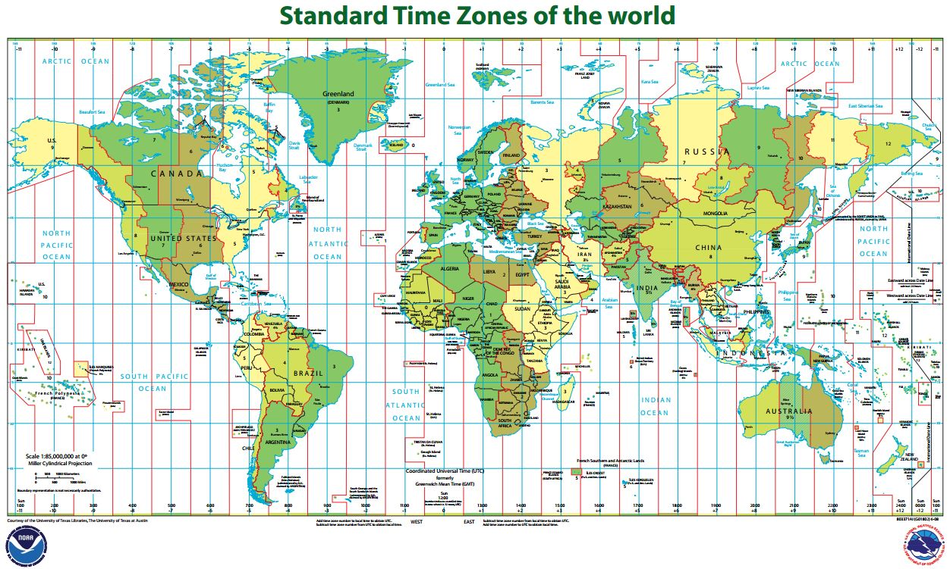
Zulu Time (Z) or Coordinated Universal Time (UTC)
Standard 24-hour time referencing all weather charts, satellite imagery, and radar products to Greenwhich, England (0° longitude)
Key is to know your local time zone’s offset and keeping track of Daylight Savings Time
Mountain Standard Time is always -7 hours (e.g., 00Z Wed 13 May 2015 is valid for 5 PM Tue 12 May 2015)

Slide 7
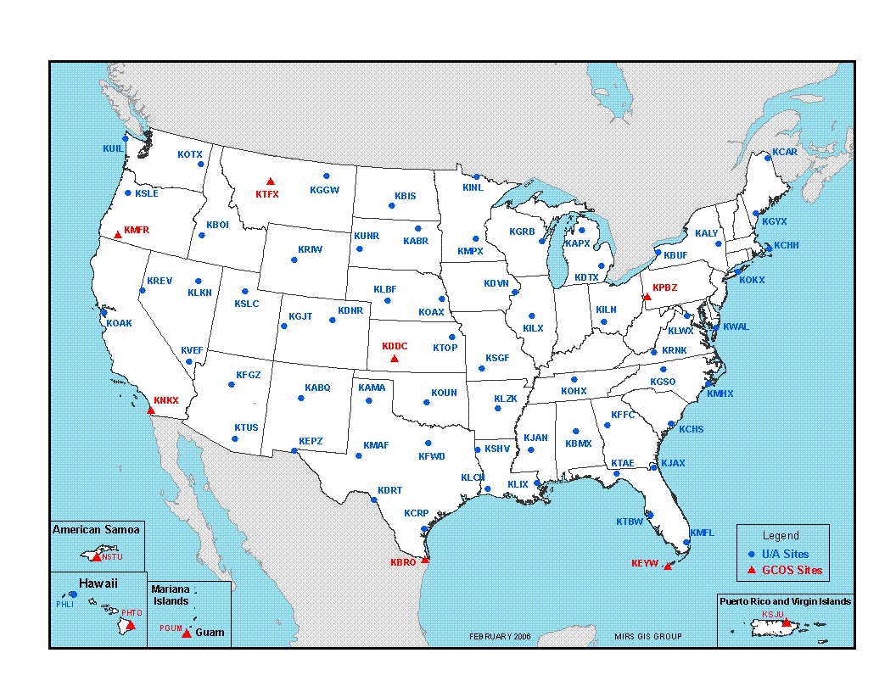
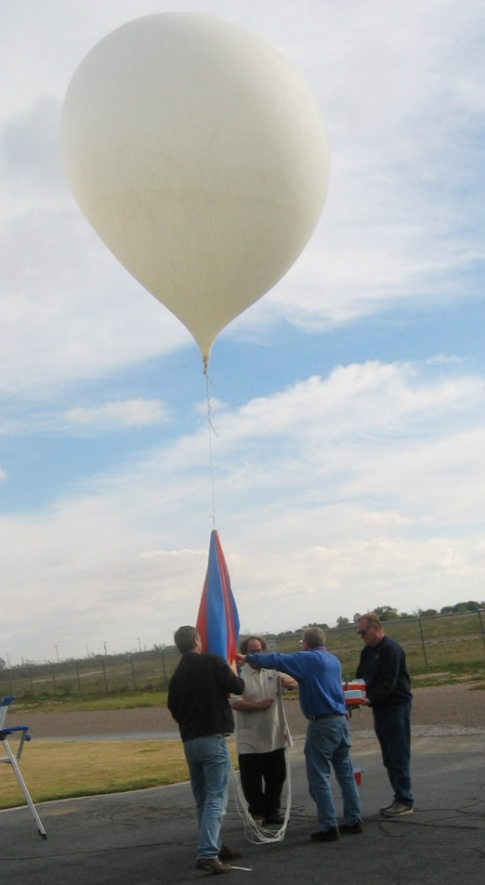
Radiosondes
Worldwide coordinated effort to capture current state of atmosphere (T, Rh, Wind, and Pressure Height) twice daily (00Z and 12Z).
Notes:
GCOS – Global Climate Observing System

Slide 8
Elements of a Balanced Forecast (Where do you find them?)
Meteorology for ARAs
Unit 5

Slide 9
Objectives
Describe where to find forecast products
Describe what elements you may want to include in a smoke forecast/briefing

Slide 10
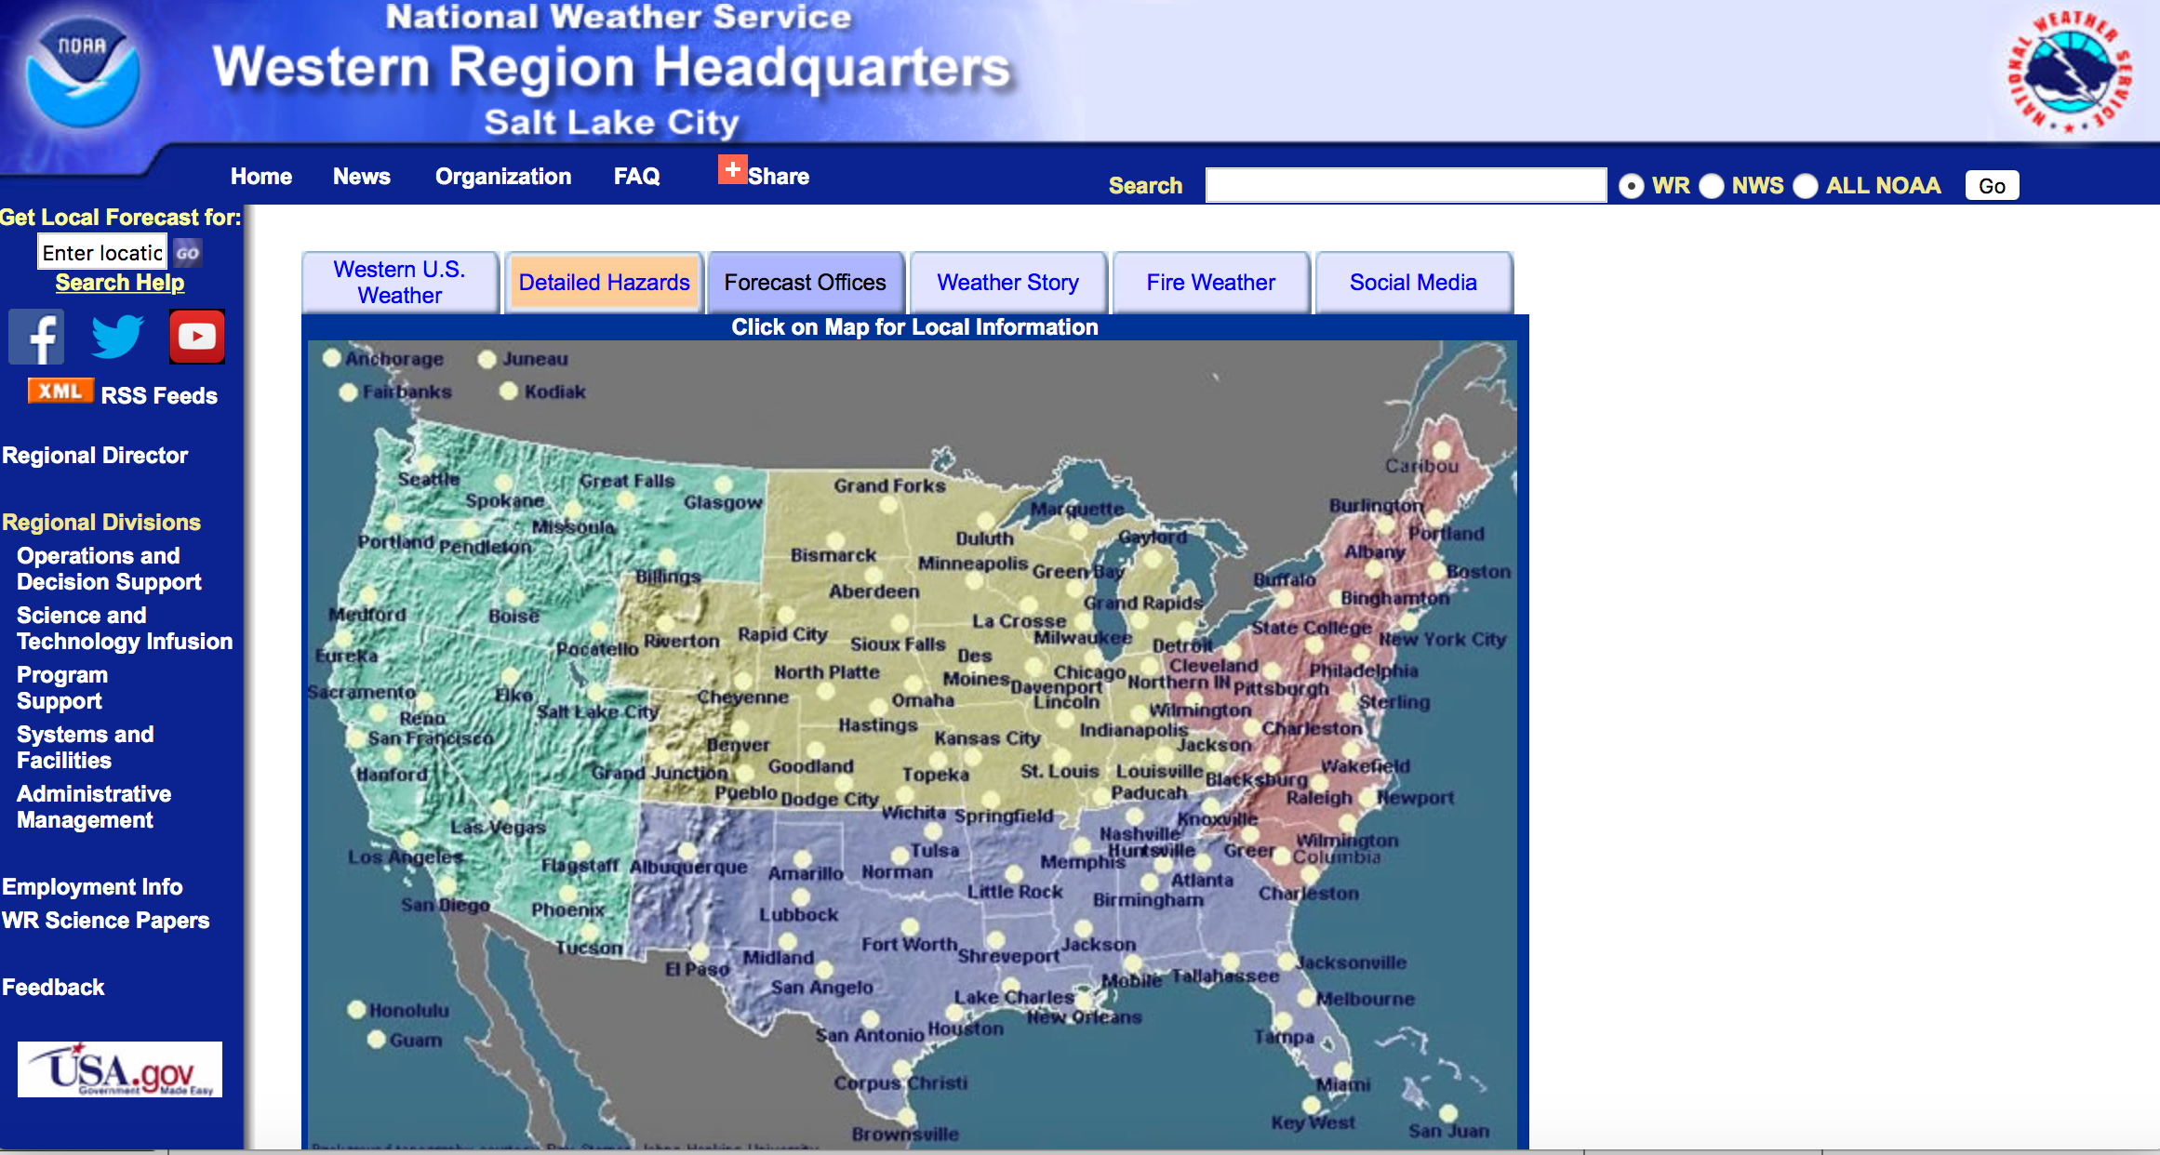
National Weather Service
http://www.wrh.noaa.gov - click on “Forecast Offices” tab

Slide 11
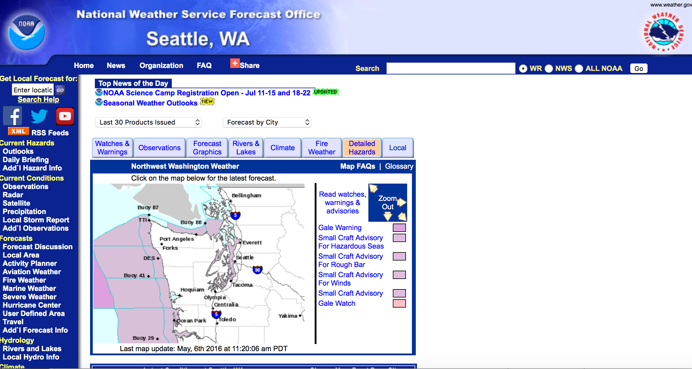
Sidebar includes links to
Current Conditions
Satellite Imagery
Forecasts
Fire Weather
Notes:
Switch to browser click on tabs

Slide 12
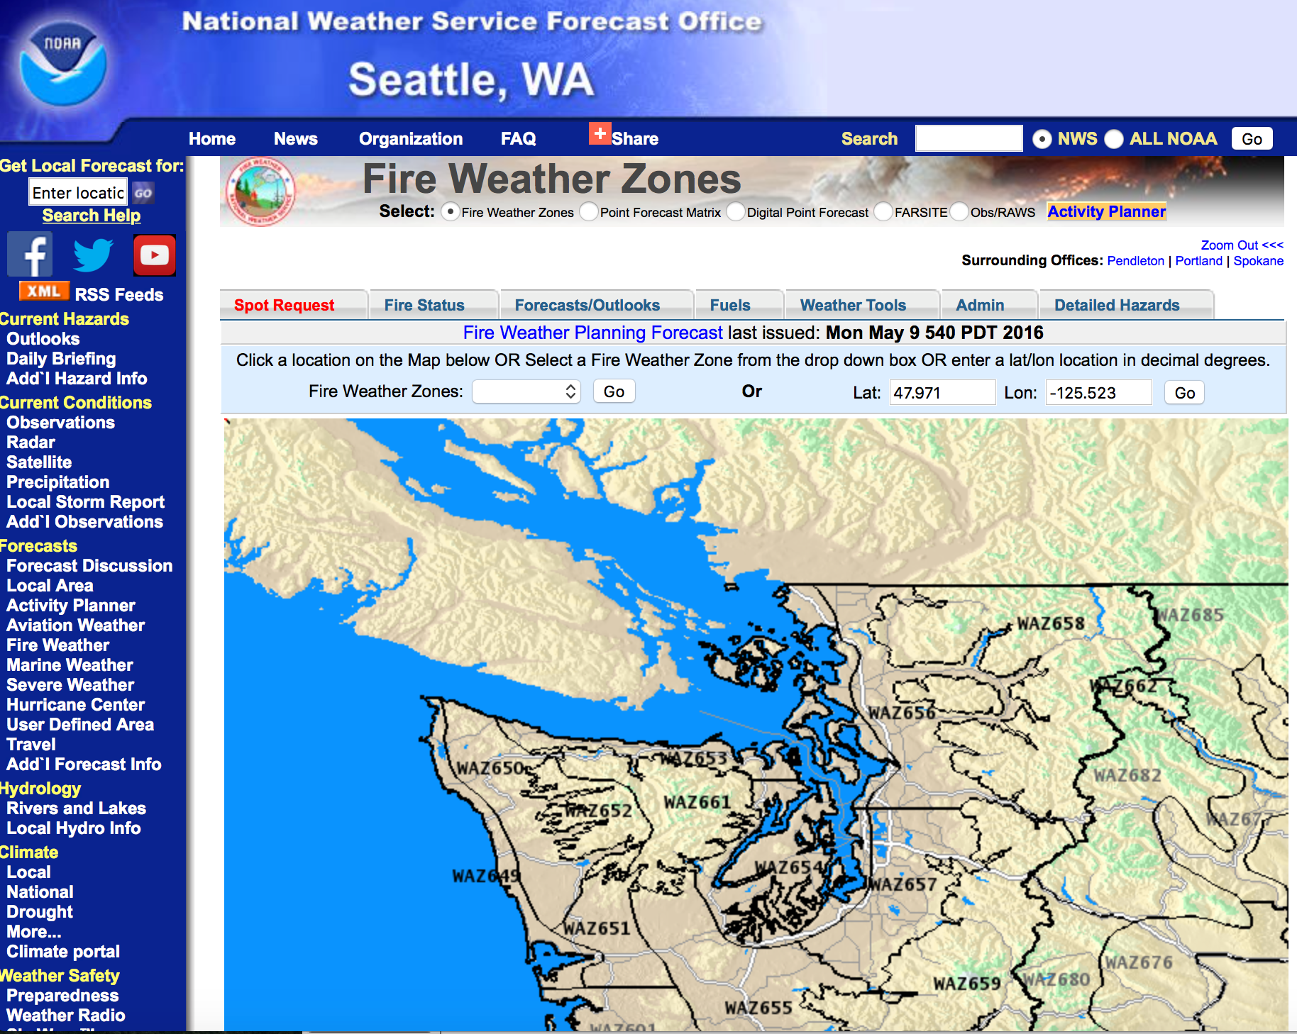

Slide 13
NCEP (NWS) Models
Notes:
Switch to browser click on tabs

Slide 14
University Websites
http://www.atmos.washington.edu/mm5rt/

Slide 15
Satellite: Visible
Shows view from space…
Advantages
1km resolution
Track smoke plumes during daytime
Verify early morning smoke in drainages
~15 min updates
Disadvantages
Lower-levels can be obscured by higher cloud deck
Needs the sun!
Image from NWS Lubbock

Slide 16
YOU!
Pay attention to the weather around you to anticipate changes and “validate” forecasts – “situational awareness”
Clouds –
increasing/decreasing
Lowering/raising
Types changing
Winds –
changes in direction and/or speed
Temperature and humidity
Increasing/decreasing

Slide 17
What to include in a smoke forecast/briefing?
What happened in the past 24 hours (compare with yesterday’s dispersion model prediction)?
What’s happening now (monitoring data, satellite imagery)?
What do you expect to happen in the next 24-48 hours? Why? (today’s dispersion model run)
Potential impacts on nearby resources (populated areas, schools, hospitals, transportation corridors, fire camps, sports events, etc.)
Current and forecast air quality indices
Any information on fire activity/growth
Anything else that is important or pertinent

Slide 18
Aspects to consider when communicating forecast…

