Slide 1
Weather Forecasting Fundamentals
Meteorology for ARAs
Unit 4

Slide 2
Objectives
Discuss advantages and limitations of different forecasting approaches
Describe common meteorological observations
Know how to convert between standard time used for weather analyses, satellite imagery, and radar products to your local time
Know frequency that weather analyses and products become available for review

Slide 3
Forecasting Methodology
Climatology
Mean observed values for a location over a specific time range
Persistence
Assumption that weather conditions won’t change significantly for a period of time
Trends
Assumption that current change in weather conditions will continue into the future
Numerical Weather Prediction (NWP)
Quantitatively modeled forecast derived from solving complex equations
Must account for conservation of mass, momentum, and energy on a rotating body
Too complex to do by hand (A six-hour forecast took six weeks to create!)
Ensemble Forecasting
Range of NWP forecasted “scenarios” based on tweaking initial conditions
Analogs
“Case-Study” approach…noting impacts that occur with similar weather patterns to anticipate future weather conditions
Empirical Prediction
Forecaster draws from past observation and experience…includes rules of thumb, lore, and deductive reasoning
Notes:
List goes from simplest to most complex. Used to be persistence was the best forecast, but not any more, with increased speed and storage capacity of computers. Ensembles good for settling on a mean forecast, or showing the range of possible forecasts. Analogs – use El Nino as example. Empirical prediction – this is what modern forecasters do, in addition to using num wx models.

Slide 4
Types of Forecast Products
Descriptive (e.g. forecast discussion)
Graphics (e.g. weather model output)
Charts (e.g. skew-T)
Tables (e.g. ventilation index)

Slide 5
Common Meteorological Observations
Altitude: feet (ft), meters (m), kilometers (km), miles (mi).
Cloud Cover: % in oktas (e.g., 0/8 oktas = clear skies)
Moisture: % relative humidity (Rh), dewpoint (Td - °C, °F), dewpoint depression (Tdd - °C, °F = T - Td), mixing ratio (w – grams of water vapor per kg of dry air)
Precipitation: inches (in), millimeters (mm)
Pressure: millibars (mb), hectopascals (hpa), inches of mercury (inHg)
Temperature: Celsius (°C), Fahrenheit (°F), Kelvin (K)
Wind Speed: miles per hour (mph), meters per second (m/s), knots (kts)
Conversions can be tedious! Use online tools to save time:
The Weather Calculator (http://www.weather.gov/epz/wxcalc)
Notes:
Point out observations are provided in different units, so be aware. Point to weather calculator at the bottom. This is one of several you can find on the web. As ARAs you will likely want to use units the general public will understand, so you may have to convert before putting data in your one-pager.

Slide 6
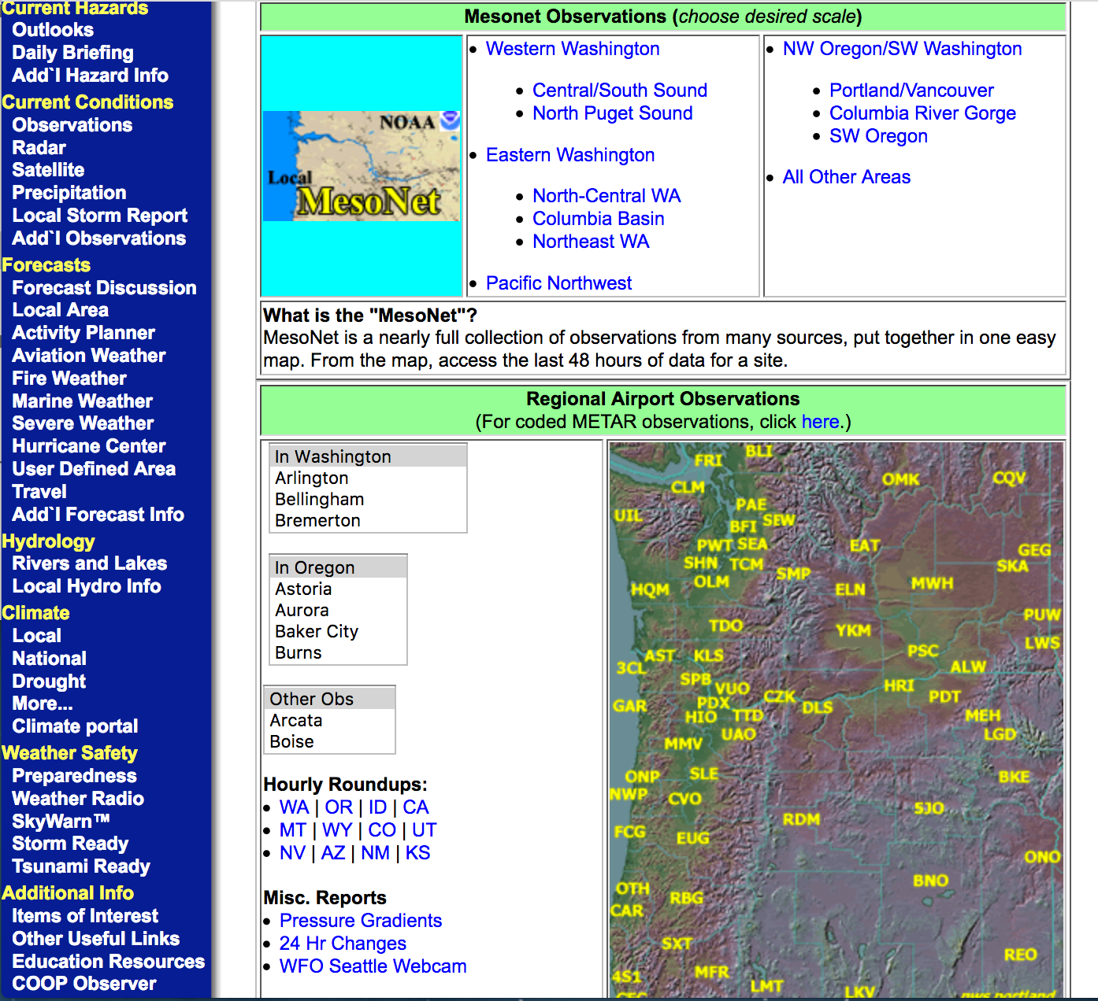
Common Meteorological Observations (cont.)
Surface Observations (hourly)
Satellite (varies – sub-hourly to every few hours)
Radar (sub-hourly)
Upper Air (twice daily)
These can be found on most NWS Forecast websites
Notes:
Example of where you can find most of these observations. This is NWS old format obs page which some forecast offices still use.

Slide 7
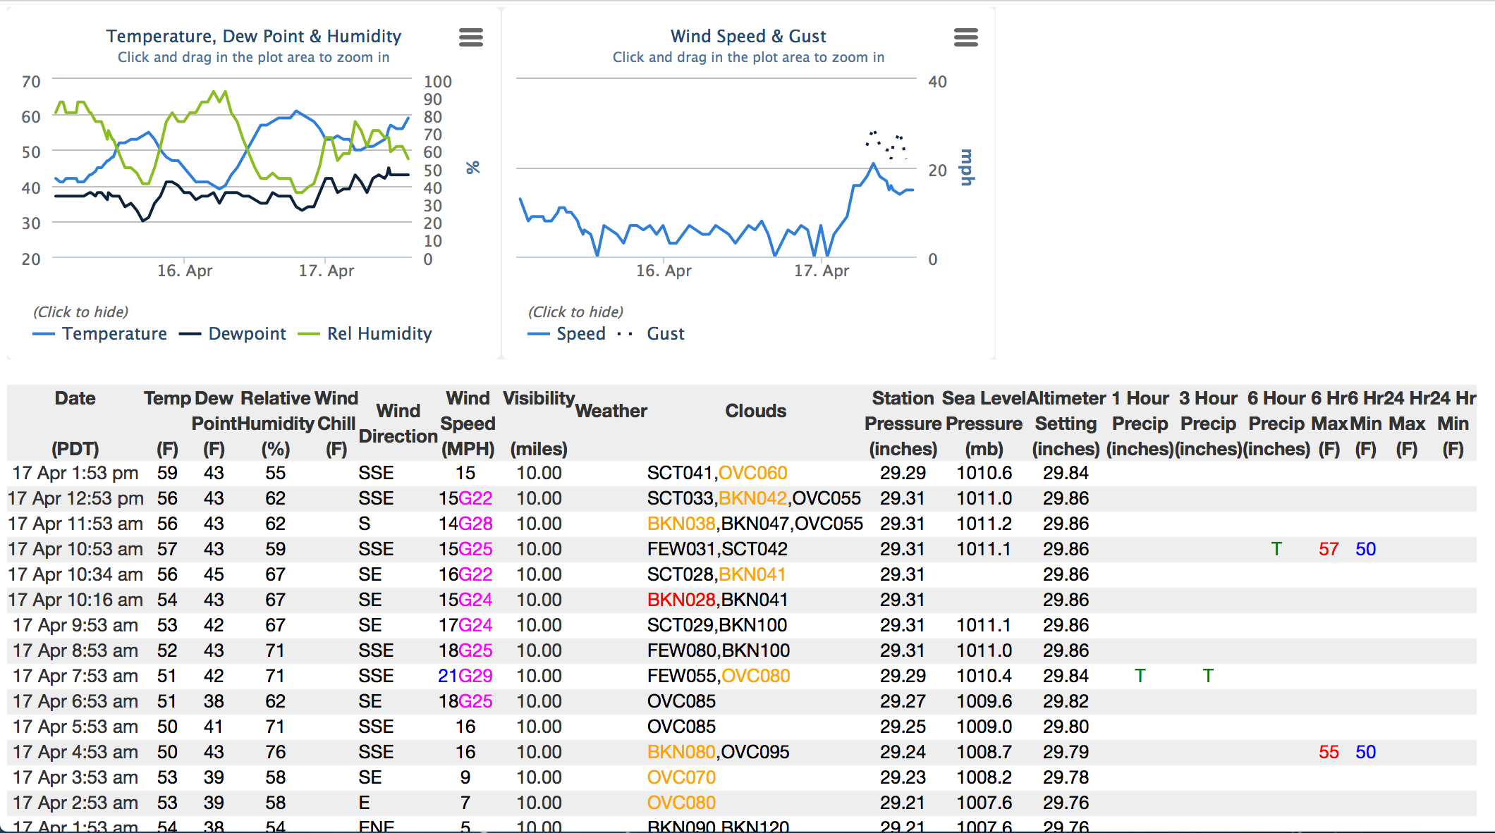
Surface Observations (Hourly)
Notes:
Example of surface obs output – shows data in tabular form, and time series graphs.

Slide 8
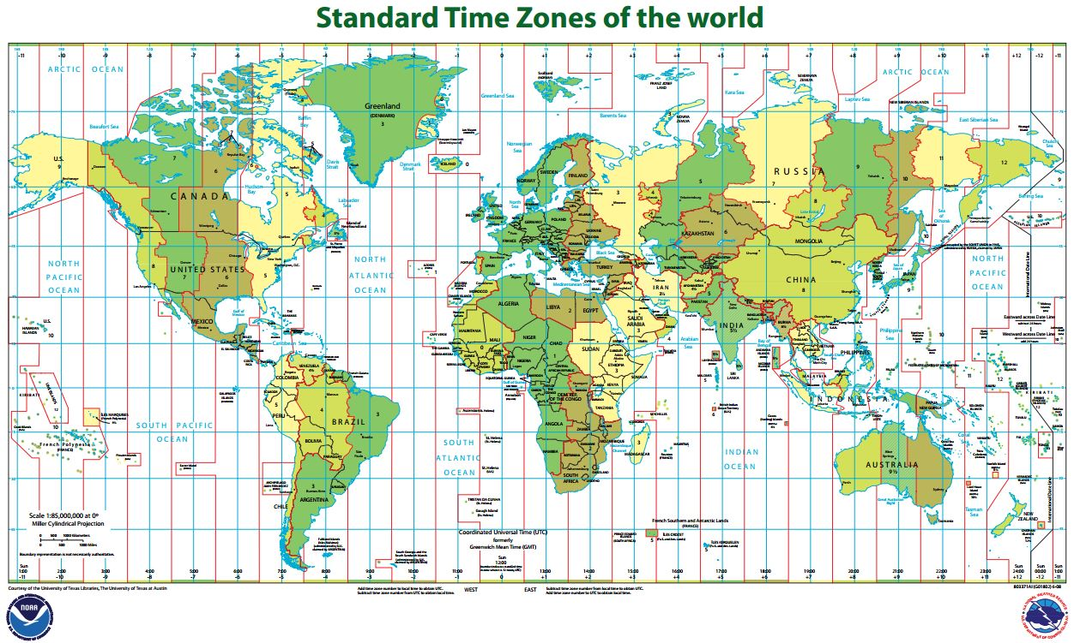
Zulu Time (Z) or Coordinated Universal Time (UTC)
Standard 24-hour time referencing all weather charts, satellite imagery, and radar products to Greenwhich, England (0° longitude)
Key is to know your local time zone’s offset and keeping track of Daylight Savings Time
Mountain Standard Time is always -7 hours (e.g., 00Z Wed 13 May 2015 is 5 PM Tue 12 May 2015)
Notes:
It’s important to understand UTC and time zone conversion. Explain time zones are not delineated by straight lines, and that not everybody uses DST.

Slide 9
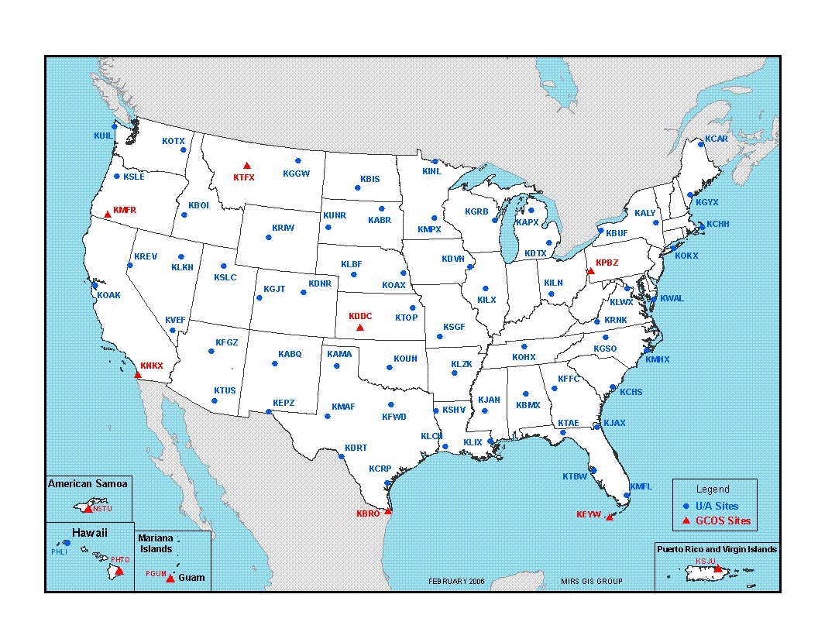
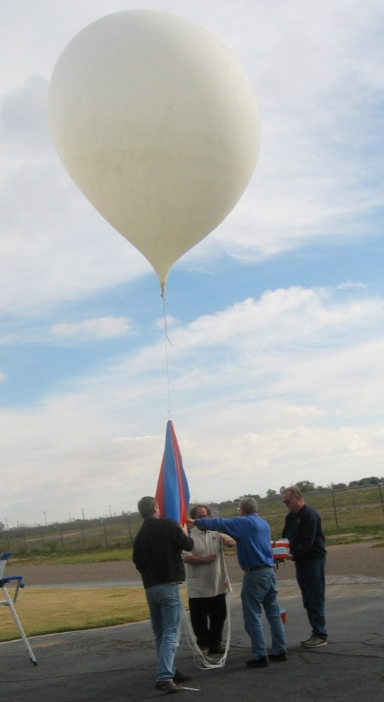
Radiosondes
Worldwide coordinated effort to capture current state of atmosphere (T, Rh, Wind, and Pressure Height) twice daily (00Z and 12Z).
Notes:
GCOS – Global Climate Observing System. Raobs launched twice daily worldwide at the same time to collect upper-air obs for use (among other things) in initializing numerical weather prediction models. Stations are about 400km apart, which is sufficient for upper level conditions.

Slide 10
Summary
Many different types of data, including surface and upper-air observations, remotely sensed (radar and satellite), and model forecast output
Observations are taken at different time intervals, depending on what is being observed
Most observations are recorded in Zulu time, so know the conversion between local time and Zulu time (don’t forget DST!)
These obs are used in numerical forecast models, and model output is available at several locations on the web.

Slide 11
Useful Websites
http://www.wrh.noaa.gov/wrh/forecastoffice_tab.php
http://www.ssd.noaa.gov/PS/FIRE/sat_west.html
https://weather.msfc.nasa.gov/GOES/goeseastconus.html
https://weather.msfc.nasa.gov/GOES/goeswestpacus.html
http://weather.rap.ucar.edu/radar/
http://weather.rap.ucar.edu/upper/

Slide 12
Elements of a Balanced Forecast (Where do you find them?)
Meteorology for ARAs
Unit 5

Slide 13
Objectives
Describe where to find forecast products
Describe what elements you may want to include in a smoke forecast/briefing

Slide 14
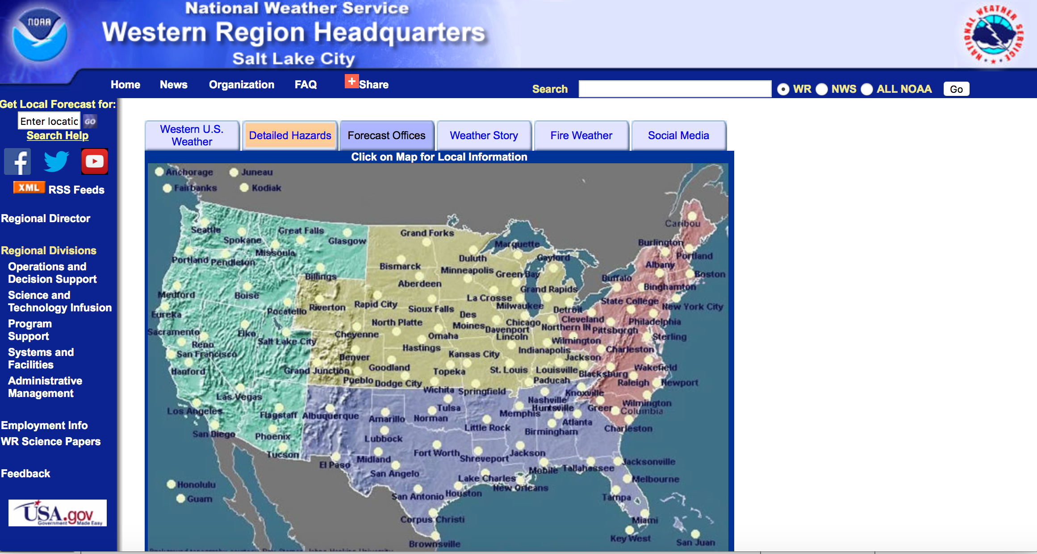
National Weather Service
http://www.wrh.noaa.gov - click on “Forecast Offices” tab
Notes:
This link will take you to a page showing the locations of all NWS offices. You can easily find and link to the closest office to your deployment.

Slide 15
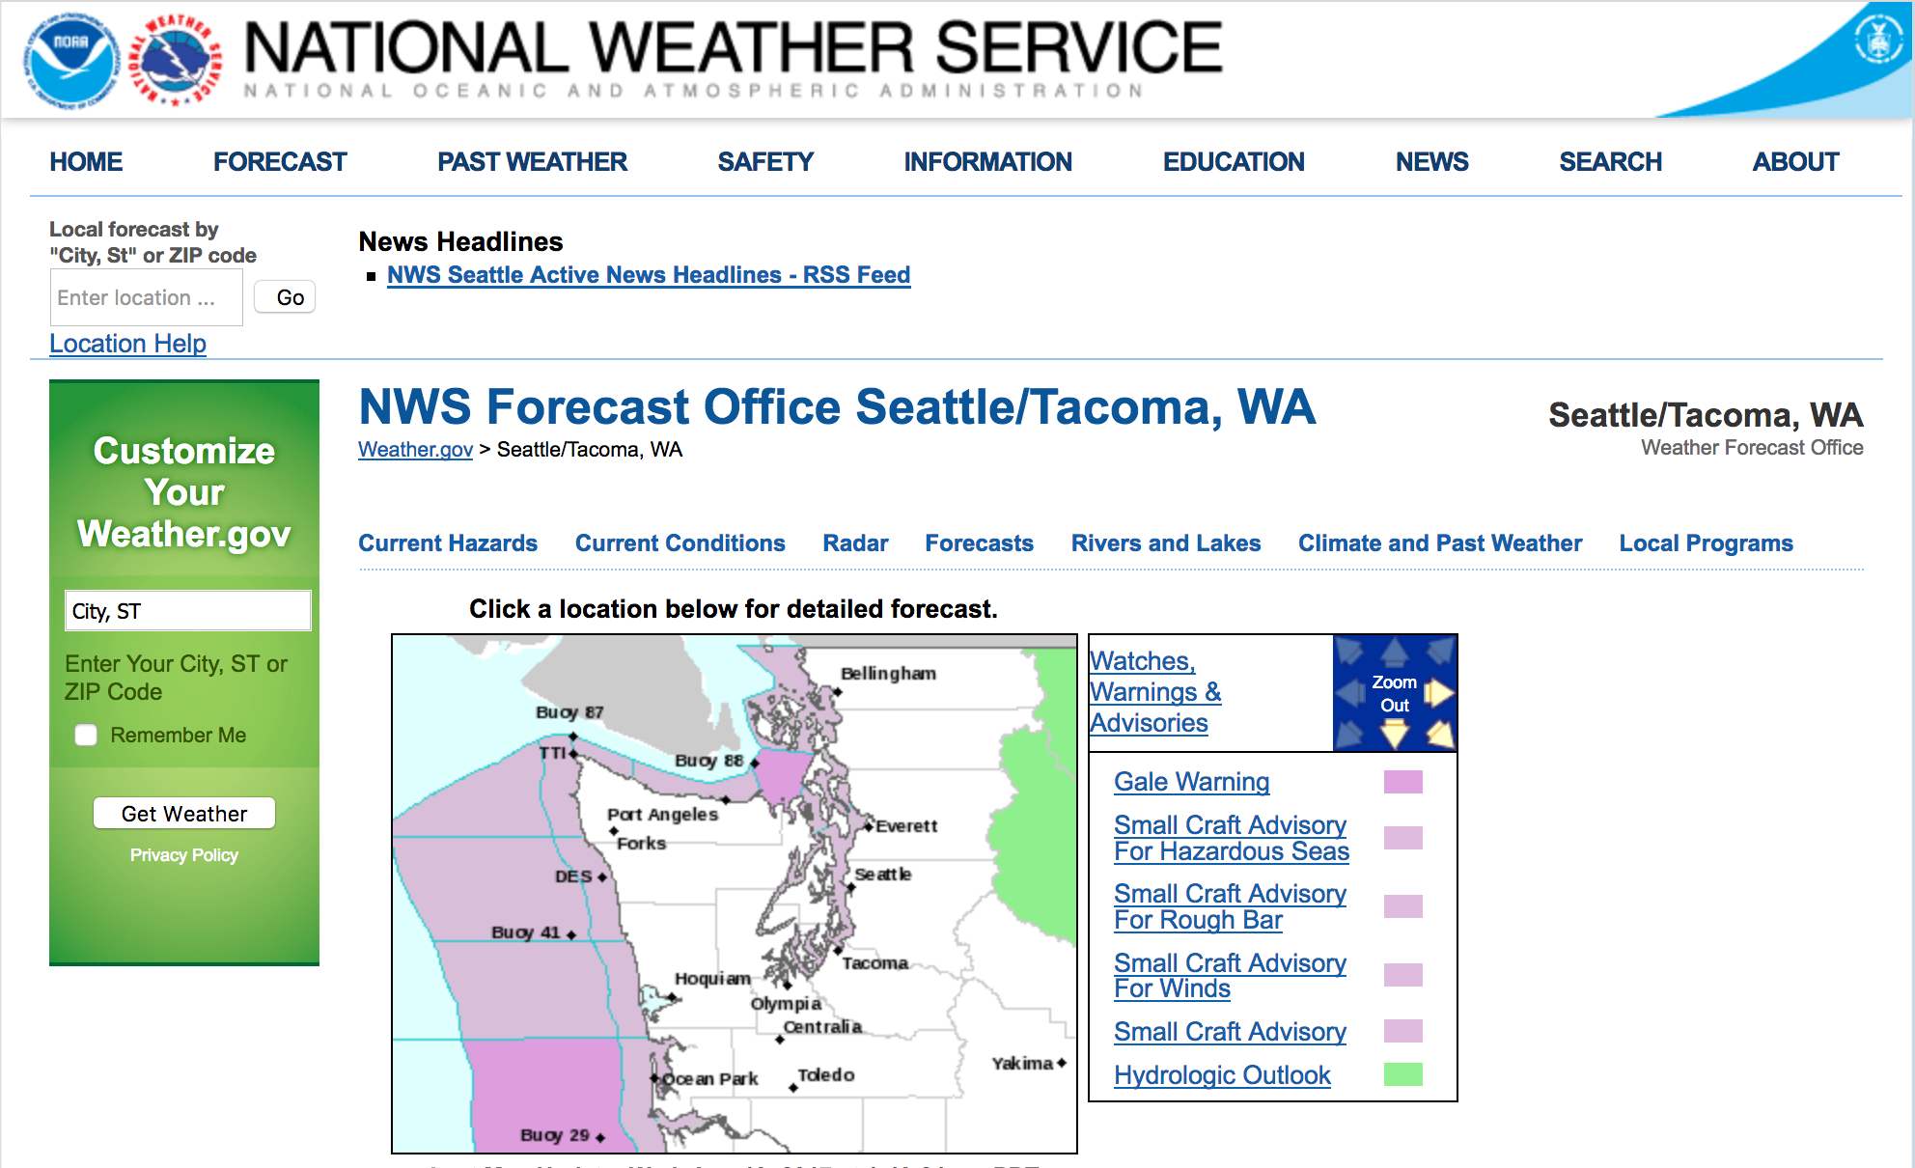
Menu bar at top includes links to
Current Conditions
Satellite Imagery
Forecasts
Fire Weather
Notes:
Almost all NWS websites look like this now. Note the two “toolbars” – one under the page title (HOME FORECAST …) and one underneath “NWS Forecast Office Seattle/Tacoma, WA). I put a red square around this one, because I find the options more useful and easier to navigate. When you hover your mouse over the headings you’ll get a drop-down list of available data.

Slide 16
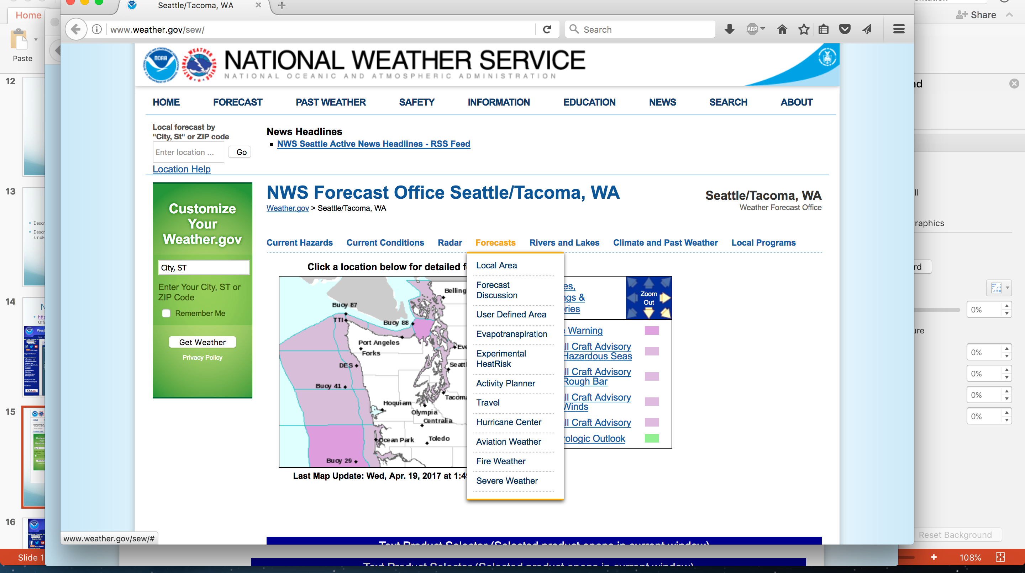
Notes:
For example, if you hover your mouse over Forecasts you will get a list of available forecasts, including Fire Weather. This will take you to a page that looks very similar to the old NWS pages.

Slide 17
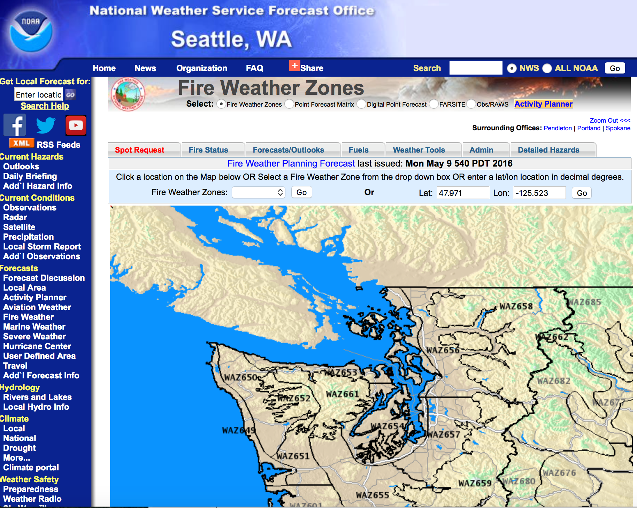
Notes:
Here you can click on a specific zone to get that zone forecast product. Also, notice the navigation bar on the left that is the same as the old NWS web site. Finally, notice the link on the left side of the menu bar, for “Spot Request.” From here you can request a spot forecast, or just as useful, search past spot forecasts for your fire. This will inform you as to what’s been happening with the weather on your fire.

Slide 18
NCEP (NWS) Models
http://mag.ncep.noaa.gov/
Notes:
From this page you can access numerical weather model output, and observation analyses maps, such as the surface analysis, 850 mb analysis, and many more.

Slide 19
University Websites
http://www.atmos.washington.edu/mm5rt/
Notes:
Many university atmospheric science departments run and post regional weather model output. This is an example from U of Washington.

Slide 20
Satellite: Visible
Shows view from space…
Advantages
1km resolution
Track smoke plumes during daytime
Verify early morning smoke in drainages
~15 min updates
Disadvantages
Lower-levels can be obscured by higher cloud deck
Needs the sun!
Image from NWS Lubbock
Notes:
There are many sources for satellite imagery

Slide 21
YOU!
Pay attention to the weather around you to anticipate changes and “validate” forecasts – “situational awareness.” Are current conditions consistent with earlier forecasts?
Clouds –
increasing/decreasing
Lowering/raising
Types changing
Winds –
changes in direction and/or speed
Temperature and humidity
Increasing/decreasing

Slide 22
What to include in a smoke forecast/briefing?
What happened in the past 24 hours (compare with yesterday’s dispersion model prediction)?
What’s happening now (monitoring data, satellite imagery)?
What do you expect to happen in the next 24-48 hours? Why? (today’s weather and dispersion model runs)
Potential impacts on nearby resources (populated areas, schools, hospitals, transportation corridors, fire camps, sports events, etc.)
Current and forecast air quality indices
Any information on fire activity/growth
Anything else that is important or pertinent
Notes:
Compare yesterday’s forecast with today’s conditions. If yesterday’s forecast was good, maybe today’s will be too. This is an example of using a “trend forecast” as discussed on Slide 3 of Unit 4.

Slide 23
Summary
There are many sources of weather data, including
observations (surface, upper-air, radar, satellite, etc.) and
forecasts (models, text forecasts, etc.).
Be familiar with resources at risk from your fire. This will help you determine which sources of data to use.
When possible, determine if information from multiple sources agrees or disagrees.
Consider what the expected weather conditions means for smoke impacts in the vicinity of the fire.

Slide 24
Useful Websites
http://www.wrh.noaa.gov/wrh/forecastoffice_tab.php
http://www.wrh.noaa.gov/firewx/?wfo=sto)
http://www.weather.gov/spot/monitor/)
http://gacc.nifc.gov/predictive_services/weather/weather.htm
http://weather.rap.ucar.edu/upper/
http://weather.rap.ucar.edu/surface/

Slide 25
Aspects to consider when communicating forecast…

