Slide 1
Smoke Modeling and Information
Smoke Model Interpretation
Unit 3

Slide 2
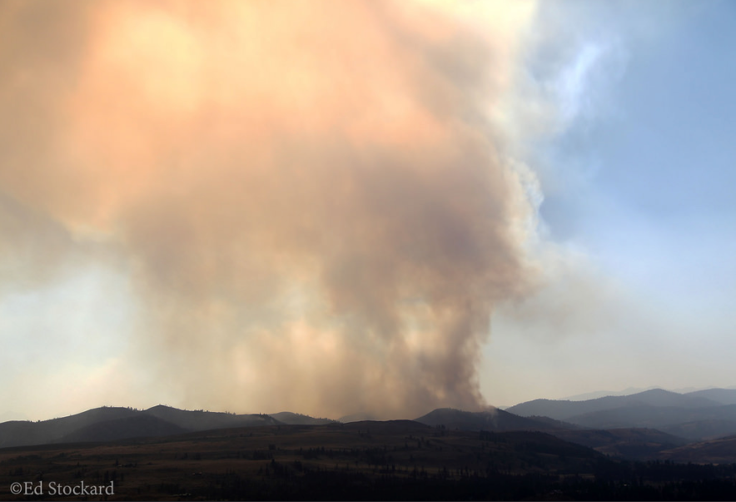
Questions for You
Why are you running and/or using smoke models?
What information/data do you need from a smoke model?
How will you use that information?
How do you determine if the model output is “good?”
What do you do if the model output is “not good?”

Slide 3
Tools (Models) Available Online
BlueSky Wildfire Operational Runs
http://tools.airfire.org/
BlueSky Playground – Do your own smoke (PM_{2.5}) modeling
http://tools.airfire.org/
NOAA HYSPLIT (Dispersion and Trajectories)
http://ready.arl.noaa.gov/HYSPLIT.php
AIRPACT (Physical and Chemical processes)
http://lar.wsu.edu/airpact/introduction.html/
Firework (Canadian PM_{2.5} predictions)
https://weather.gc.ca/firework/index_e.html
“Picking a model of choice for the day is a little like speed-dating: too little time/information to make up the mind leading to regrets by the end of the date/shift.”
- Wes Adkins, Meteorologist, National Weather Service, Juneau, AK

Slide 4
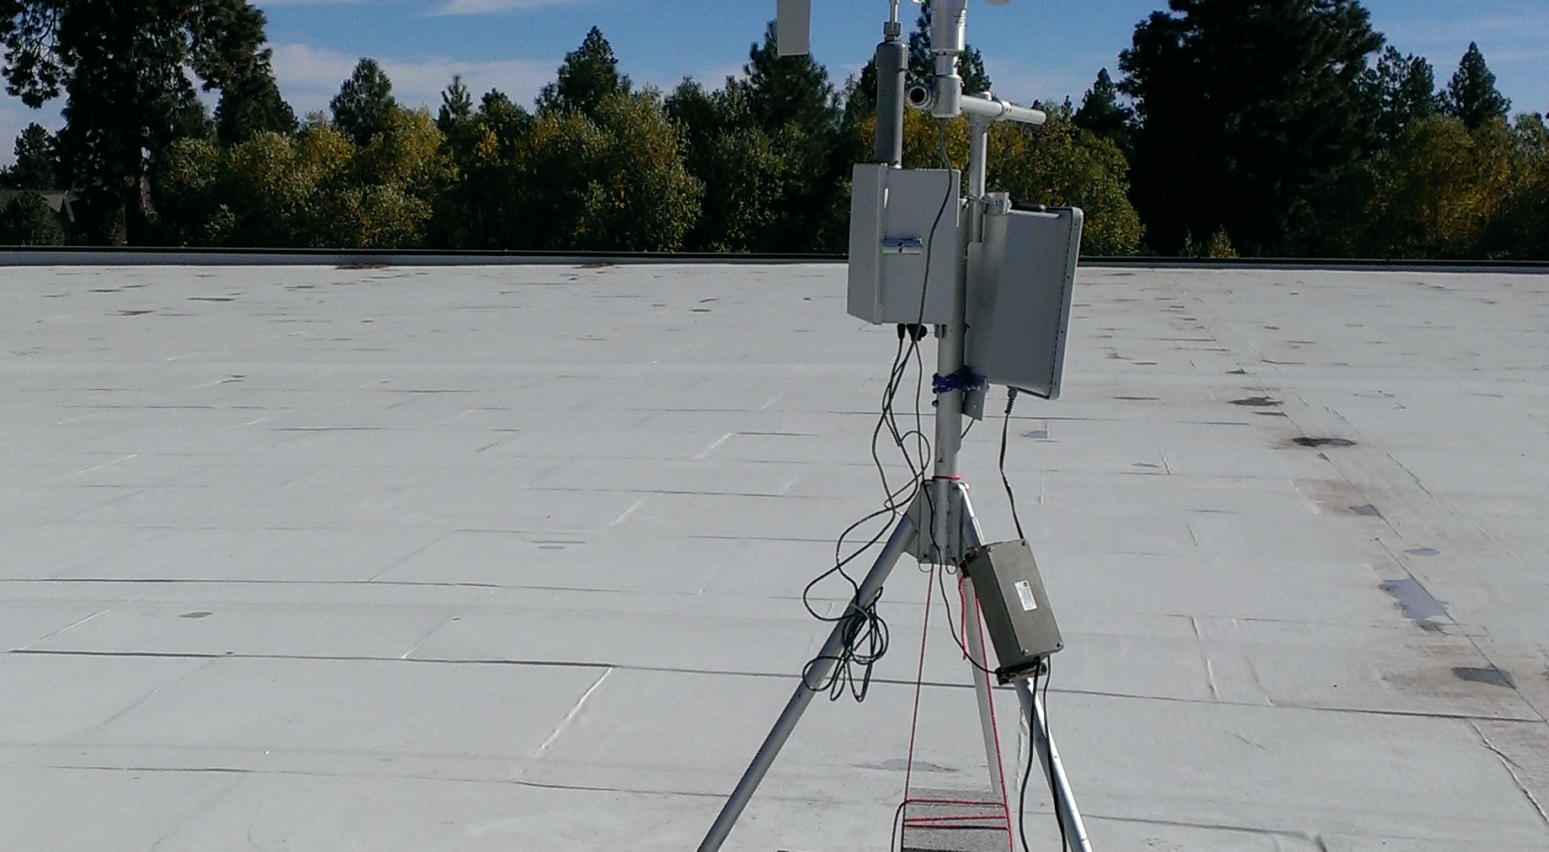
Additional Online Tools
Monitoring report page
“Easy” trajectory page
Ventilation Climate Information System
Find these at:
http://tools.airfire.org

Slide 5
Additional useful sites
Visible satellite imagery
  http://weather.msfc.nasa.gov/GOES/goeswestpacus.html
  http://weather.msfc.nasa.gov/GOES/goeseastconus.html
  http://rammb.cira.colostate.edu/dev/lindsey/loops/
  http://www.ssd.noaa.gov/PS/FIRE/sat_west.html
Fire and AQ Information
  http://inciweb.nwcg.gov
  http://www.airnowtech.org
  http://www.wrcc.dri.edu/cgi-bin/smoke.pl
  https://www.star.nesdis.noaa.gov/smcd/spb/aq/index.php?product_id=0 (IDEA- Infusing satellite Data into Environmental Applications)
  Wildlandfiresmoke.net/resources

Slide 6
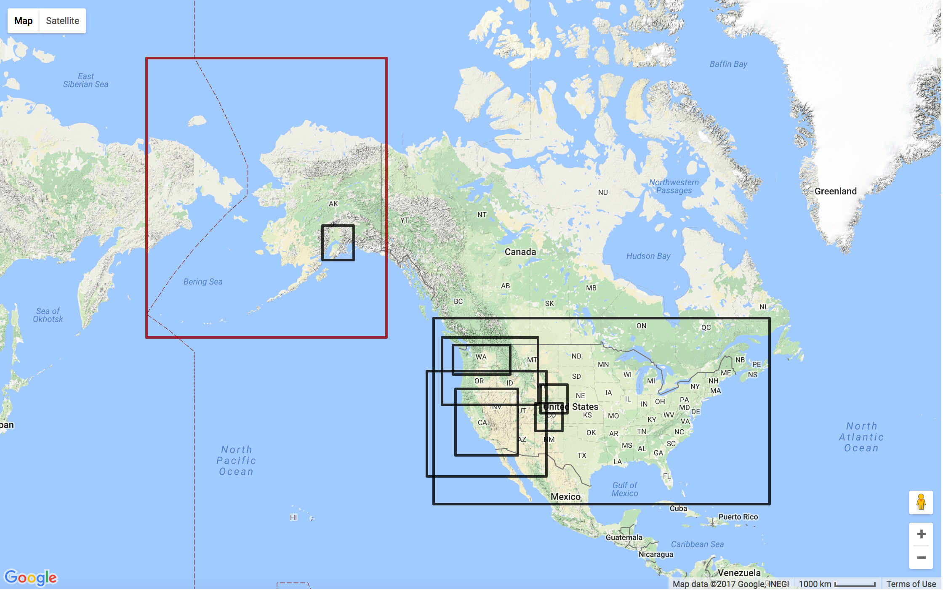
Daily BlueSky Production Runs
http://www.airfire.org/data/bluesky-daily

Slide 7
What am I looking at to evaluate the models?
Visible satellite imagery (look at several!) – compare where smoke from your fire is this morning compared with yesterday’s model run (remember – the dispersion model predicts surface PM_{2.5} and the satellite images may show surface smoke or smoke aloft). Radar imagery can also show smoke.

Slide 8
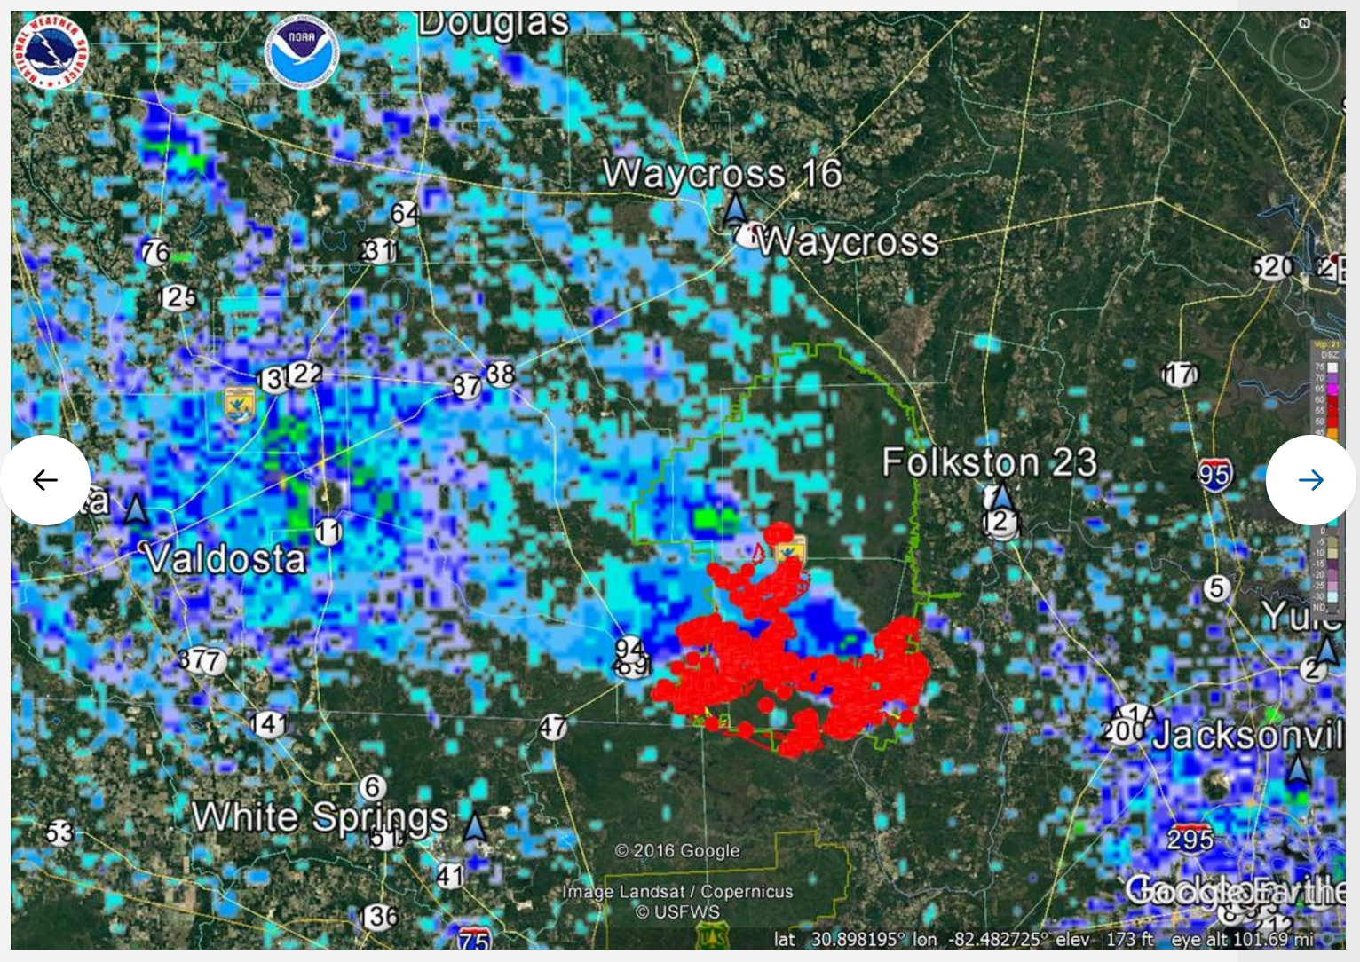
Notes:
Trent Wickman’s example of radar image from West Mims fire. Blue colors indicate smoke; red dots are hot spots

Slide 9
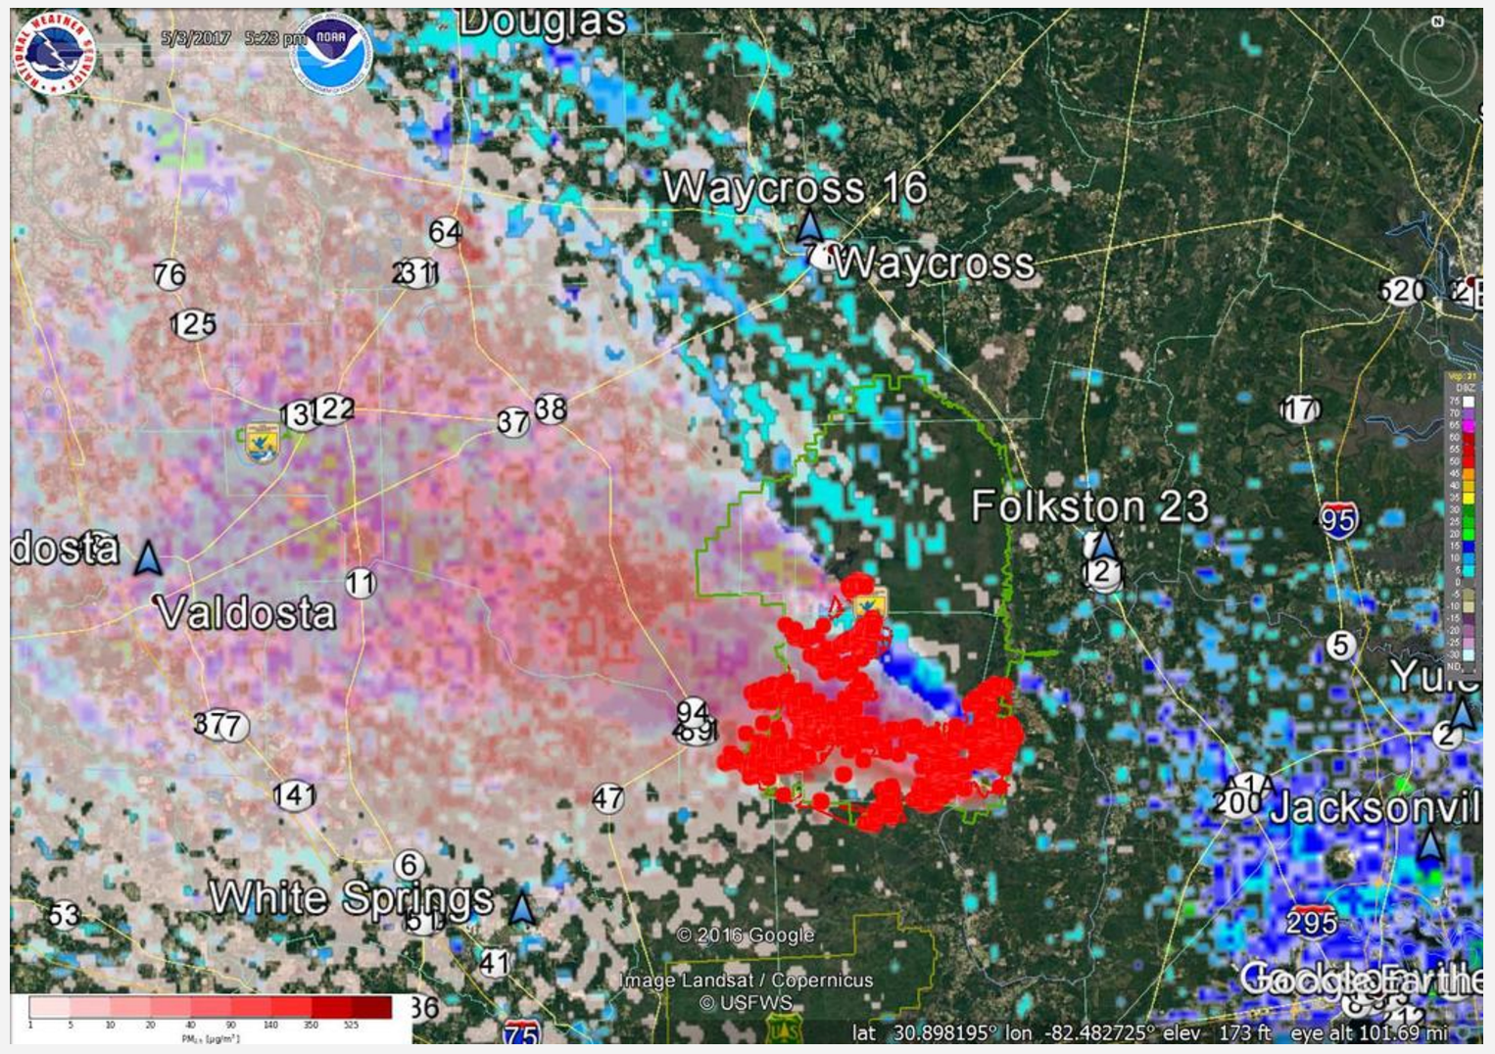
Notes:
This slide shows BlueSky output (pink colors) superimposed on the radar image from the same fire. Good agreement!

Slide 10
What am I looking at to evaluate the models?
Visible satellite imagery (look at several!) – compare where smoke from your fire is this morning compared with yesterday’s model run
This morning’s sit report (https://www.nifc.gov/nicc/sitreprt.pdf) - see how many acres consumed on your fire yesterday – can compare with the number of acres used in this morning’s BlueSky run.

Slide 11
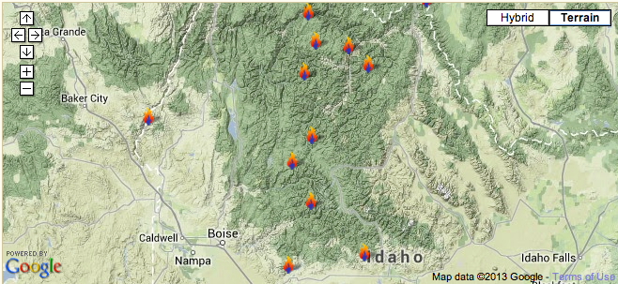
Southern Idaho fires – Summer/Fall 2012

Slide 12
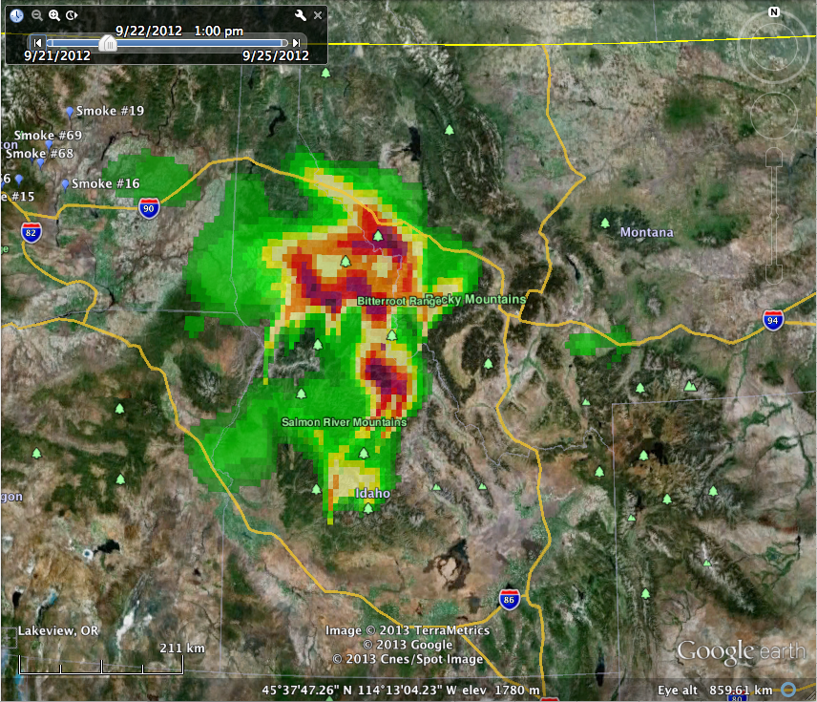
100% estimated fire growth
Notes:
Comparing this slide and the next, note when acres are increased by 300%, predicted PM2.5 concentrations are much higher, but the “footprint” (locations) of those higher concentrations is roughly the same. This is because we’re using the same met model output for both BlueSky runs (forecast winds are the same).

Slide 13
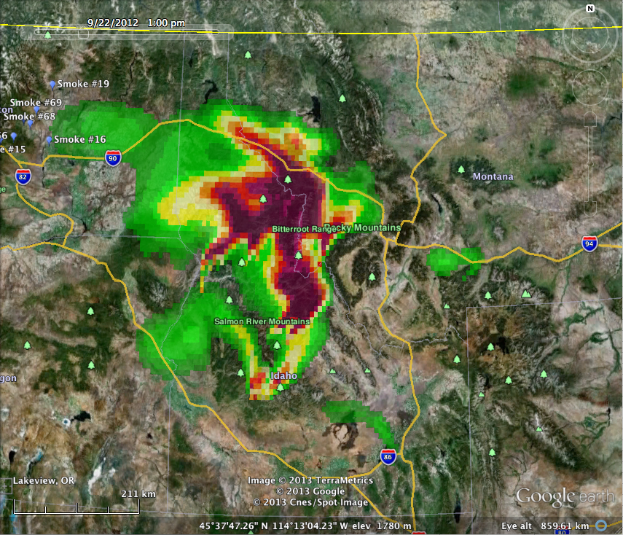
300% estimated fire growth
Notes:
Toggle between this slide and the previous one.

Slide 14
What am I looking at to evaluate the models?
Visible satellite imagery (look at several!) – compare where smoke from your fire is this morning compared with yesterday’s model run
This morning’s sit report (https://www.nifc.gov/nicc/sitreprt.pdf) - see how many acres consumed on your fire yesterday
Current PM_{2.5} monitoring data – compare this morning’s values with yesterday’s model runs (you can download a csv file from the nearest monitor)

Slide 15
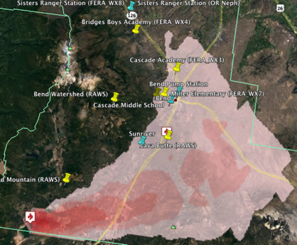
Prescribed burns outside Bend, OR, May 4 - 6 2015
1-hr PM2.5 concentrations predicted by the BlueSky smoke modeling framework May 4, 2015 at 1400 PDT
Notes:
Here’s an example of comparing monitoring data (pushpin locations) with BlueSky prediction for the same time. See next slide.

Slide 16
Notes:
The arrow on x-axis corresponds to time of BlueSky prediction in previous slide. The two monitors in Bend showed a spike in concentration the same time Bluesky predicted higher PM2.5 concentrations. This indicates the BlueSky prediction was reliable, giving you confidence in the output.

Slide 17
What am I looking at to evaluate the models?
Visible satellite imagery (look at several!) – compare where smoke from your fire is this morning compared with yesterday’s model run
This morning’s sit report (https://www.nifc.gov/nicc/sitreprt.pdf) - see how many acres consumed on your fire yesterday
Current PM_{2.5} monitoring data – compare this morning’s values with yesterday’s model runs
Today’s model runs (seek out highest resolution available) – how do they compare with yesterday’s model runs? Is your fire missing from today’s run (cloud cover, e.g.)? Try Playground.

Slide 18
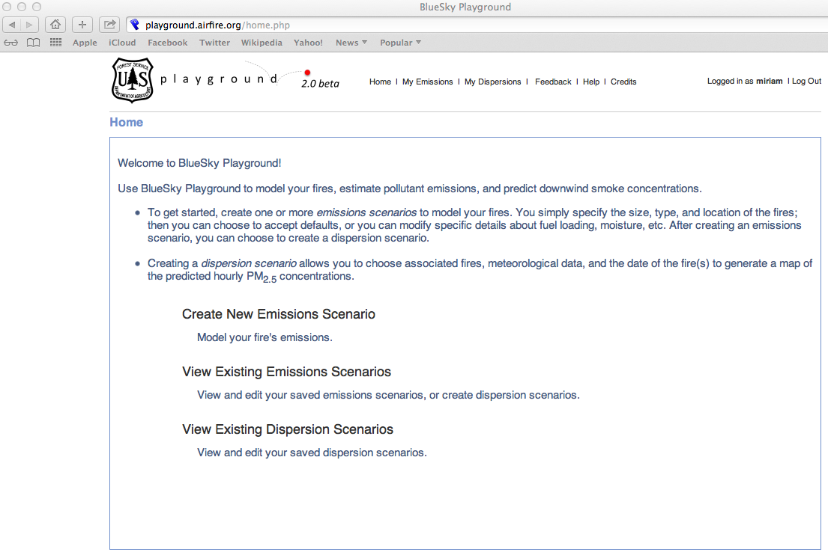
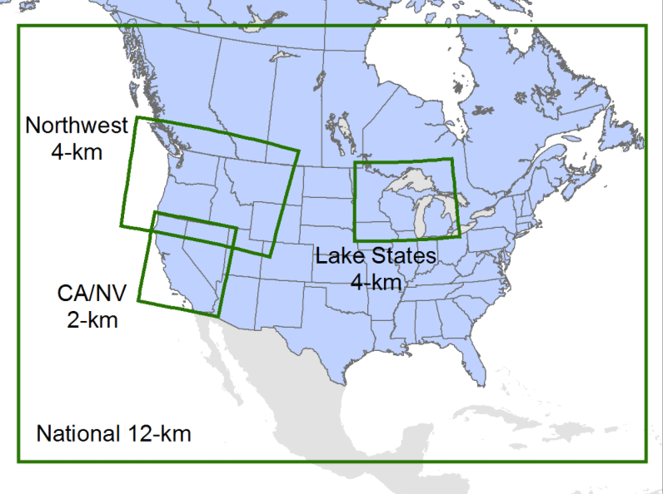
BlueSky Playground – allows users to do custom runs
playground.airfire.org

Slide 19
BlueSky Custom Runs
Reasons to request a custom run include:
Better information on fire location/size/growth rate/timing/fuels (e.g.information coming from WFDSS and/or ARAs)
Higher resolution met available (e.g. NAM 1km FW domains)
Special projects/studies (e.g. Bend smoke intrusions)

Slide 20
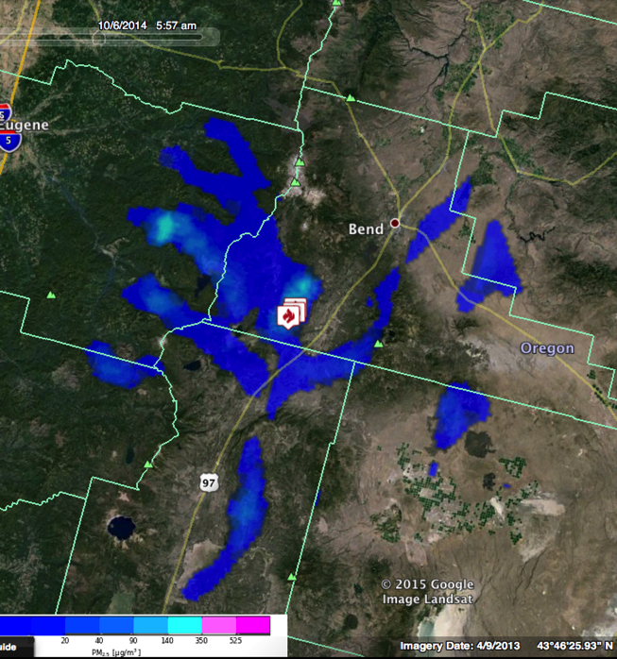
Daily scheduled BlueSky run
PNW
4km
10/6/2014 5am
Notes:
http://viewer.smoke.airfire.org/run/hysplit-pp/PNW-4km-Bend-Intr/2014100500/

Slide 21
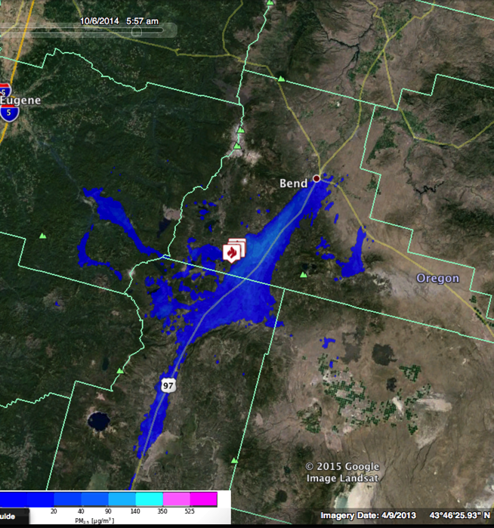
Custom hi-res BlueSky run
NWS 1km
10/6/2014 5am
Notes:
Go interactive with websky if possible.
http://viewer.smoke.airfire.org/run/hysplit-pp/FW06Z-1km-Bend-Intr/2014100506/

Slide 22
What am I looking at to evaluate the models?
Visible satellite imagery (look at several!) – compare where smoke from your fire is this morning compared with yesterday’s model run
This morning’s sit report (https://www.nifc.gov/nicc/sitreprt.pdf) - see how many acres consumed on your fire yesterday
Current PM_{2.5} monitoring data – compare this morning’s values with yesterday’s model runs
Today’s model runs (seek out highest resolution available) – how do they compare with yesterday’s model runs? Is your fire missing from today’s run (cloud cover, e.g.)? Try Playground.
Look at today’s weather forecasts – are they consistent with the model runs? Look at forecasts of mixing heights to select heights for your trajectories.

Slide 23
www.weather.gov/glossary
Planetary Boundary Layer
The layer within the atmosphere between 1 km and the earth's surface where friction affects wind speed and wind direction.
Mixing Heights
The height to which a parcel of air, or a column of smoke, will rise, mix or disperse. A column of smoke will remain trapped below this height.

Slide 24
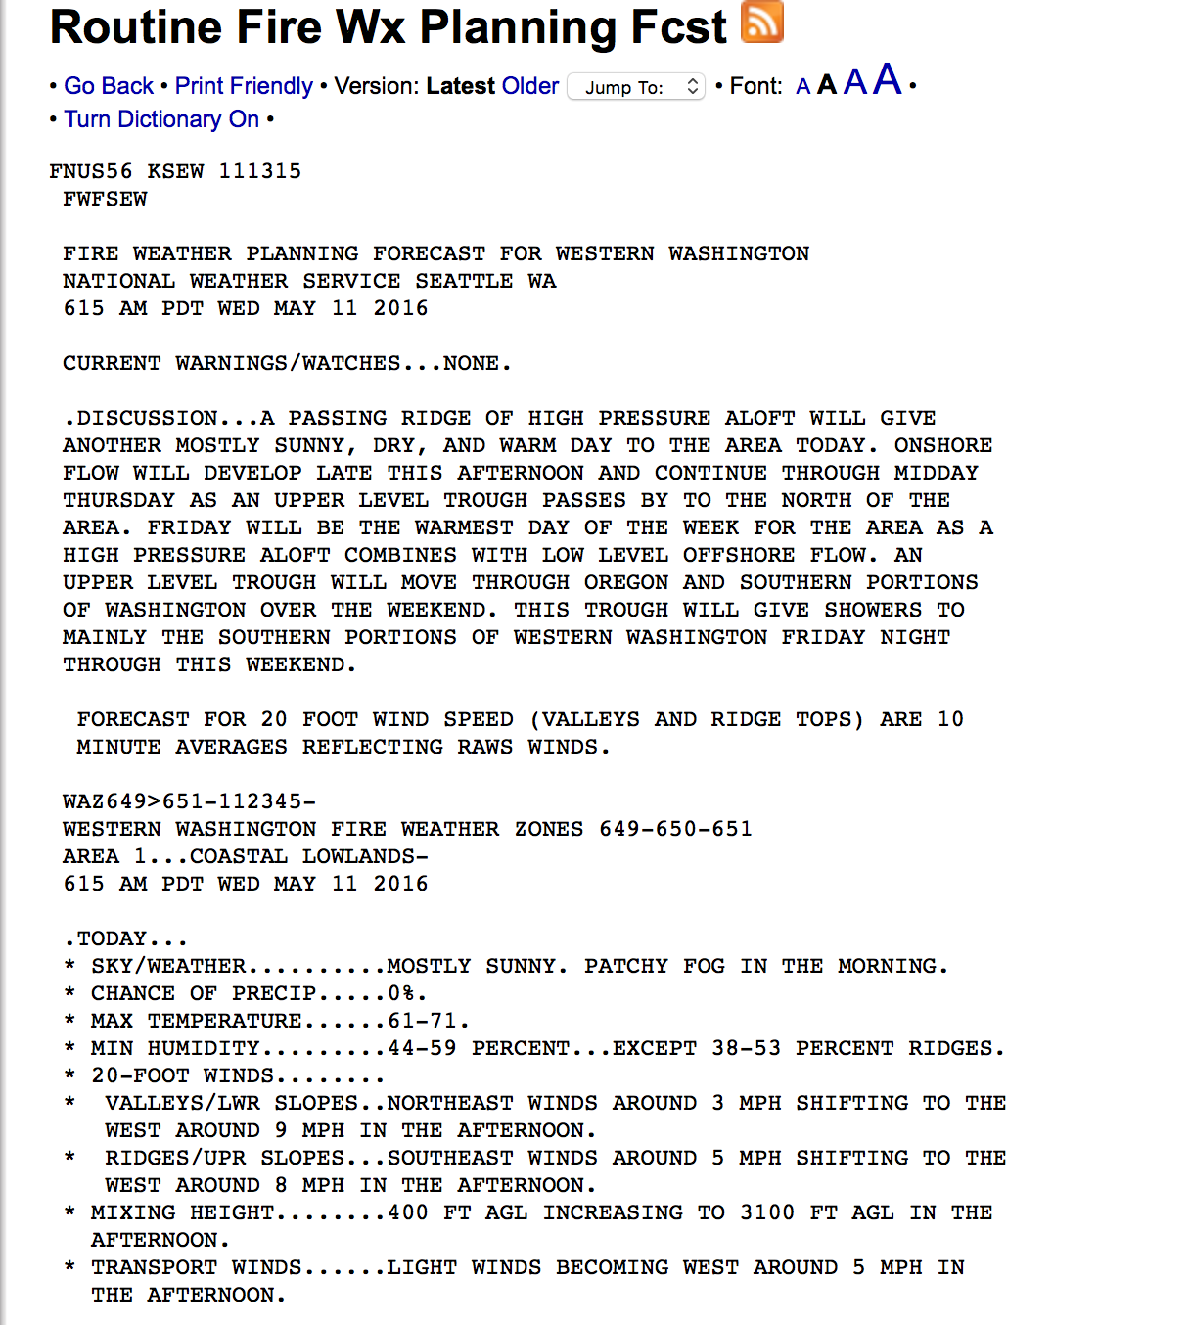
Notes:
Where to find mixing height forecasts

Slide 25
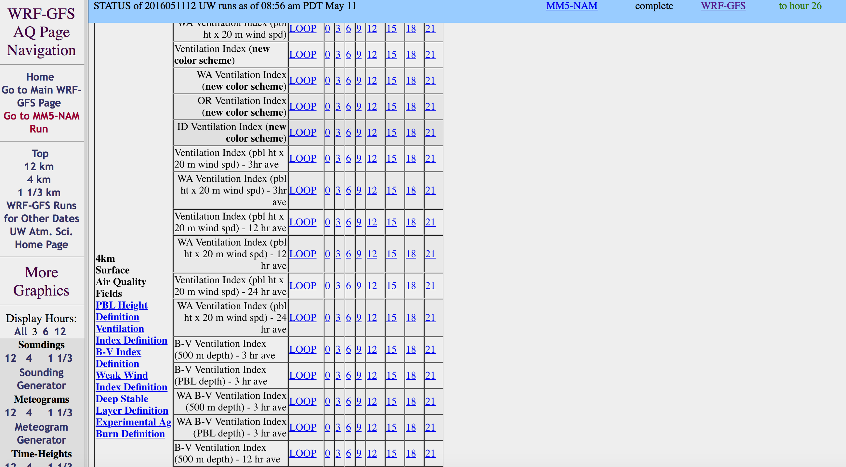
Notes:
Here is a source of predicted PBL (which is not exactly the same as mixing height – but they should correlate) from the UW WRF model.

Slide 26
What am I looking at to evaluate the models?
Visible satellite imagery (look at several!) – compare where smoke from your fire is this morning compared with yesterday’s model run
This morning’s sit report (https://www.nifc.gov/nicc/sitreprt.pdf) - see how many acres consumed on your fire yesterday
Current PM_{2.5} monitoring data – compare this morning’s values with yesterday’s model runs
Today’s model runs (seek out highest resolution available) – how do they compare with yesterday’s model runs? Is your fire missing from today’s run (cloud cover, e.g.)? Try Playground.
Look at today’s weather forecasts – are they consistent with the model runs? Look at forecasts of mixing heights to select heights for your trajectories.
Run some trajectories.

Slide 27
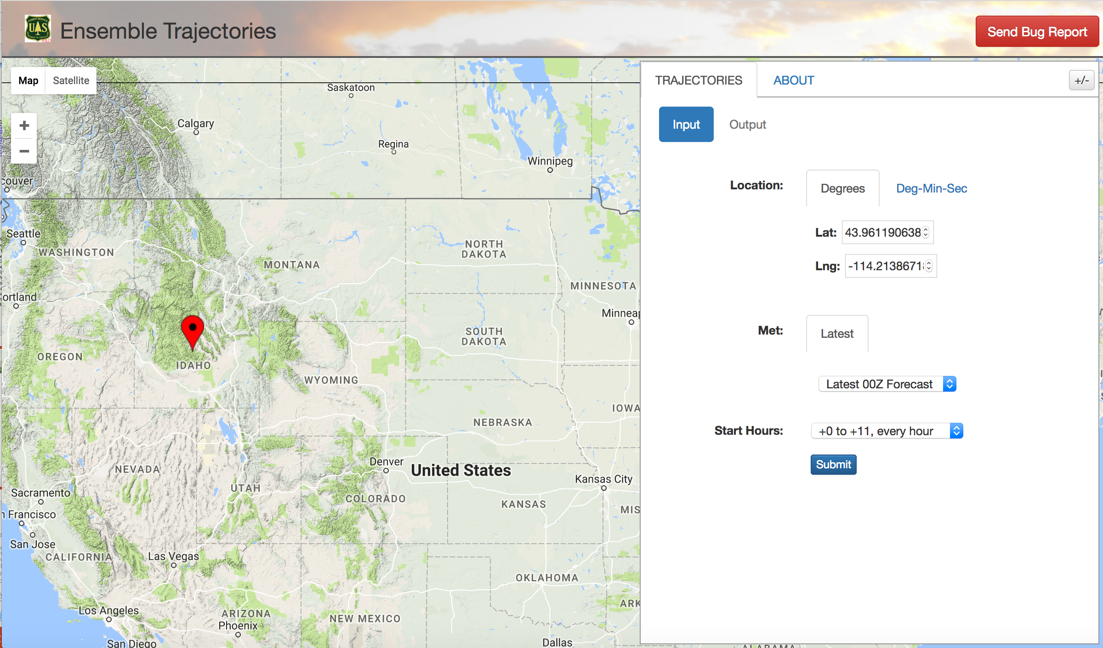
tools.airfire.org
Notes:
Select the location for your trajectories, then click on the Submit button.

Slide 28
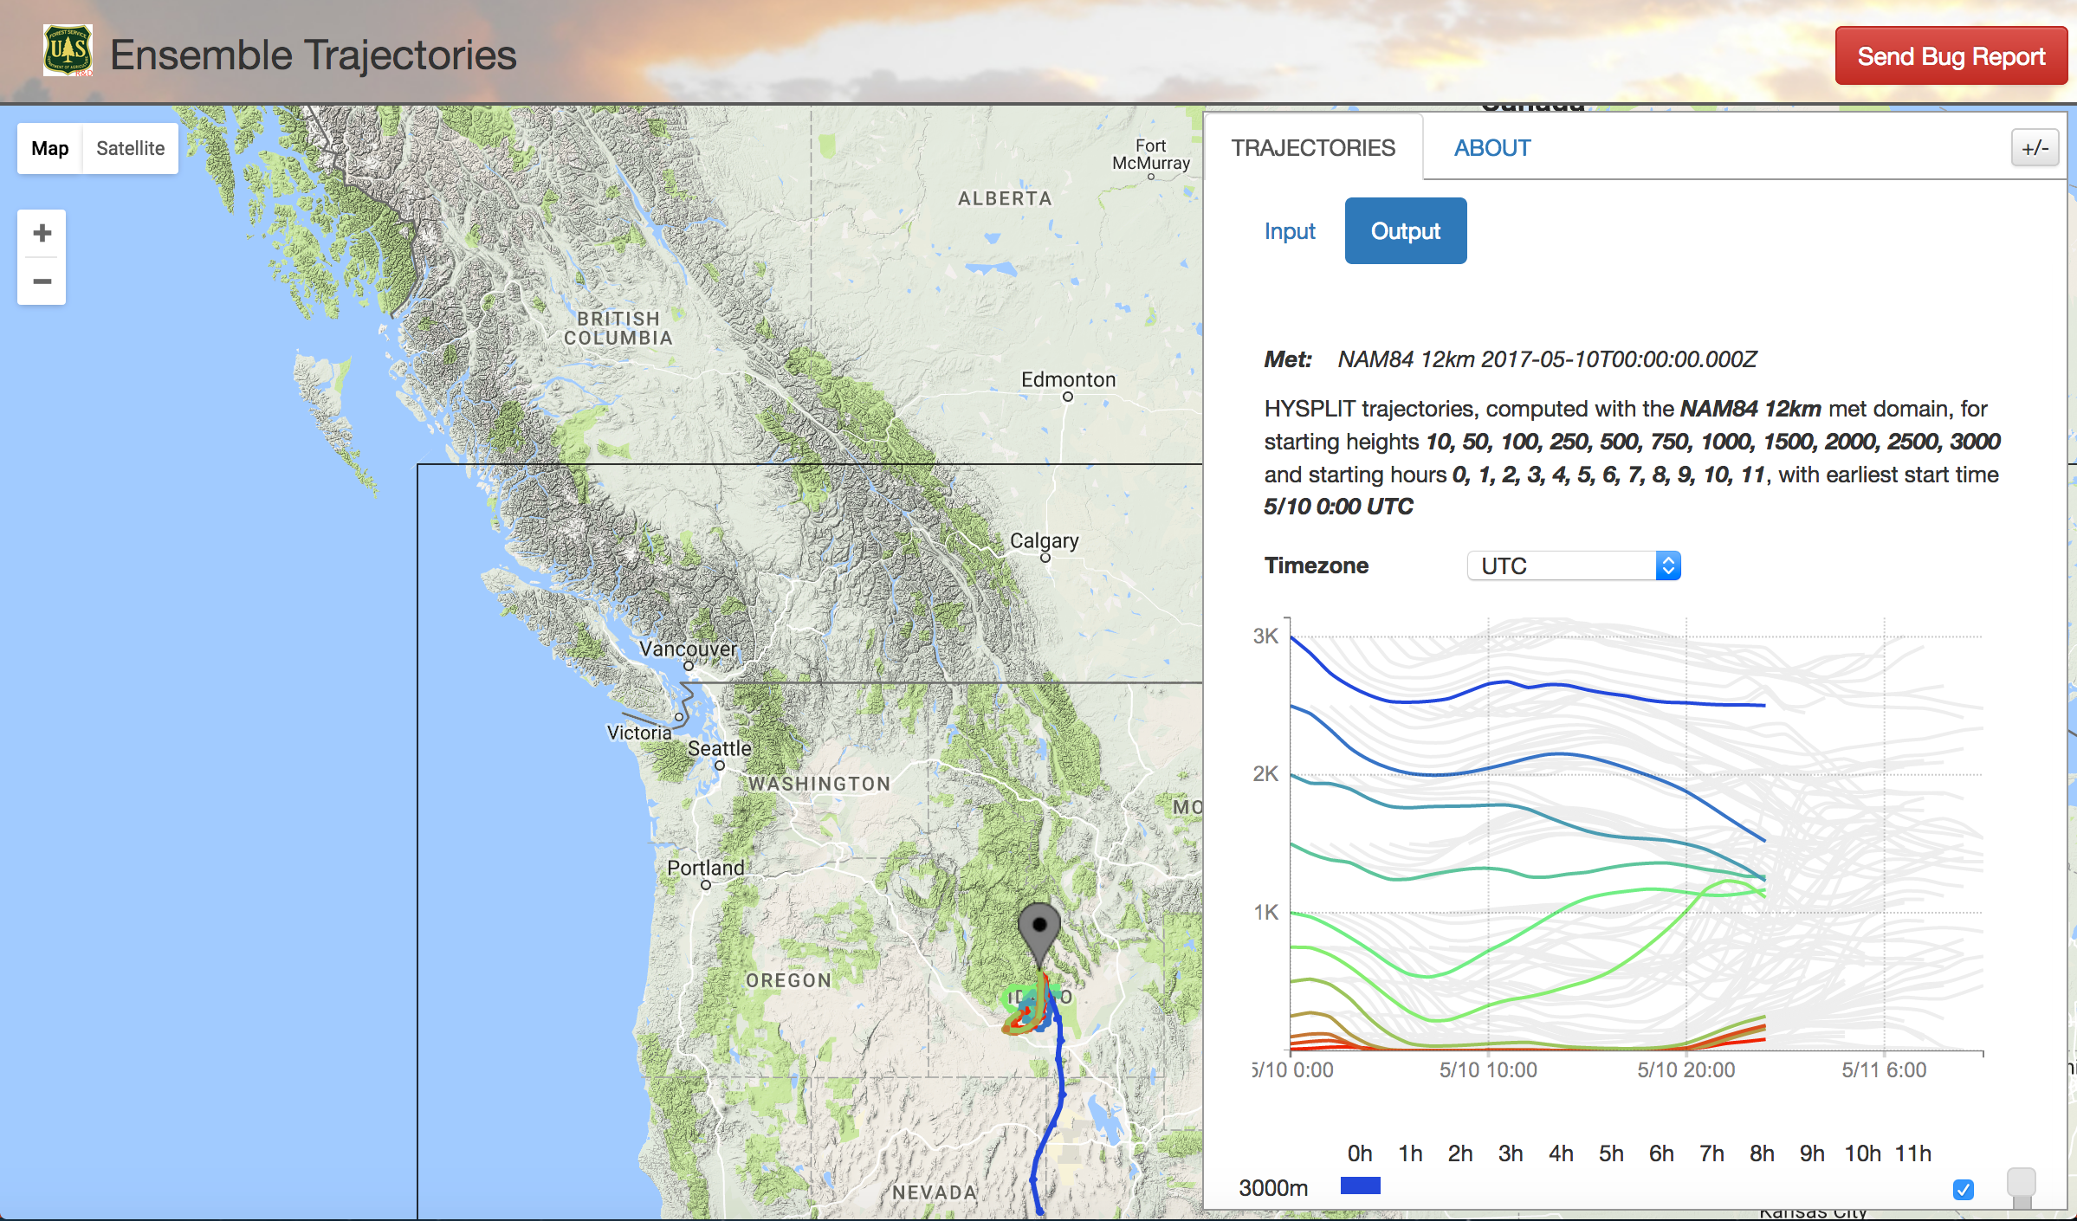
Notes:
You will get a plan view showing trajectories for 12-hour period and a time-height profile. The text at the top provides information on which met model was used to generate the trajectories.

Slide 29
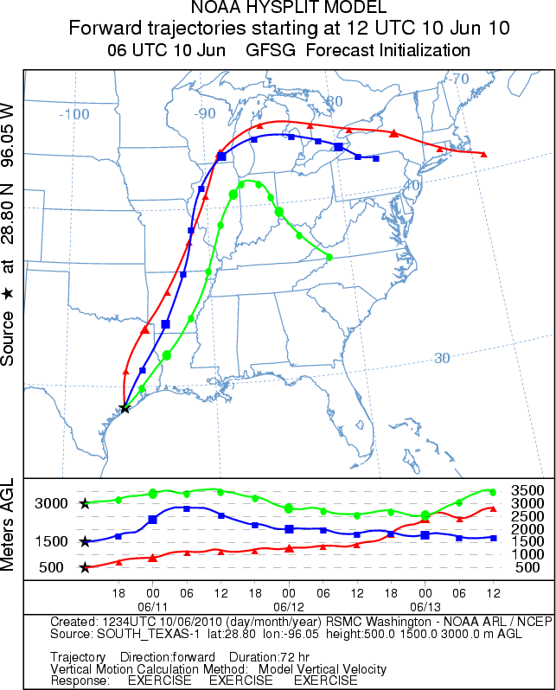
NOAA HYSPLIT
Dispersion
Trajectory – Simulates where a parcel of air would travel, given:
  A Release Location
  Release Height
  Date and Time
Many meteorological choices
http://ready.arl.noaa.gov/HYSPLIT.php
Notes:
Each point is 6 hours out in time.
12-km NAM
The three release heights are not modifiable currently.
Trial product over the last year.
Looking at making operational.

Slide 30
Interpreting Model Runs
  What question are you trying to answer?
    When/where will smoke effects occur
    Will there be an exceedence of the AQ standards?
    Anything else pertinent to your fire?
  Get as much information as possible on what went into the model runs – includes fuels, weather, fire location, fire size, local knowledge, etc.
  Familiarize yourself with model limitations
  Familiarize yourself with monitor limitations
  Compare different model outputs (different domains, resolutions, etc.)
  Mentally adjust output to compensate for known inaccuracies (too many acres, dispersion down wrong drainage, etc.)
  Think in terms of relative, rather absolute impacts (are concentrations higher/lower; more/less widespread than yesterday?).
No model is “bad.” All models are useful!

Slide 32
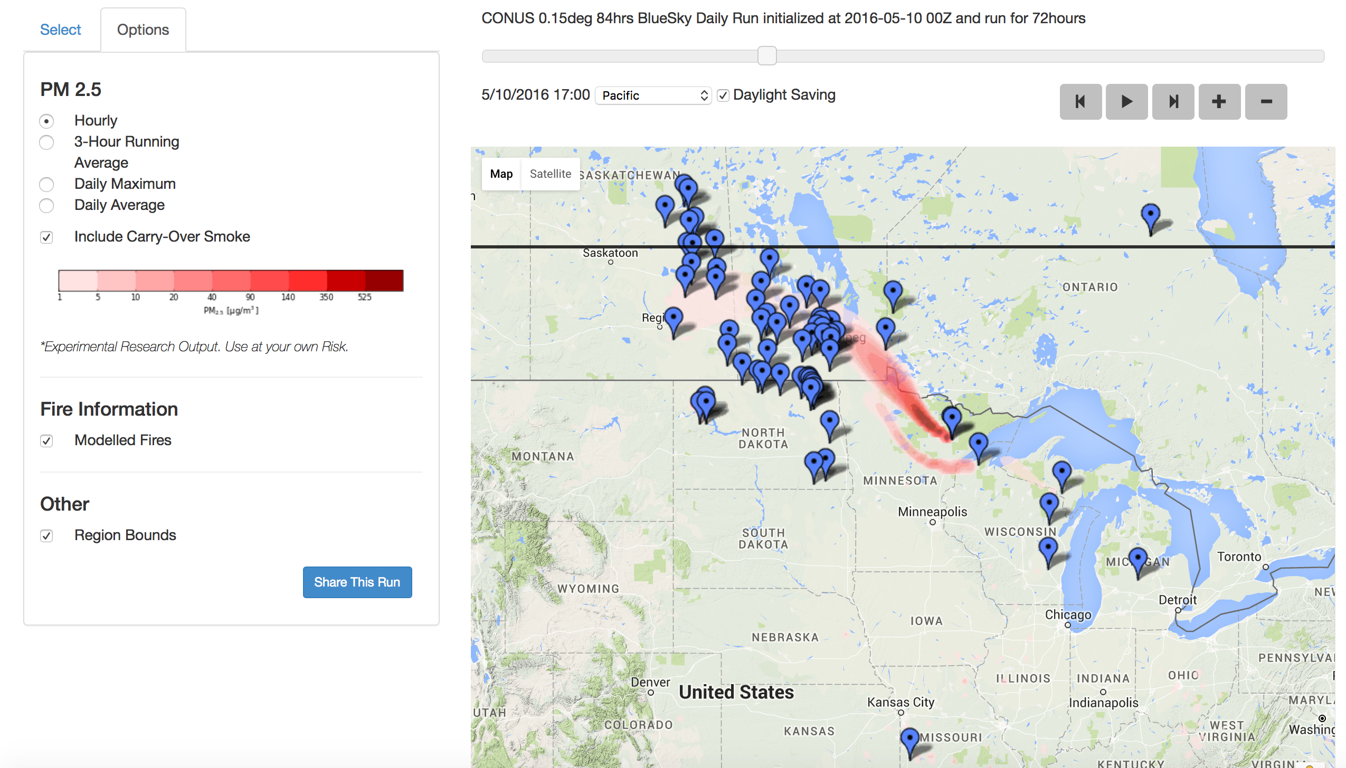
Carryover smoke – Forecast hour 24 from yesterday’s 00Z run…

Slide 33
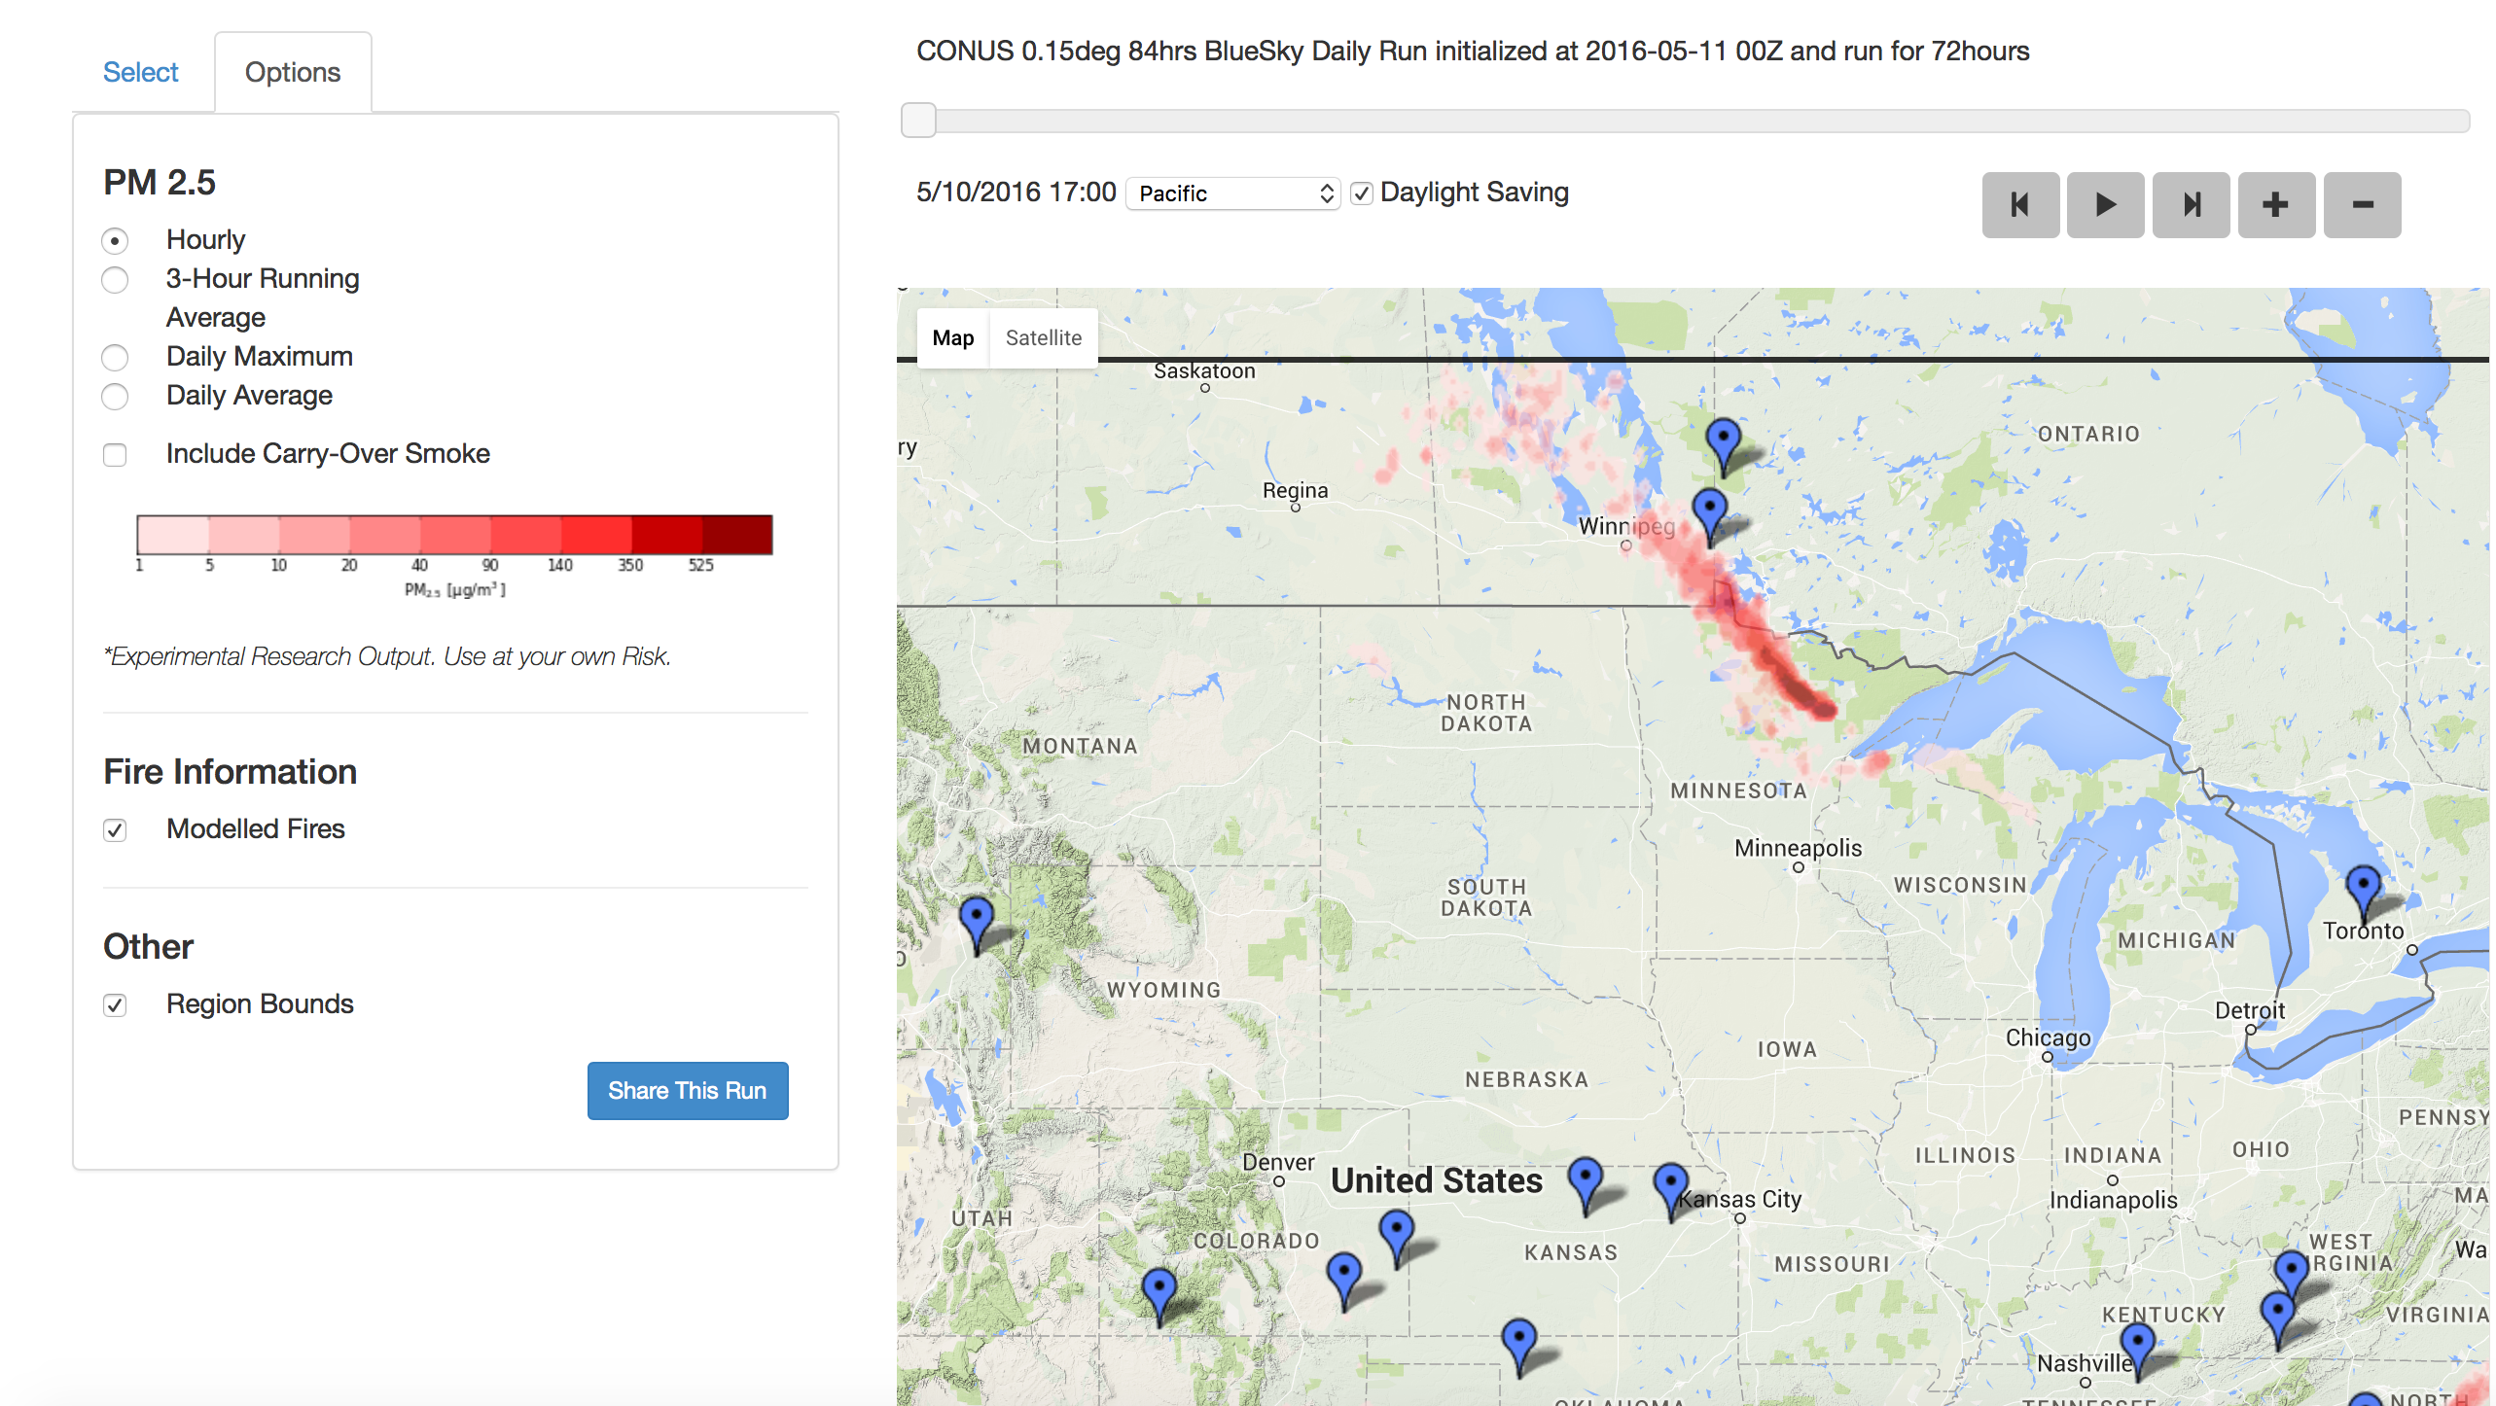
Carryover smoke
…is used to “initial” today’s 00Z run.

Slide 34
State Smoke Blogs
http://wasmoke.blogspot.com
http://www.oregonsmoke.blogspot.com
http://californiasmokeinfo.blogspot.com
http://idsmoke.blogspot.com
Probably others coming online in the future

Slide 35
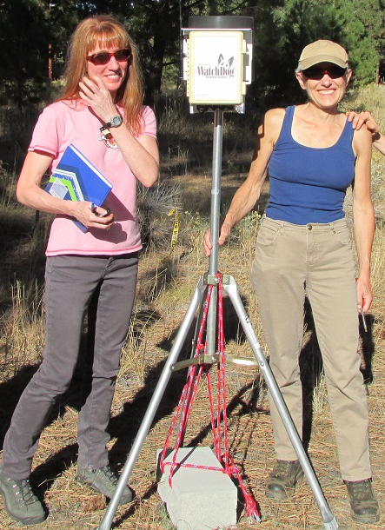









Many thanks to a cast of thousands (OK, maybe 10’s). Here’s an incomplete list (in no particular order):
Sue Ferguson Janice Peterson
Sim Larkin Miriam Rorig
Susan O’Neill Robert Solomon
Candace Krull Joel Dubowy
Ramesh Narasimhan Pete Lahm
Roger Ottmar Susan Prichard
Sonoma Tech, Inc.
Thank you!
Miriam Rorig
mrorig@fs.fed.us
mrorig@gmail.com
206-732-7843
Susan O’Neill
smoneill@fs.fed.us
susan.m.oneill@gmail.com
206-732-7851

